Slide 1




Igizo la Jitihada
Kuhimili na Kukabili
Mabadiliko ya Tabianchi
Notes:
Dear Facilitator, these slides can support your facilitation of the Climate Action Simulation roleplaying game, which complements the En-Roads simulation model. You may pick and choose from these slides and adjust them to suit your audience and setting.
Script: Welcome everyone! I am [introduce yourself] and I’ll be facilitating the Climate Action Simulation today.
These slides were last updated in November 2020.

Slide 2



Imeandaliwa na:
Notes:
Script: We’ll be using an interactive tool called En-ROADS which is developed by Climate Interactive, a leading nonprofit climate & energy think tank, in partnership with the MIT Sloan Sustainability Initiative and UMass Lowell’s Climate Change Initiative.

Slide 3
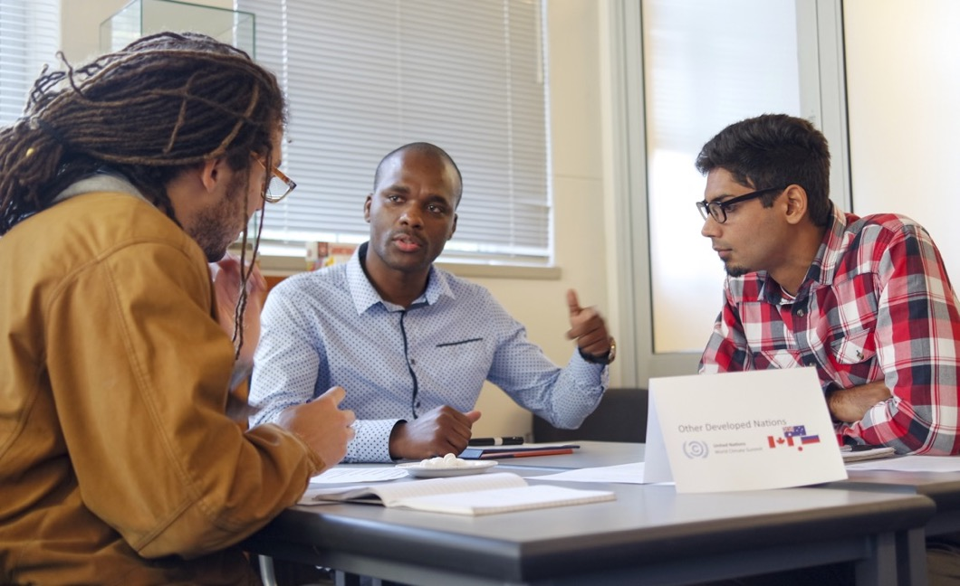

Agenda:
Utangulizi
Ukaribisho wa Mkutano
Mzunguko wa Majumuisho
Mjadala wa ufafanuzi

Slide 4
Utangulizi

Slide 5



Igizo la Jitihada Kuhimili na Kukabili Mabadiliko ya Tabianchi ni mchezo wa kundi la kuigiza wenye dhana ya kutoa suluhu ya kukabiliana na mabadiliko ya tabianchi.
Data halisi
Mfumo wa Igizo kwa Komputa
Muonekano wa Mkutano wa Umoja wa Mataifa
Notes:
Script: Today you will experience the Climate Action Simulation, which is an interactive group roleplaying game that helps you learn about the solutions for mitigating climate change. You will engage with:
the latest research on climate science and solutions
brought together into one powerful and dynamic computer simulator model called En-ROADS abbreviated for “Energy Rapid Overview and Decision Support”
and you will be roleplaying a mock United Nations climate summit

Slide 6
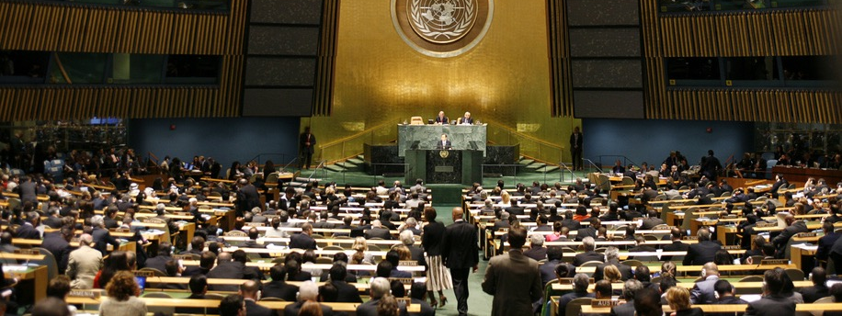
Namna Igizo la Jitihada Kuhimili na Kukabili Mabadiliko ya Tabianchi linavyo fanya kazi… “Viongozi wa dunia” kutoka sekta mbali mbali za kibiashara, kiserikali, na za kijamii hukutana kupata muafaka kuhusu mpango wa suluhu ya mabadiliko ya tabianchi wa kuzuia ongezeko la joto duniani kufikia joto la wastani wa chini ya sentigredi mbili (2ºC) na kufikirika kuwa ni joto la wastani wa juu ya sentigredi moja na nusu (1.5ºC) kabla ya ukuaji wa Viwanda.
Notes:
Script: You will all act as global leaders from different sectors across business, government, and civil society. Our goal will be to negotiate a climate solutions plan to limit global warming to less than 2ºC (3.6ºF) and ideally 1.5ºC (2.7ºF) above pre-industrial levels.

Slide 7
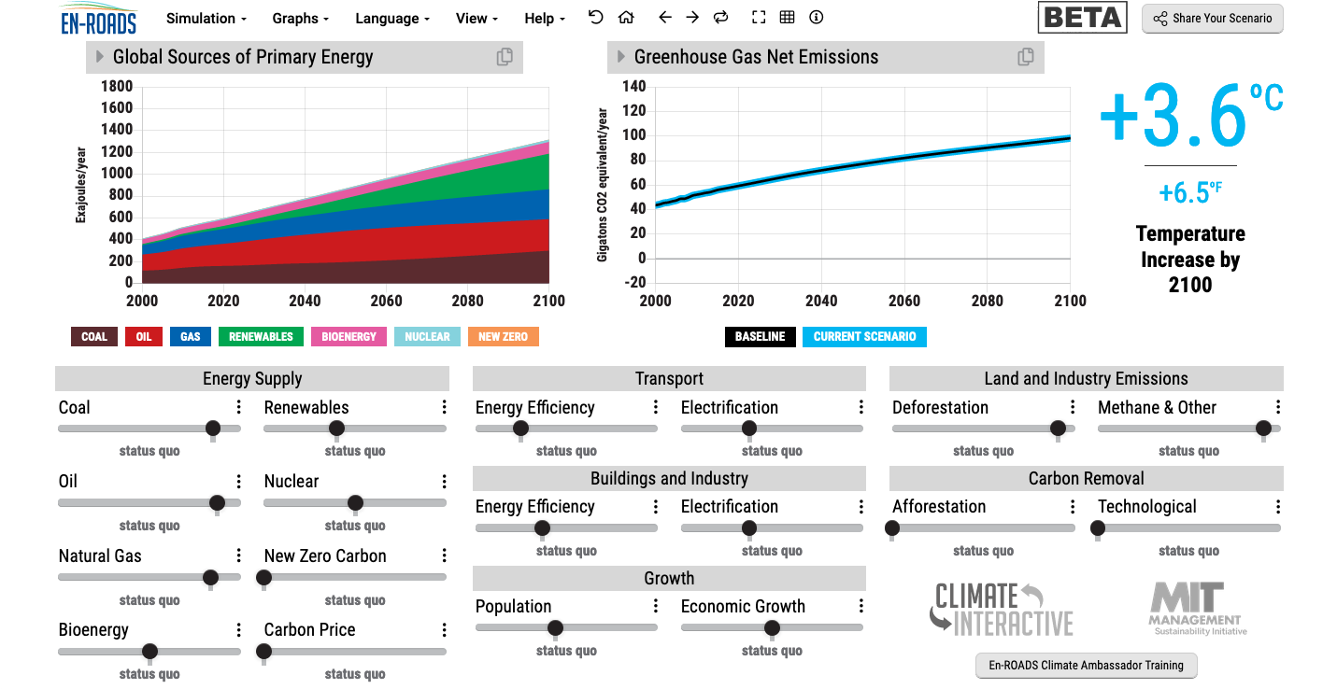
Imewezeshwa na data…
Tutatumia En-ROADS, aina ya mfumo wa igizo la kufanya majaribio ya suluhu ya mabadiliko ya tabianchi na kutengeneza matukio ya tabianchi kwa baadae.
Notes:
Updated: October 2020

Slide 8
Tutafakari kwa ufupi kuhusu sayansi na janga tulilonalo….

Slide 9
Kiwango cha hewa ukaa (CO₂) katika anga ni kikubwa kuliko kipindi chochote kile kwa miaka 800,000 iliyopita, na ukuaji wake huongezeka kwa kasi zaidi ya kipindi chochote kwa miaka milioni.
Source: NASA
Notes:
Script: Atmospheric CO2 is higher than at any time in the last 800,000 years, and levels are increasing faster than at any time in millions of years.
Sources: NASA Jet Propulsion Laboratory https://climate.nasa.gov/
Updated: October 2020

Slide 10
Mabadiliko ya Joto duniani toka kabla ya viwanda (°C)
Mpangilio wa Data Kihistoria:
Chanzo: C-ROADS
Notes:
Script: This graph shows a closer look at the last 170 years. Measuring from 1850, which is often used to approximate temperature in pre-industrial times, surface temperature has increased approximately 1 degree C, or 1.8 degrees F.
Sources: C-ROADS, using data from NASA GISS Surface Temperature Analysis (GISTEMP) and Met Office Hadley Centre HadCRUT4
Updated: October 2020

Slide 11
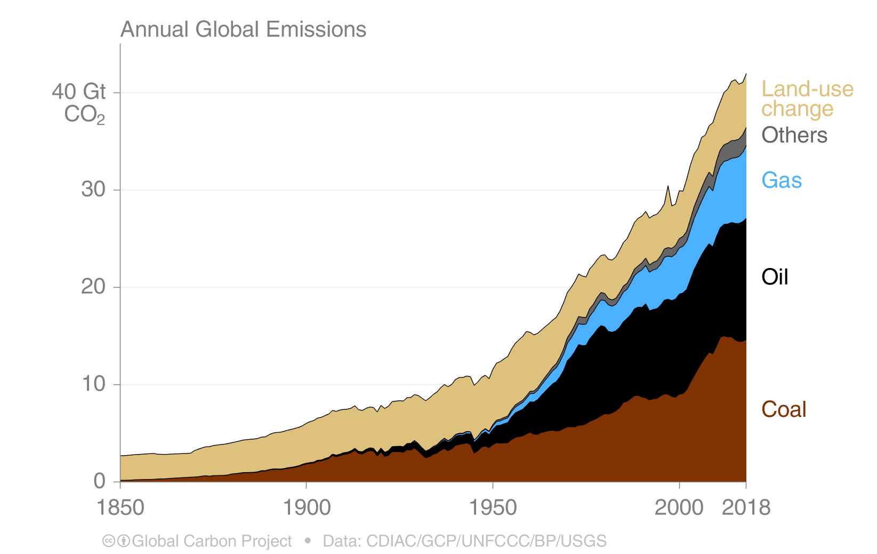
Uzalishaji wa hewa ukaa kwa chanzo husika
Uzalishaji wa hewa ukaa (Gtons CO₂/year)
Source: Carbon Dioxide
Information Analysis Center (CDIAC)
Other: Emissions from cement production and gas flaring
Notes:
Script: But where does all the CO2 come from? Any ideas? This graph shows the sources of CO2 from the year 1850 to 2018. The primary contributor to CO2 emissions are the fossil fuels: coal (which you see in brown), oil (in black), and gas (in blue). You can see that there has been lots of growth in coal, oil and gas over the last 100 years. Comparatively, land-use change emissions, which are primarily from deforestation, have not grown as substantially and may even be declining. Others emissions primarily consist of lime calcination for concrete production.
Sources: CDIAC (https://www.globalcarbonproject.org/carbonbudget/19/presentation.htm), drawing from Houghton and Nassikas 2017; Hansis et al. 2015; Friedlingstein et al. 2019; Global Carbon Budget 2019
Updated: October 2020

Slide 12

Total Annual Global Greenhouse Gas Emissions by Gas
Jumla ya kiwango cha uzalishaji Gesi joto duniani kwa kila Gesi kwa mwaka
Source: C-ROADS
Notes:
Script: Carbon dioxide is not the only thing that is contributing to climate change. There are also several other greenhouse gases. Here you see the relative contribution from different gases. In black and green you can see the contribution that CO2 makes from fossil fuels and land use, then in light blue is methane (CH4), then nitrous oxide (N2O), and the F-gases (fluorinated gases). Agriculture contributes 50% of global methane (CH4) emissions and 60% of global nitrous oxide (N2O) emissions. Heavy industry and manufacturing, as well as consumer goods, are sources of N2O and F-gases.
Sources: C-ROADS (Climate Interactive)
Updated: September 2020

Slide 13
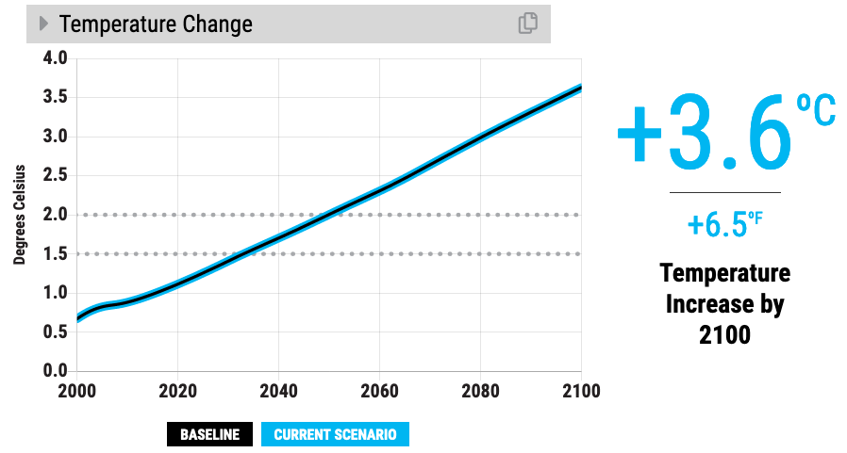

Taswira ya awali
Lengo la tabia nchi (1.5ºC to 2ºC)
Notes:
Script: If we continue business as usual, we estimate that temperature change will reach 3.6 degrees Celsius by 2100. That’s 6.5 degrees Fahrenheit. Compare the bold line to the dotted lines where our climate goals (2 degrees C and 1.5 degrees C) are on the graph.
Updated: November 2020

Slide 14
Je, ongezeko la joto 3+ °C (or 5.4+ °F) huashiria nini?
Barafu ya bahari ya aktiki imepotea katika mbili ya tatu kwa kila mara tatu ya kipindi cha joto¹
Asilimia hamsini ya aina za wadudu hupotea kwa zaidi ya asilimia hamsini ya kiwango cha makazi yao²
Ukame: Vipindi virefu kwa Miezi kumi na moja
Huongeza wastani wa urefu wa ukame³
Eneo lilichomwa moto unaosababishwa na kipindi cha joto kuongezeka mara mbili katika eneo la Mediterania ⁴
^{Ikilinganishwa na sasa}
Notes:
Script: However, I want to be clear. A 3-4 degree future is still very bleak – especially for the world’s most vulnerable nations and communities who experience the impacts of climate change disproportionately. We need to do better. Far better. Here’s what a 3 degree future means for our world: [Read bullets from the slide].
Notes:
Arctic sea ice: Melting of Arctic sea ice has a positive feedback effect on global warming, as ice and snow reflect energy from the sun back into space. Without sea ice, more of the energy is absorbed, contributing to further warming. A warming Arctic and lessening sea ice are linked to extreme weather effects in other parts of world, as a result of the global atmospheric circulation. For more on this topic, see https://www.carbonbrief.org/qa-how-is-arctic-warming-linked-to-polar-vortext-other-extreme-weather
Insects: Insects are important as pollinators, for nutrient cycling, and for breaking down waste, among other services. They are the major or sole food source for many amphibian, reptile, bird, and mammal species.⁵
Updated: September 2020
Sourcess:
1. Sigmond, M., Fyfe, J.C. & Swart, N.C. Ice-free Arctic projections under the Paris Agreement. Nature Clim Change 8, 404–408 (2018). https://doi.org/10.1038/s41558-018-0124-y
2. Warren, R., et al. "The projected effect on insects, vertebrates, and plants of limiting global warming to 1.5 C rather than 2 C." Science 360.6390 (2018): 791-79
3. Naumann, G. et al. (2018) Global Changes in Drought Conditions Under Different Levels of Warming, Geophysical Research Letters
4. Turco, M. et al. (2018) Exacerbated fires in Mediterranean Europe due to anthropogenic warming projected with nonstationary climate-fire models, Nature Communications. https://www.nature.com/articles/s41467-018-06358-z
5. https://www.si.edu/spotlight/buginfo/benefits
Photos:
Arctic: https://pixabay.com/images/id-1913559/
Trees: https://pixabay.com/images/id-947331/
Bee: https://pixabay.com/images/id-4243850/
Wildfire: https://www.flickr.com/photos/slworking/29034137667

Slide 15
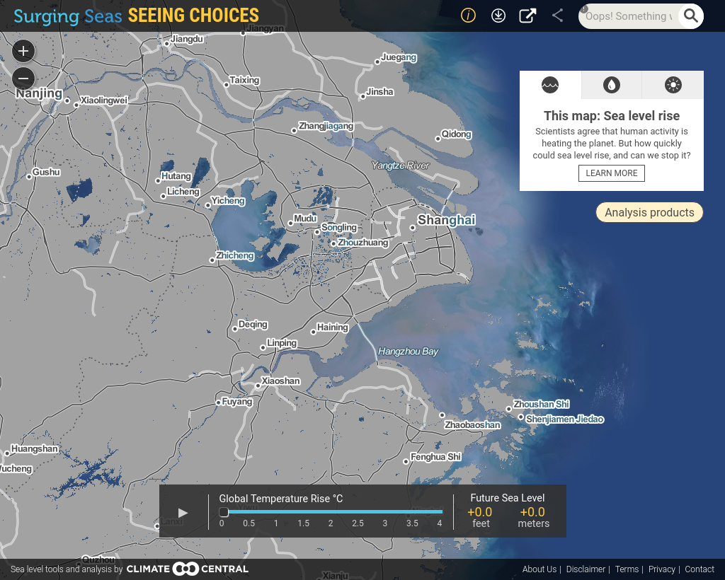
Shanghai: Kwa sasa
Chanzo: Climate Central
Notes:
Note: The sea level rise shown here is a projection of long-term (over centuries) sea level rise due to sea levels locked in by different amounts of carbon pollution. This is “committed” sea level rise – it will continue even if carbon emissions are cut. The sooner we cut carbon emissions, the lower the eventual sea level rise.
Use Climate Central’s Surging Seas Seeing Choices tool to search for a coastal city near you, and modify this presentation to fit your audience: https://seeing.climatecentral.org/
Sources: Climate Central https://seeing.climatecentral.org/
Updated: November 2020

Slide 16
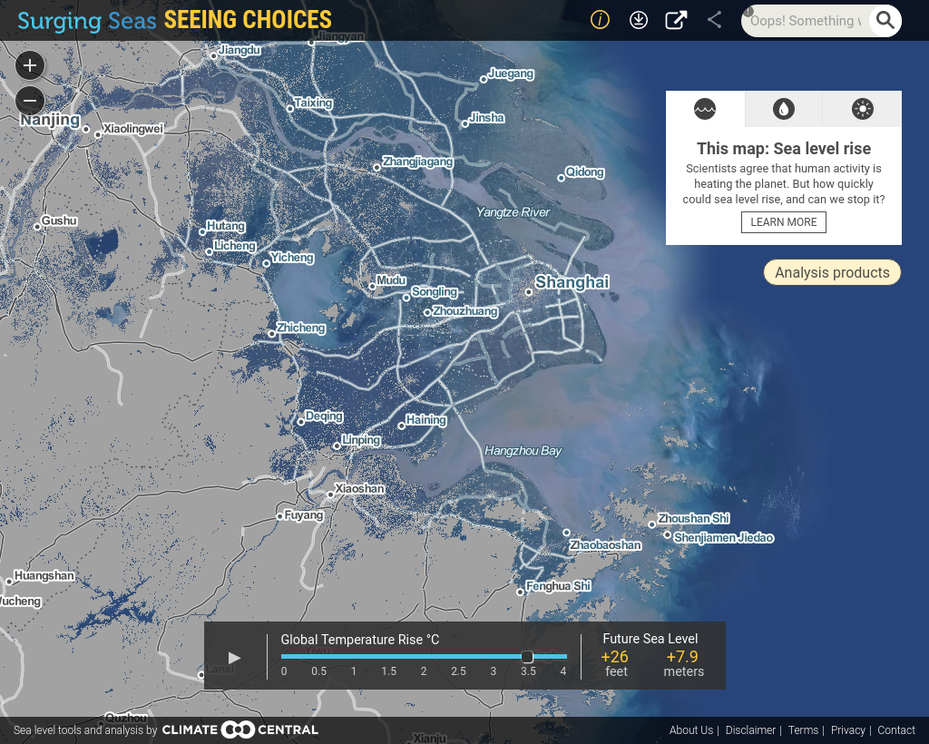
Shanghai: Nyuzi joto 3.5 Centigredi (3.5°C)
Chanzo: Climate Central
Notes:
Note: The sea level rise shown here is a projection of long-term (over centuries) sea level rise due to sea levels locked in by different amounts of carbon pollution. This is “committed” sea level rise – it will continue even if carbon emissions are cut. The sooner we cut carbon emissions, the lower the eventual sea level rise. The map shown here shows a future sea level of 7.9 meters (26 feet) 26 feet higher than today. A global temperature rise of 2 degrees C, instead, would lock in 4.7 meters (15 feet).
Use Climate Central’s Surging Seas Seeing Choices tool to search for a coastal city near you, and modify this presentation to fit your audience: https://seeing.climatecentral.org/
Sources: Climate Central https://seeing.climatecentral.org/
Updated: November 2020

Slide 17
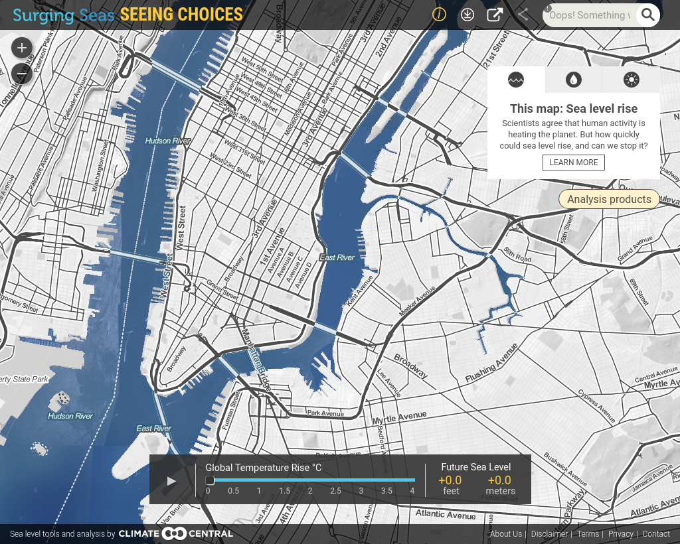
Jiji la New York : Kwa sasa
Chanzo: Climate Central
Notes:
Note: The sea level rise shown here is a projection of long-term (over centuries) sea level rise due to sea levels locked in by different amounts of carbon pollution. This is “committed” sea level rise – it will continue even if carbon emissions are cut. The sooner we cut carbon emissions, the lower the eventual sea level rise.
Use Climate Central’s Surging Seas Seeing Choices tool to search for a coastal city near you, and modify this presentation to fit your audience: https://seeing.climatecentral.org/
Sources: Climate Central https://seeing.climatecentral.org/
Updated: November 2020

Slide 18
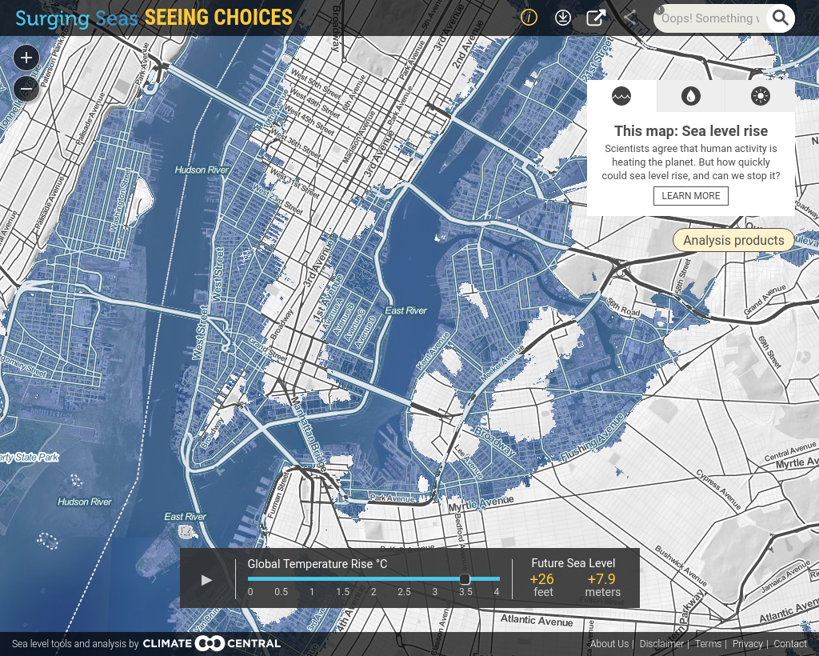
Jiji la New York: Nyuzi joto 3.5 Centigredi (3.5°C)
Chanzo: Climate Central
Notes:
Note: The sea level rise shown here is a projection of long-term (over centuries) sea level rise due to sea levels locked in by different amounts of carbon pollution. This is “committed” sea level rise – it will continue even if carbon emissions are cut. The sooner we cut carbon emissions, the lower the eventual sea level rise. The map shown here shows a future sea level of 7.9 meters (26 feet) 26 feet higher than today. A global temperature rise of 2 degrees C, instead, would lock in 4.7 meters (15 feet).
Use Climate Central’s Surging Seas Seeing Choices tool to search for a coastal city near you, and modify this presentation to fit your audience: https://seeing.climatecentral.org/
Sources: Climate Central https://seeing.climatecentral.org/
Updated: November 2020

Slide 19
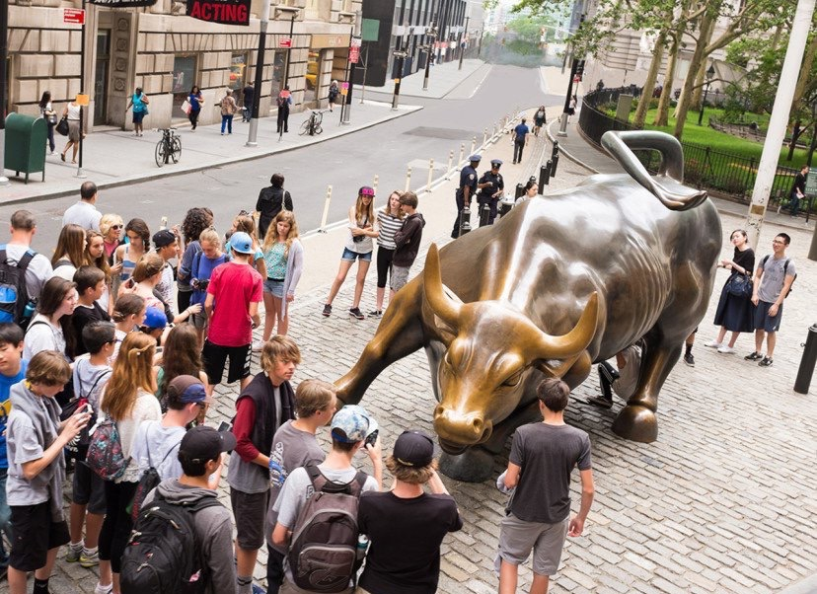
Wall Street
kwa sasa
Chanzo: Climate Central
Notes:
Script: Here is what Wall Street in New York City looks like today…
Sources:
Climate Central. (2015). https://www.climatecentral.org/news/global-icons-at-risk-from-sea-level-rise-pictures-19633
Image based on research from:
Strauss, B., Kulp, S., Levermann, A. “US cities committed below future sea levels.” Proceedings of the National Academy of Sciences. Nov 2015, 112 (44) 13508-13513. https://www.pnas.org/content/112/44/13508

Slide 20
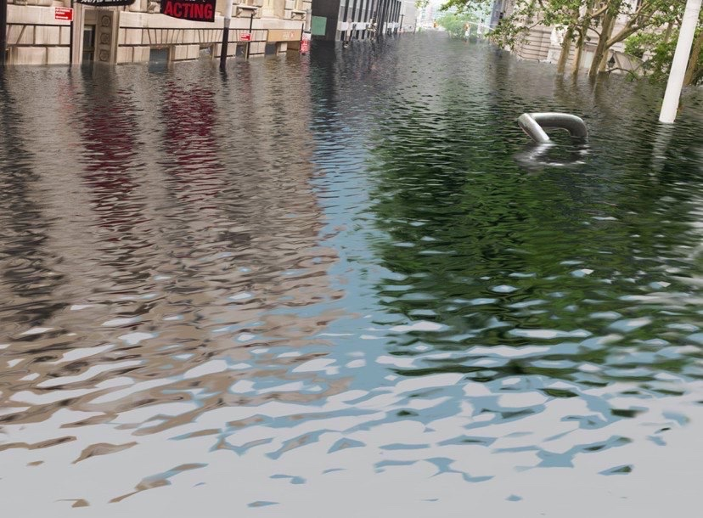
… na ongezeko la joto la nyuzi joto 4 sentigredi (4ºC)
Chanzo: Climate Central
Notes:
Script: and with 4 degrees Celsius of warming.
Sources:
Climate Central. (2015). https://www.climatecentral.org/news/global-icons-at-risk-from-sea-level-rise-pictures-19633
Image based on research from:
Strauss, B., Kulp, S., Levermann, A. “US cities committed below future sea levels.” Proceedings of the National Academy of Sciences. Nov 2015, 112 (44) 13508-13513. https://www.pnas.org/content/112/44/13508

Slide 21
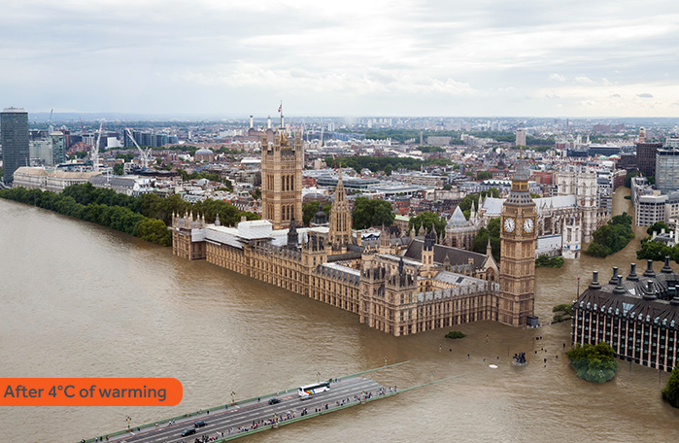
Ongezeko la joto jijini London kwa nyuzi joto 4 sentigredi (4ºC)
Chanzo: Climate Central
Notes:
Script: Here is what the UK’s parliament building with Big Ben would look like with 4 degrees Celsius of warming.
Sources:
Climate Central. (2015). https://www.climatecentral.org/news/global-icons-at-risk-from-sea-level-rise-pictures-19633
Image based on research from:
Strauss, B., Kulp, S., Levermann, A. “US cities committed below future sea levels.” Proceedings of the National Academy of Sciences. Nov 2015, 112 (44) 13508-13513. https://www.pnas.org/content/112/44/13508

Slide 22
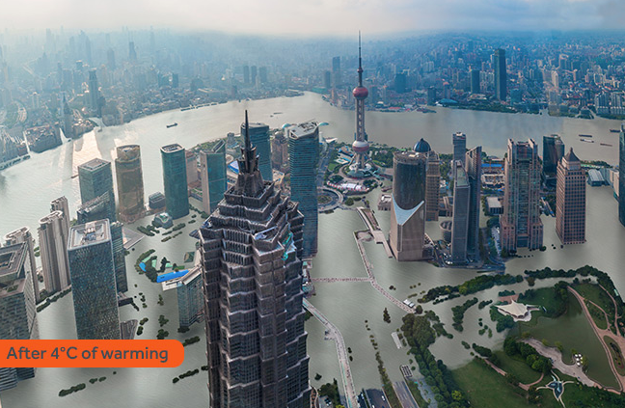
Shanghai baada ya ongezeko la joto sentigredi nne (4ºC)
Chanzo: Climate Central
Notes:
Script: And here is Shanghai, China with 4 degrees Celsius of warming.
Sources:
Climate Central. (2015). https://www.climatecentral.org/news/global-icons-at-risk-from-sea-level-rise-pictures-19633
Image based on research from:
Strauss, B., Kulp, S., Levermann, A. “US cities committed below future sea levels.” Proceedings of the National Academy of Sciences. Nov 2015, 112 (44) 13508-13513. https://www.pnas.org/content/112/44/13508

Slide 23
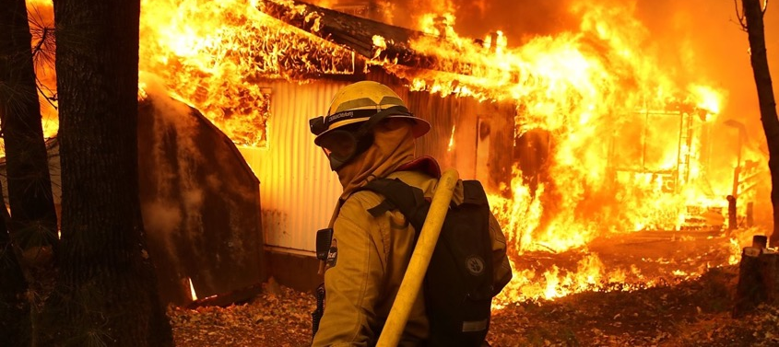
Gharama ya majanga yanayotokana na mabadiliko ya tabianchi ni dola za kimarekani bilioni 650 kati ya mwaka 2016 na 2018. Madhara yatokanayo na ongezeko la joto duniani yanaweza kufikia jumla ya zaidi ya dola za kimarekani bilioni 54 pale joto likifikia nyuzi joto 1.5 sentigredi (1.5°C).
Chanzo: Morgan Stanley, IPCC, CNBC
Notes:
Sources:
Morgan Stanley. “Five Sectors that Cannot Escape Climate Change.” March 23, 2020. https://www.morganstanley.com/im/en-us/individual-investor/insights/articles/five-sectors-that-cannot-escape-climate-change.html
IPCC, 2018: Global warming of 1.5°C. An IPCC Special Report on the impacts of global warming of 1.5°C above pre-industrial levels and related global greenhouse gas emission pathways, in the context of strengthening the global response to the threat of climate change, sustainable development, and efforts to eradicate poverty [V. Masson-Delmotte, P. Zhai, H. O. Pörtner, D. Roberts, J. Skea, P.R.Shukla,A. Pirani, W. Moufouma-Okia, C.Péan, R. Pidcock, S. Connors, J. B. R. Matthews, Y. Chen, X. Zhou, M. I. Gomis, E. Lonnoy, T. Maycock, M. Tignor, T. Waterfield(eds.)]. https://www.ipcc.ch/site/assets/uploads/sites/2/2019/06/SR15_Full_Report_Low_Res.pdf
Photo: https://www.cnbc.com/2019/02/14/climate-disasters-cost-650-billion-over-3-years-morgan-stanley.html

Slide 24
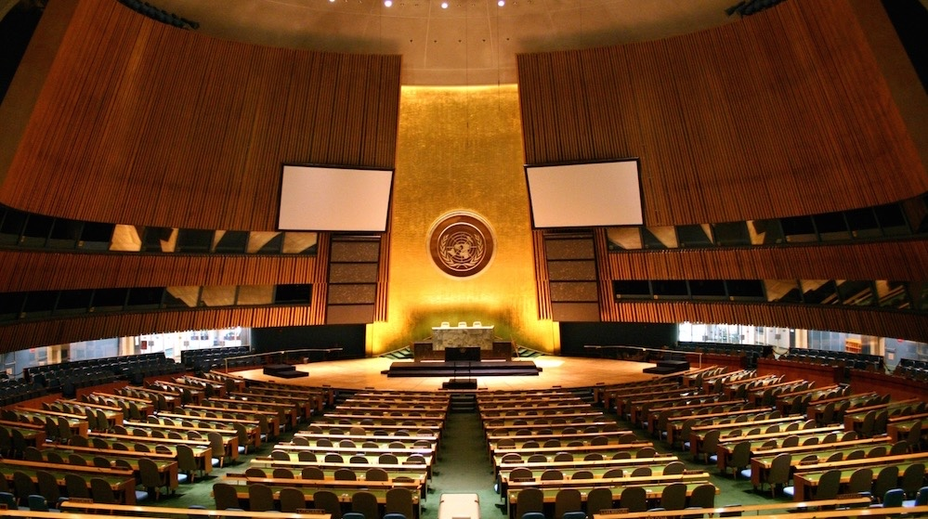
Karibu kwenye mkutano wa Umoja wa Mataifa (UN) kuhusu kuhimili na kukabili Mabadiliko ya tabiachi
Notes:
Note - Open the roleplaying period. Enter the room as the UN Secretary General, and deliver your opening speech! (example speech from UN Secretary General Antonio Guterres: https://youtu.be/P8M-2gSm3bs)

Slide 25
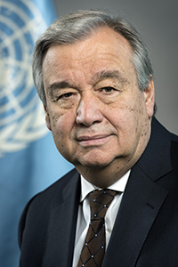
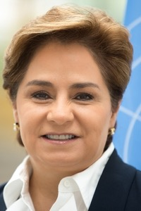

Neno la Ufunguzi kutoka kwa
Katibu Mkuu Umoja wa Mataifa
Katibu Mkuu, Umoja wa Mataifa
António Guterres
Katibu Mtendaji, UNFCCC
Patricia Espinosa
Notes:
Note – Insert your own professional headshots above. Depending on your co-facilitator’s skillset and role, you may choose to replace the second role e.g., IPCC Science Specialist, UN Policy Specialist, etc.
Sources:
https://www.un.org/sg/en/content/sg/biography
https://unfccc.int/about-us/the-executive-secretary
Updated: October 2020

Slide 26
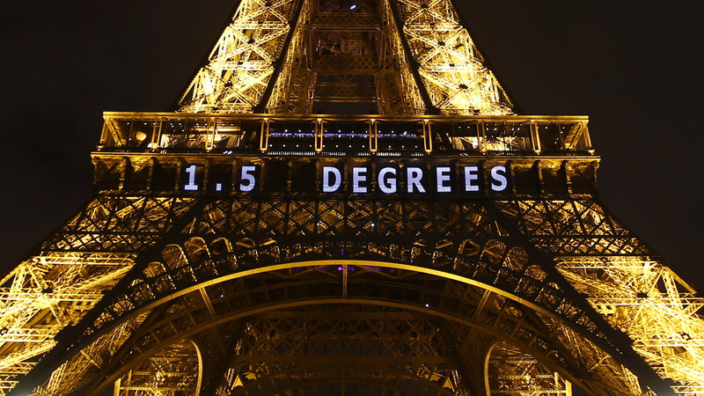
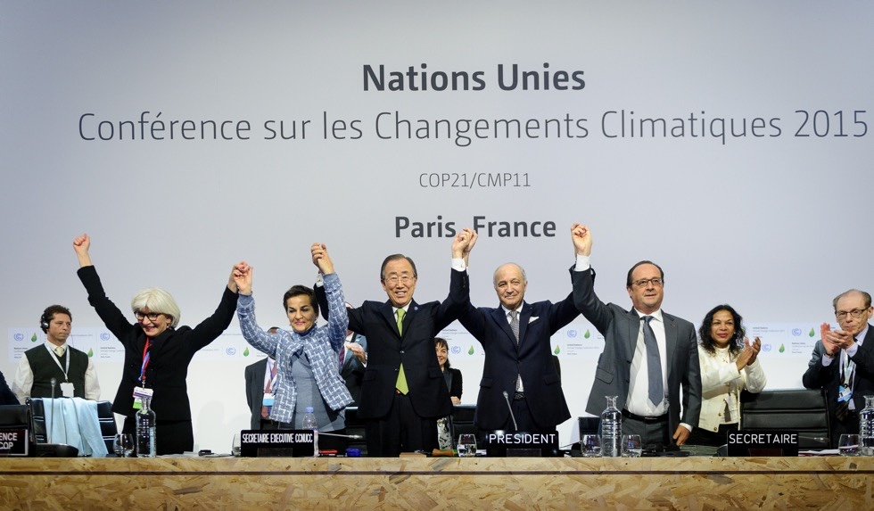
Lengo Letu Kwa sasa
Kuzuia ongezeko la joto duniani liwe chini ya nyuzi joto 2 sentigredi na kukaribia nyuzi joto 1.5 sentigredi kwa kadri iwezekanavyo, kabla ya viwango cha viwanda.
Notes:
Sources:
https://www.npr.org/sections/thetwo-way/2015/12/12/459502597/2-degrees-100-billion-the-world-climate-agreement-by-the-numbers
https://www.nature.com/articles/d41586-020-00834-7

Slide 27
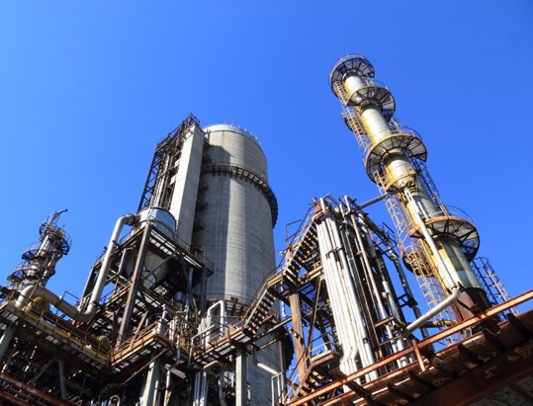
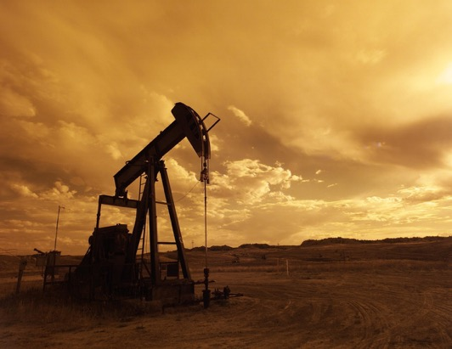



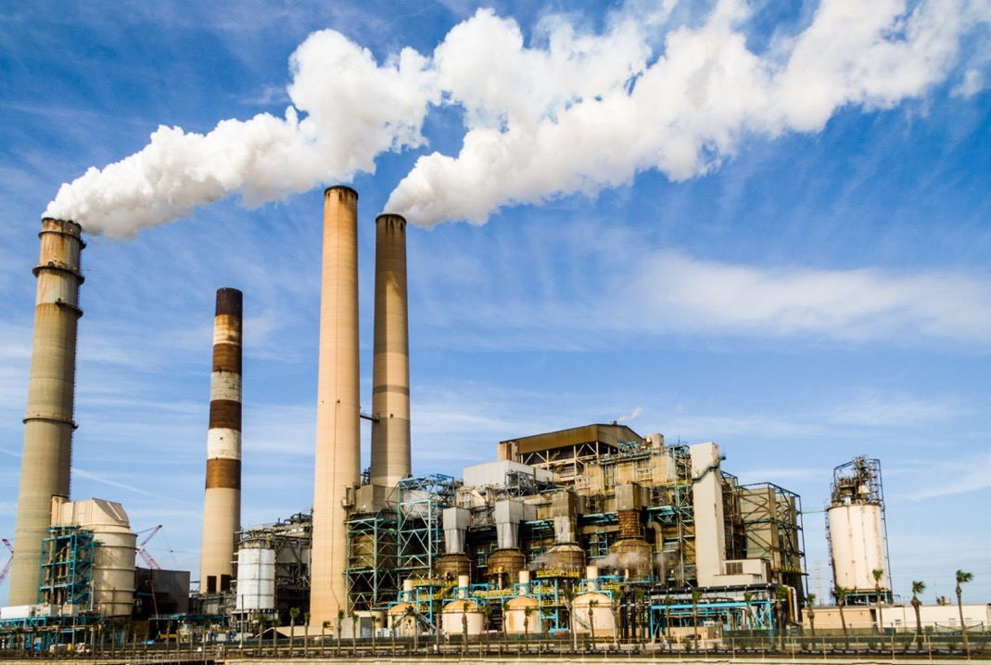
Nishati ya kawaida
Wasambazaji wa Nishati wakubwa duniani:
Makaa ya Mawe
Mafuta
Gesi
Nyukilia
Huduma za Umeme
Notes:
Note - Introduce the groups in the room.

Slide 28
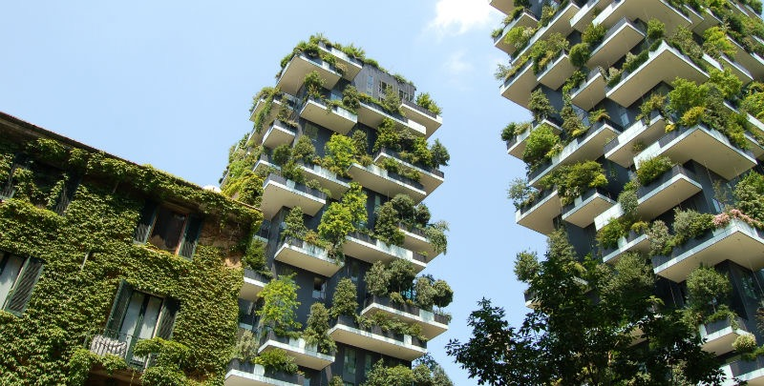



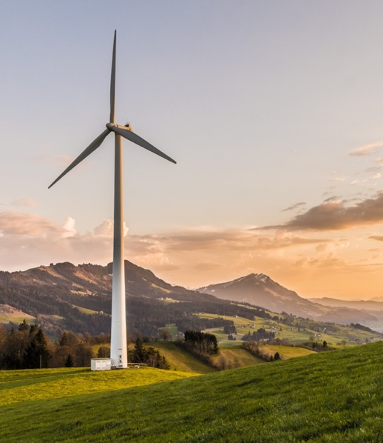
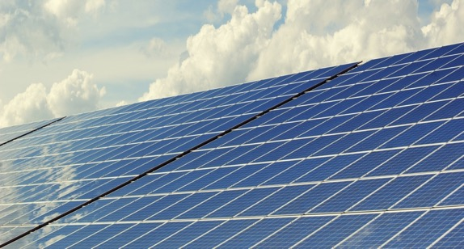
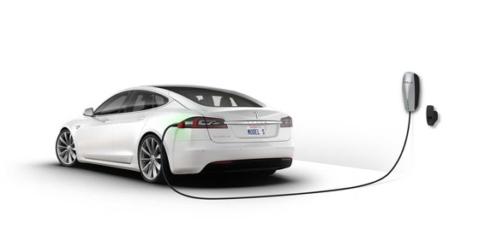
Teknolojia Safi
Viongozi wa dunia katika teknolojia safi:
Upepo, Jua, na vyanzo vinginevyo vya nishati jadidifu.
Umeme wa magari, nishati iliyohifadhiwa.
Ufanisi wa Nishati, Majengo ambayo ni rafiki wa Mazingira.
Uondoaji wa hewa ukaa kupitia teknolojia
Nishati mpya kwa baadae

Slide 29

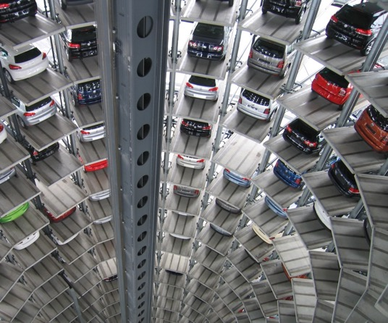
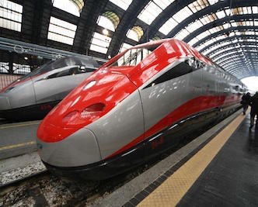

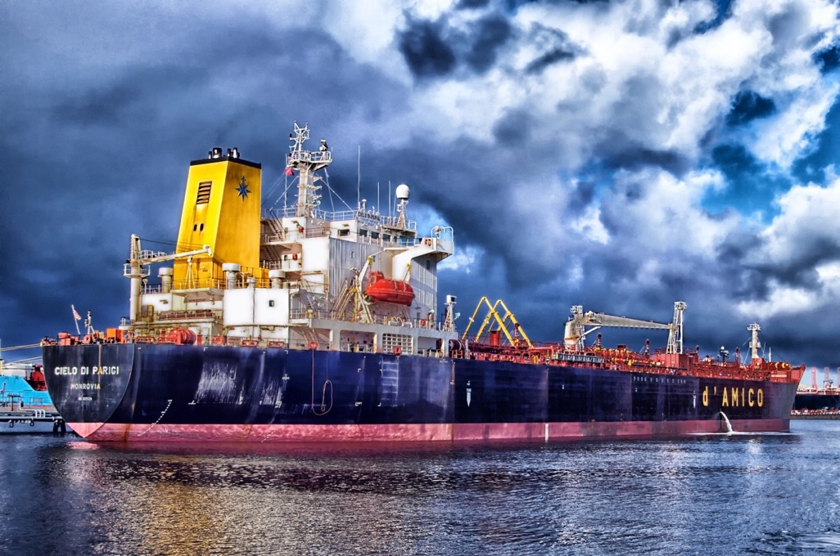
Viwanda & Biashara
Mashirika makubwa yanayotumia Nishati kwa wingi:
Watengenezaji Magari, Ndege, Wasafirishaji wa Mizigo kwa kutumia meli &Nchi Kavu, aina nyingine ya Usafirishaji.
Wajenzi
Watengenezaji Mashine za Viwandani
Wazalishaji
Bidhaa za zinazotumika
Teknolojia ya juu

Slide 30
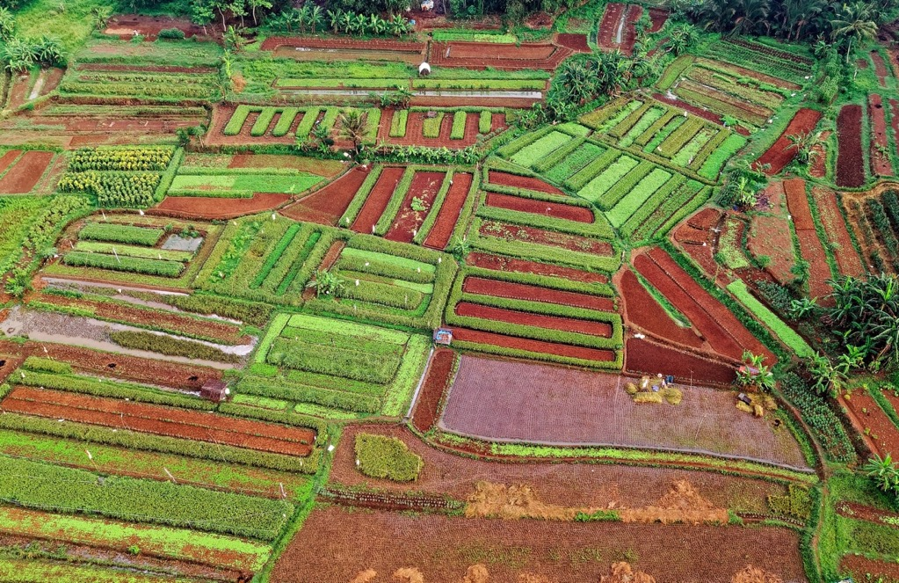



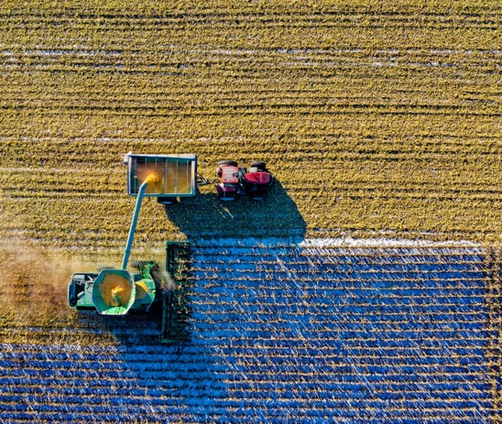
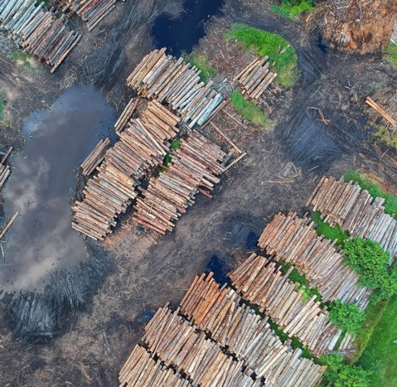
Ardhi, Kilimo, na Usimamizi Misitu
Muunganiko Duniani wa:
Makampuni ya Chakula & Kilimo.
Makundi ya wamiriki wa maeneo makubwa na Watetezi wa wakulima
Makampuni yanayo husika na ukataji miti kwa ajili ya mbao.
Makundi ya kuhifadhi ardhi

Slide 31




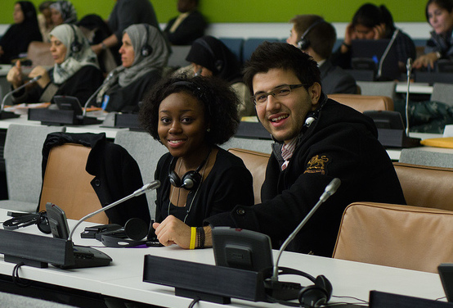
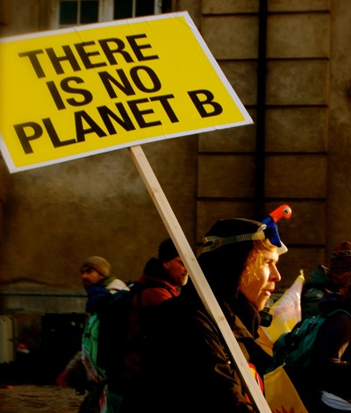
Watetezi wa Hali ya tabianchi
Mashirika yanaongoza harakati za mazingira.
Mashirika yanayo kabiliana na mabadiliko ya hali ya hewa.
Harakati za vijana & wahusika wakuu.
Raia duniani kutoka katika jamii zilizo athiriwa na mabadiliko ya tabia Nchi.

Slide 32




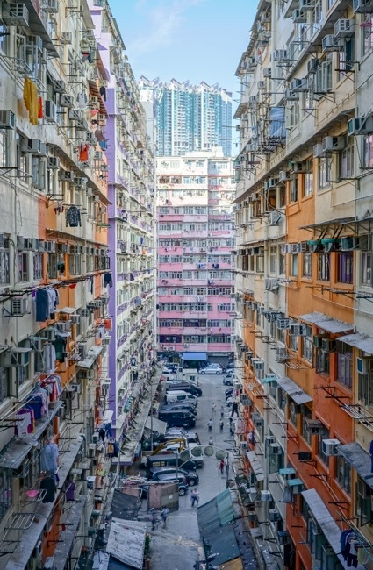
Serikali za dunia
Viongozi wa kiserikali kutoka katika sehemu mbali mbali za dunia wanao wakilisha:
Nchi zilizo endeleo – Umoja wa Ulaya, Marekani, Canada, na nyinginezo.
Nchi zinazokua kwa kasi – China, India, na nyinginezo.
Nchi kutoka kwenye visiwa vidogo vidogo.

Slide 33
Mzunguko wa Majumuisho ya Mjadala
Notes:
Note – The following slides will help guide the group through the stages of the game. They may be projected as a helpful reminder in the background, although the focus of the room should be on the interactive roleplaying, with each other and the model. You may alternate between the Slides and the En-ROADS model on the projected screen.

Slide 34
Hatua za kufuata
Kila timu inaweza kupendekeza aina moja ya utendaji kwa kila hatua. Mnaweza kupendekeza:
Kuongeza suluhisho jipya kwenye mpango kwa kuchagua kubadilisha moja kati ya hatua kumi na nane kwenye En-ROADS
Au Kurejea utendaji wa awali ambao kundi jingine lilipendekeza.
Tutapitia matokeo ya vitendo vilivyopendekezwa kwenye En-ROADS.

Slide 35
Mtazamo wa Utatuzi shirikishi
Fikiria:
Kipindi kinachokaribiana chenye faida jumuishi kutoka kwenye mapendekezo yenu. Namna gani unaweza elezea zaidi ya tatizo moja kwa kutumia aina moja ya utendaji?
Ni kwa namna gani unaweza hakikisha kuwa jamii zilizokwisha athiriwa haziwezi kukandamimizwa bila kutolinganisha na/au kuachwa nje ya fursa kuelezea na kukabiliana na mabadiliko ya hali ya Tabianchi ?

Slide 36
Notes:
Note – Use the En-ROADS control panel guide to help orient participants to their decision variables e.g., 18 levers. Use this time to also briefly orient people to the actual En-ROADS simulator, and show how this Guide relates to the En-ROADS simulator.

Slide 37
Hatua zote kwa ujumla
Mapumziko kwenye hatua ya kwanza ya vikao.
Kila timu itatuma mwakilishi kuzungumza kwa dakika mbili ili kupendekeza kitendo kimoja kwa kila hatua. Mnaweza kupendekeza:
Kuongeza suluhisho jipya – AU –
Kurejea kitendo kilicho pita.
Tutajazilizia kila kitendo katika En-ROADS na kutathimini matokeo kwa pamoja. Hatua hii hufunga wakati ambao kila timu imekwisha toa suluhisho moja.
Hatua za mkutano hutamatishwa wakati ambao tunafikia malengo yetu ya mabadiliko ya hali ya hewa au kupitwa na wakati.

Slide 38
Mzunguko wa 1 Mkutano wa timu
(Dakika 10-15)
Anza kwa kutazama dhidi ya En-ROADS paneli dhibiti. Kujaribu kuendesha vitendo viwili hadi vitatu ambavyo unaviunga mkono kwa nguvu zaidi dhidi ya vile unavyo vipinga
“Kitendo” ni badiliko lolote la moja ya wenzo kumi na nane kwenye En-ROADS
2. Zungumza na timu yako ili kuunda mkakati wenu wa pamoja.
3. Jadili na timu yako kuafikiana kukubaliana kwenye Utendaji wenu wa awali ikiwa ni pamoja na taarifa za kina – kama vile., hatua ya mabadiliko, Mwaka wa kuanza
4. Pendekezeni mwakilishi wenu na kuandaa hotuba ya dakika mbili
Notes:
Note - Change the (time) for each of the sections in the following slides per your game timing

Slide 39
Mzunguko wa 1 Mkutano wa timu
(Dakika 10-15)
Kwa kila pendekezo, zingatia maswali haya:
Ni yapi Maslahi yako ya msingi? Nini kinachowezekana kisiasa? Kipi unahitaji kutoka kwenye makundi mengine? Nini unaweza kutoa kwao?
Nini faida ya karibu kutokana na mapendekezo yako?
Unawezaje kutatua matatizo zaidi ya moja kwa suluhisho moja? Una hakikishaje kuwa jamii zilizo katika mazingira magumu haziathiriwi kwa kiasi kikubwa na pendekezo lako?

Slide 40
Mzunguko wa Kwanza Mawasilisho ya mkutano
(Dakika 10-15)

Slide 41

Mkutano wa Pili Kikundi na Maridhiano
(Dakika 15-20)
Jadili marejeo ya shughuli kama timu
Kuridhiana na makundi mengine na kuwachechemua ili kubadili nafasi ikiwa kama itawezekana.

Slide 42
Mzunguko wa Pili Mawasilisho ya mkutano
(Dakika 10-15)

Slide 43
Mawasilisho ya pili ya Mkutano (Dakika 20)
Timu zitaendelea kupendekeza shughuli kama ilikuwa awali ambapo kila timu itapendekeza shughuli moja kwa kila duru
Kikao kitahitimishwa pale ambapo kwa pamoja tumefikia malengo yetu ya mabadiliko ya hali ya hewa au muda utakapo kuwa umekwisha

Slide 44
Majadiliano na Ufafanuzi

Slide 45
Tafakuli
Fikiria kitu ambacho utakipenda kuwa sehemu ya aina hii kwa siku zijazo.
Chukua dakika moja ya ukimya kutafakari uzoefu wako.

Slide 46
Unajisikiaje?

Slide 47
Mjadala wa Ufafanuzi
Kipi kilikushangaza?
Malengo yako muhimu yalikuwa yapi?
Kipi utachukua siku ya leo, na unawezaje kukitumia kile ulichojifunza katika uhalisia wa hii dunia?
Notes:
Note – These are the three basic guiding questions to lead the debriefing discussion. You may choose your own and follow up with more detailed questions. We provide some options for Additional Discussion Questions in the Facilitator’s Guide.

Slide 48
Kutazamia mbele
Tuna zana
Jua na Upepo vinaongezeka na kuwa nafuu zaidi
Mashirika yanawekeza katika teknolojia safi
Nchi na Majimbo zinapiga hatua
Umma kwa ujumla unazidi kuelimika na kushiriki

Slide 49

Makampuni yanaanza kuchukua hatua
Zaidi ya Makampuni 260 makubwa duniani yamejitolea kutumia 100% ya umeme wa nishati jadidifu ifikapo 2050, kwa lengo la wastani wa tarehe za 2028
Kampuni ya ubunifu wa mavazi H&M imetoa ahadi kuongeza ufanisi wa nishati yake
ifikapo 2030
Microsoft imeahidi kupinga kuzalisha hewa ukaa ifikapo 2030, kuondoa gesi ukaa zaidi ya inavyotoa
Notes:
Sources:
https://blogs.microsoft.com/blog/2020/01/16/microsoft-will-be-carbon-negative-by-2030/
https://www.there100.org/technical-guidance
https://hmgroup.com/media/news/general-2017/h-m-joins-international-initiative-to-enhance-energy-productivit.html
Photos:
https://unsplash.com/photos/PQmXUxmfR44
https://unsplash.com/photos/_h0xG4s6NFg
https://pixabay.com/images/id-1712699/
https://unsplash.com/photos/_h0xG4s6NFg
Updated: October 2020

Slide 50
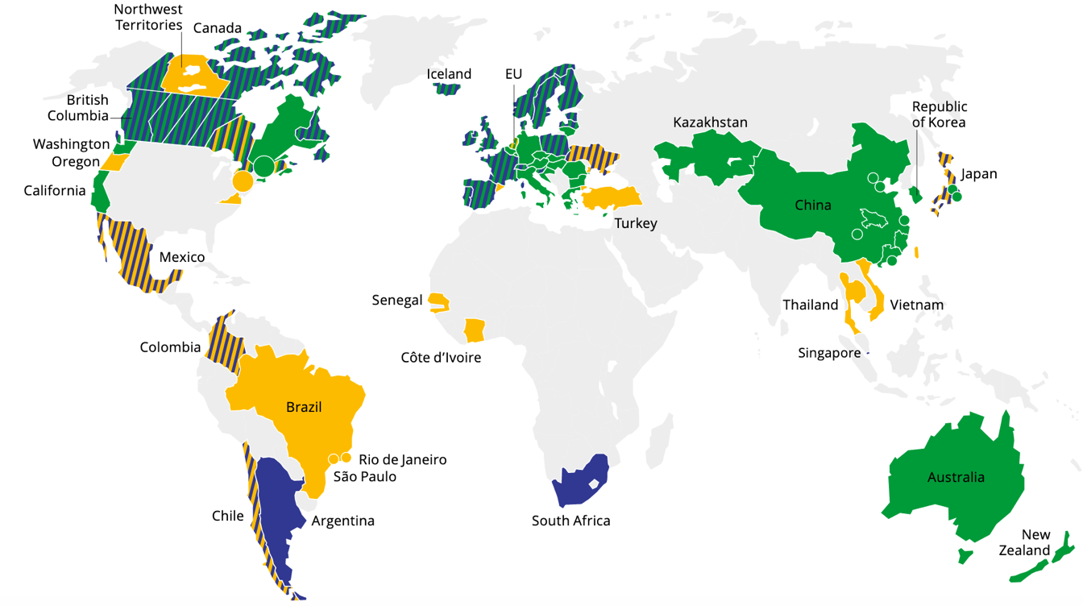
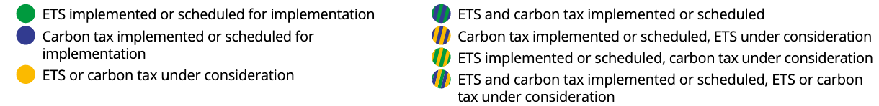

Gharama za kuzalisha hewa ukaa zinatekelezwa duniani kote
Bei ya sasa au iliyopangwa ya hewa ukaa hushughulikia asilimia ishirini na mbili ya uzalishaji wa dunia
Zaidi ya mamlaka 80 (Kikanda, Kitaifa au chini ya kitaifa) zimeweka au zinazingatia bei ya hewa ukaa
Chanzo: Benki ya dunia, 2020
Notes:
Sources:
https://carbonpricingdashboard.worldbank.org/map_data and World Bank Group. (2019). State and Trends of Carbon Pricing 2019. Washington, DC: World Bank. https://openknowledge.worldbank.org/handle/10986/31755
Notes:
ETS = Emissions Trading System
Notes from World Bank’s “State and Trends of Carbon Pricing 2019”: “The large circles represent cooperation initiatives on carbon pricing between subnational jurisdictions. The small circles represent carbon pricing initiatives in cities. Note: Carbon pricing initiatives are considered “scheduled for implementation” once they have been formally adopted through legislation and have an official, planned start date. Carbon pricing initiatives are considered “under consideration” if the government has announced its intention to work towards the implementation of a carbon pricing initiative and this has been formally confirmed by official government sources. The carbon pricing initiatives have been classified in ETSs and carbon taxes according to how they operate technically. ETS not only refers to cap-and-trade systems, but also baseline-and-credit systems as seen in British Columbia and baseline-and-offset systems as seen in Australia. The authors recognize that other classifications are possible."
Updated: September 2020

Slide 51
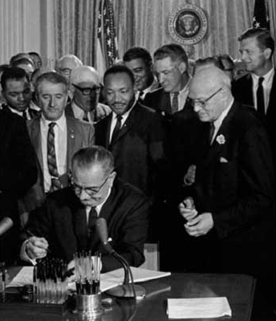
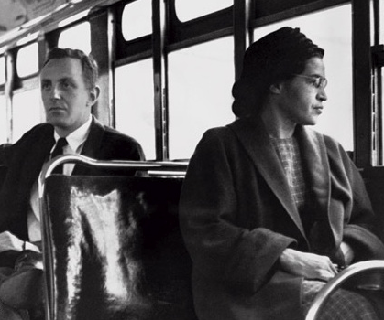
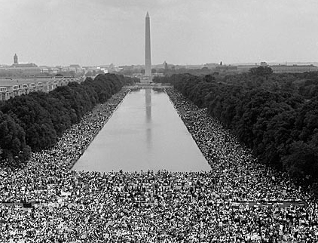
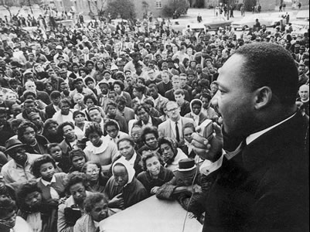
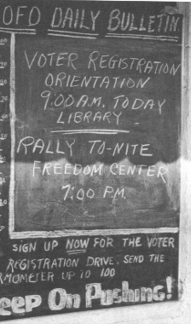
“Dunia kama tulivyoitengeneza, ni mchakato wa mawazo yetu. Haiwezi kubadilishwa bila kubadili mawazo yetu.”
- Albert Einstein
“ Usiwe na shaka kuwa kundi dogo lenye kufikiri, raia waliojitoa linaweza kuibadili dunia. Hakika, ni jambo pekee ambalo tumekuwa nalo.” - Margaret Mead

Slide 52
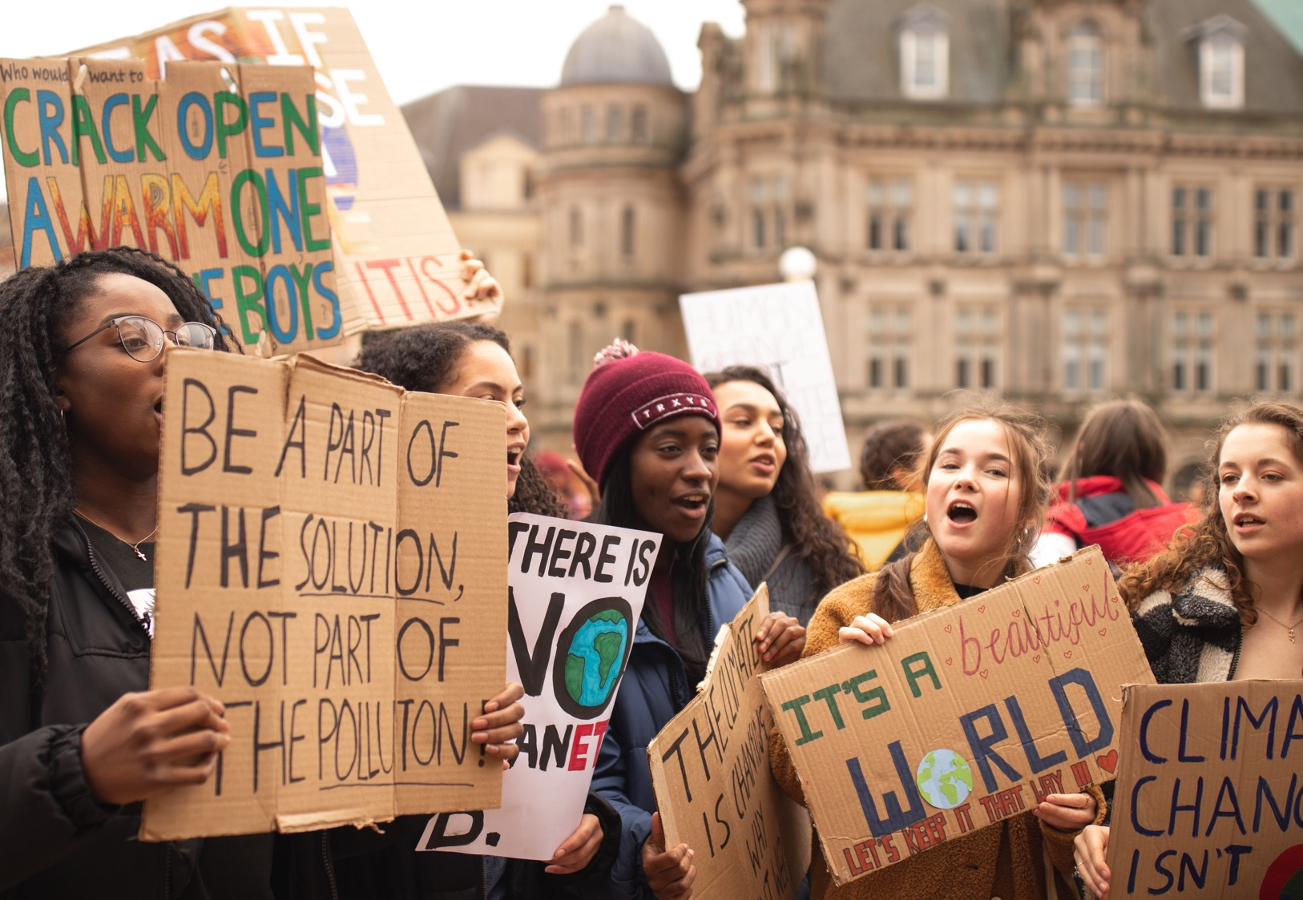

Septemba 2019: Zaidi ya watu milioni 7 katika Nchi 185
Migomo ya kuhusiana na Tabianchi ya Dunia
Notes:
Sources:
https://unsplash.com/photos/7SE389kUVGw
https://350.org/7-million-people-demand-action-after-week-of-climate-strikes/

Slide 53
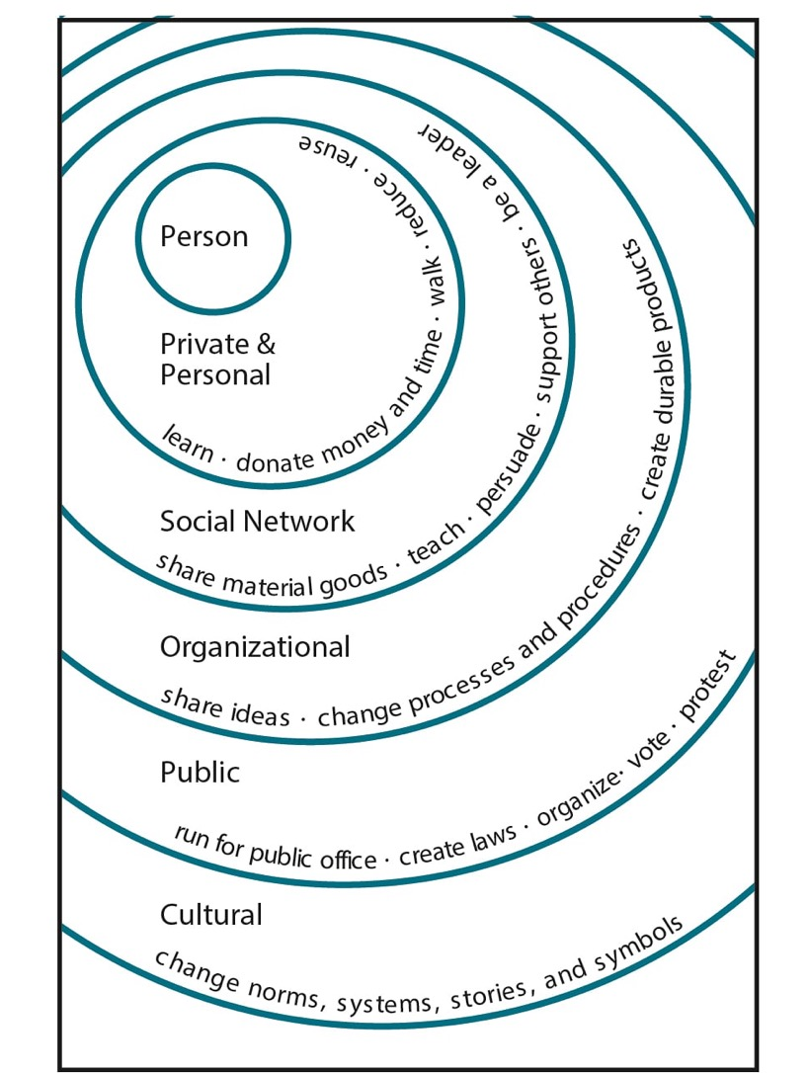
Kipi unaweza kufanya?
Picha na Elise Amel
Notes:
Source: https://www.theguardian.com/environment/climate-consensus-97-per-cent/2017/may/19/study-inspiring-action-on-climate-change-is-more-complex-than-you-might-think

Slide 54
Kusaini Mkataba wa Maridhiano
Sisi, wajumbe wa mkutano wa suluhu za tabia nchi, baada ya kuongoza maafikiano yaliyotokea katika (Ingiza eneo lako) tarehe (Ingiza tarehe), na kusainiwa kwa niaba ya kila mwakilishi, tunakubali wajibu wa kufanya kazi pamoja na kutumia jitihada zetu zote kutekeleza mpango huu, ili kuzuia ongezeko la joto duniani hadi chini ya digrii mbili za sentigredi juu ya kiwango kabla ya ukuaji wa viwanda , kama ilivyoelekezwa na kwenye kanuni zinazotuongoza za makubaliano ya Paris ya tabia Nchi.

Slide 55
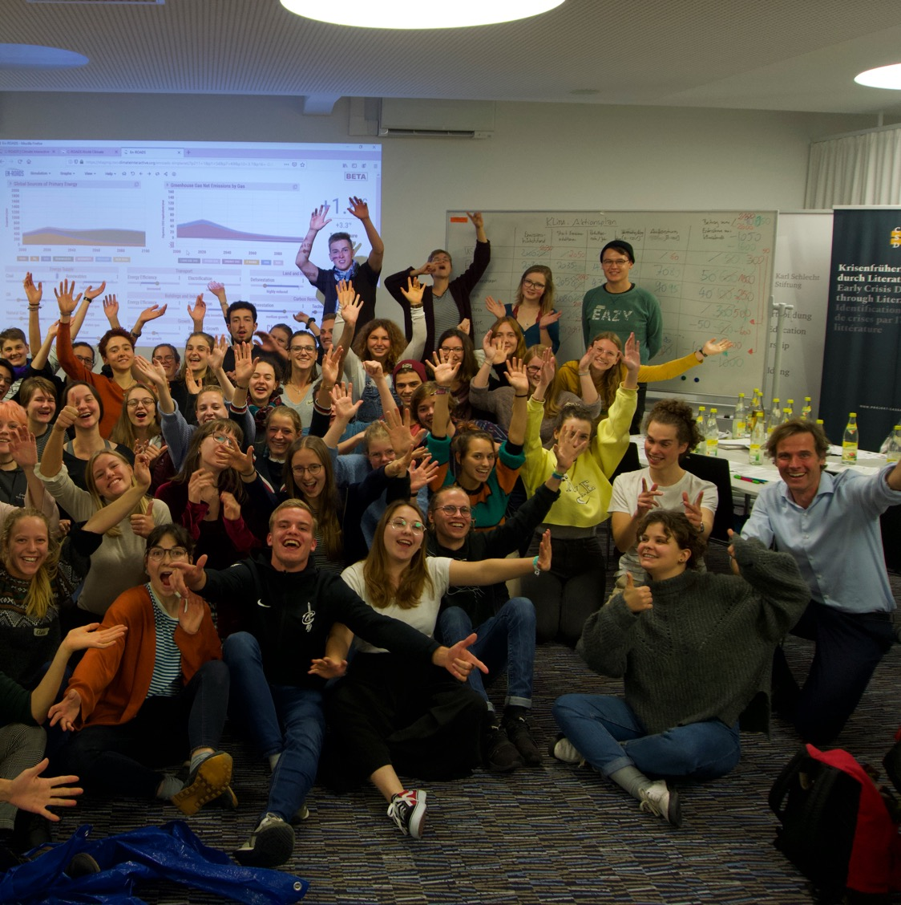
Asante!
Tembelea: climateinteractive.org

Slide 56
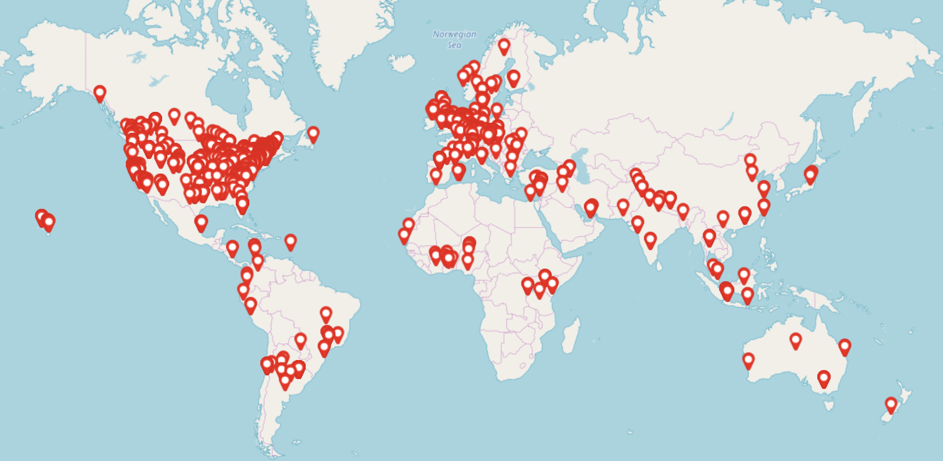
Igizo za En-ROADS:
Zaidi ya Washiriki 30,000 katika Nchi 65
ya Octoba, 2020
Notes:
Script: You are part of a global movement to become more knowledgeable about and equipped to solve climate change by experiencing this interactive workshop.
Updated: October 2020

Slide 57
Kiambatanisho

Slide 58
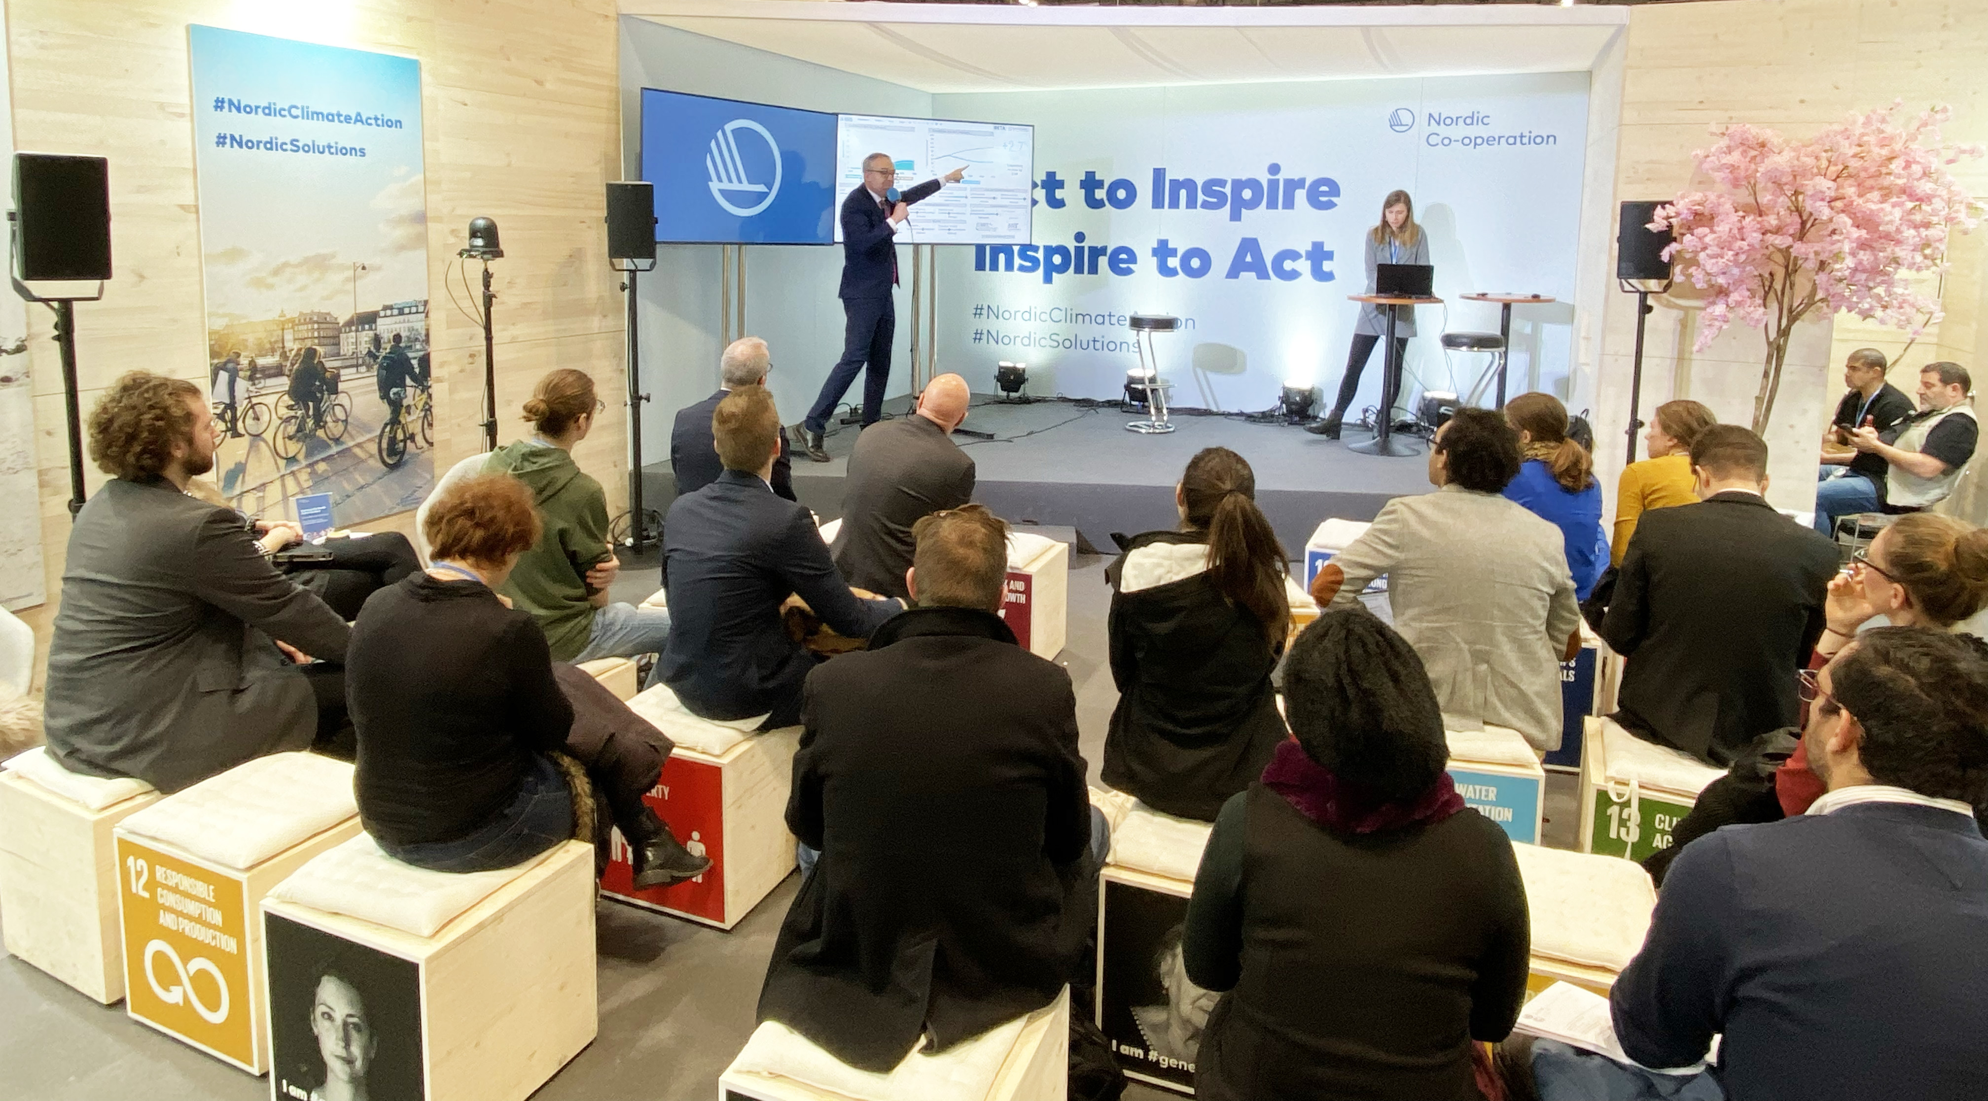
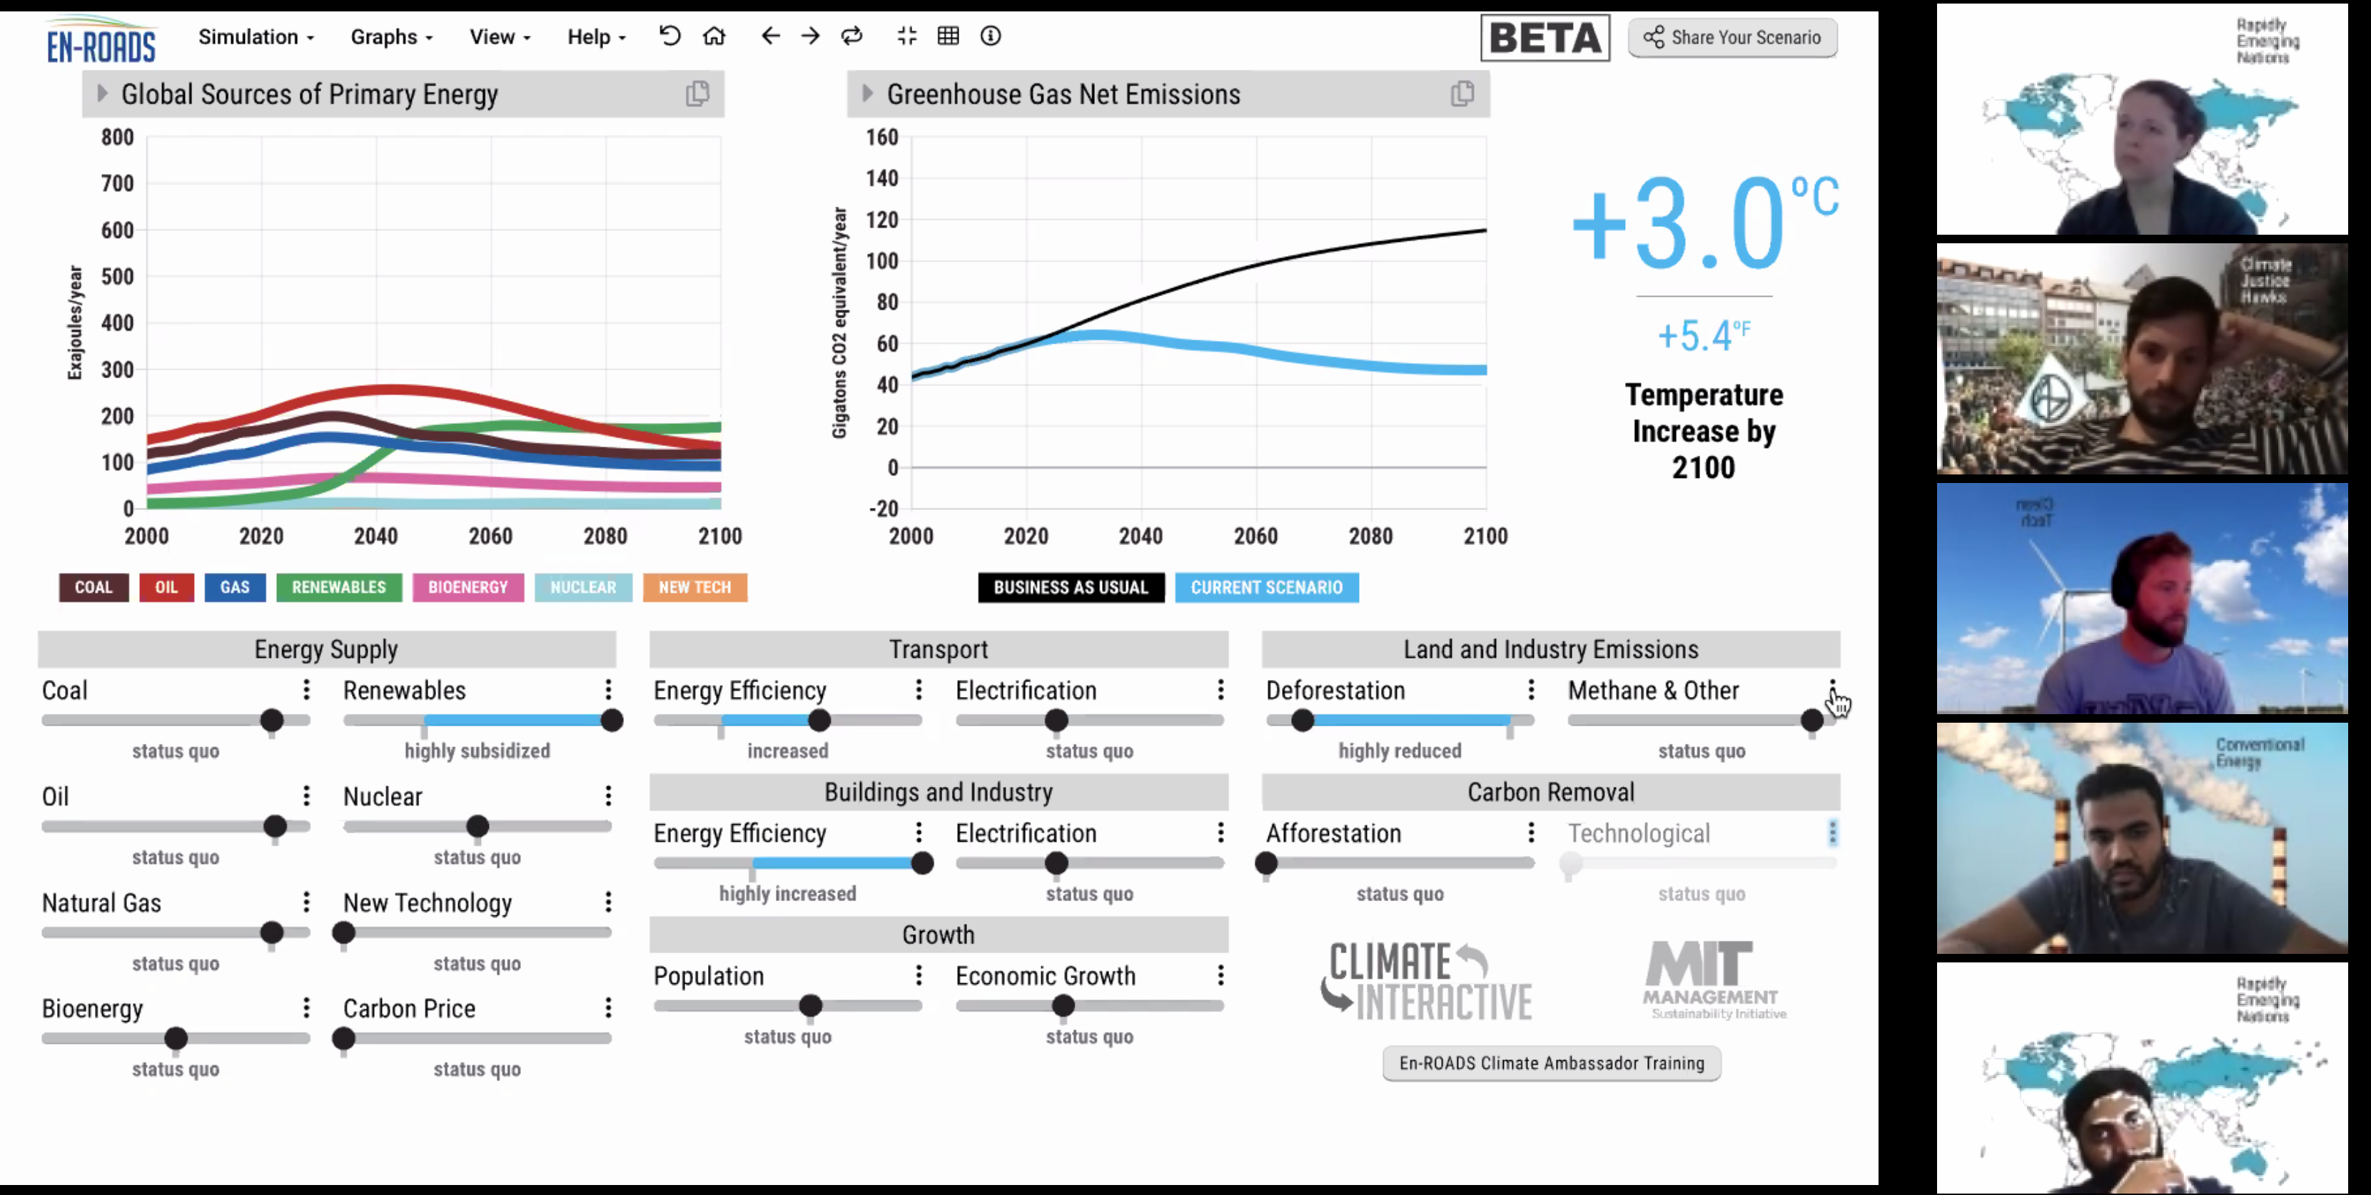
Mfululizo wa Kufuzu Mafunzo ya En-ROADS
Jiunge na mfululizo wabure wa hizi webinar ili…
Kujifunza zaidi kuhusu igizo la En-ROADS
Kuwezesha hafla za kuhusika kuchochea hatua za tabia Nchi – yote kwa njia ya Mtandao na Binafsi
Kuongeza ufahamu muhimu juu ya mawazo ya mifumo, kusuluhisha kwa aina tofauti tofauti, vidokezo vya juu vya uwezeshaji, na zaidi
Kuanza safari yako kama balozi wa tabia Nchi kwenye En-ROADS
Hali kadhalika, tuna mabalozi wa tabia nchi kwenye En-ROADS zaidi ya mia mbili kutoka katika nchi tofauti tofauti zaidi ya thelathini!
Jisajili kupitia: https://www.climateinteractive.org/tools/en-roads/en-roads-ambassador-program/

Slide 59
Tafakuri kutoka En-ROADS
Hakuna risasi ya fedha – hakuna suluhisho moja ambalo litazuia mabadiliko ya tabia nchi.
Kutekeleza ~2° kunahitaji “silver buckshot” – mafanikio kwa kila kitu.
Uwezeshali wa kiwango cha juu: kuhifadhi makaa ya mawe, gesi na mafuta ardhini.
Hata wakati ambao usambazaji wa kiwango cha chini cha gesi ukaa kutahamasishwa na kushamiri, tutaendelea kukataa makaa ya mawe, gesi na mafuta.
Teknolojia mpya zinakua kupitia kuimalisha kujifunza kwenye mzunguko wa maoni.
Ufanisi wa nishati hupunguza ukuaji wa nishati jadidifu.
Wakati ambao gharama za nishati zinakuwa nafuu (kama vile., jadidifu, nyukilia, mageuzi mapya ya teknolojia), mahitaji ya nishati huongezeka kupitia wastani wa “athari za kujirudia.”
Kuongezeka kwa kasi ya ukuaji wa gesi asilia (kama vile., kupitia ruzuku) kutokuwepo kwa bei ya gesi ukaa hupunguza jadidifu na kupunguza uzalishaji kidogo wa gesi joto.
Teknolojia mpya haswa imecheleweshwa kuchangia vya kujitosheleza.
Badiliko kutoka matumizi ya juu ya gesi ukaa kufikia matumizi kiasi kidogo cha gesi ukaa huchukua miaka mingi kwa sababu ya mtaji wa muda mrefu wa miundo mbinu inayotokana na makaa ya mawe, gesi na mafuta.
Katika hali ya juu ya kupunguza, nyuklia nyingi/teknolojia mpya/jadidifu japo kuondoa vyanzo vingine vya matumizi ya chini ya gesi ukaa.
Kupunguza “Gesi nyinginezo” hupunguza hali nzuri kiasi.
Kubadilika kwa pato la kila siku la kila mtu ni ushawishi mkubwa.
Bei ya gesi ukaa ni thamani kubwa iliyopo kwa sababu inabadili mchanganyiko wa mafuta na kupunguza uhitaji.
Kupunguza ukataji wa miti ni ushawishi mdogo kwa muda mrefu kuliko tulivyotegemea.

Slide 60
Mienendo ya mfumo kwenye En-ROADS
Mapinduzi ya soko la hisa – Kubadilika kwa miundo mbinu huchukua muda
Athari za kujirudia - Bei, Uhitaji, na Usambazaji vinajumuishwa.
Viwango vya uchumi na Kujifunza – Mafanikio huleta mafanikio kupitia kiwango cha maendeleo
Kuzuia Uwekezaji binafsi– Ueneaji wa matumizi kidogo ya gesi ukaa hushindana na gawiwo la soko la muda mrefu
Kuzuia Ukuaji na Ueneaji – Ueneaji wa makaa ya mawe, gesi na mafuta hupata uzoefu wa kufidia maoni
Vichocheo vya ukuaji– Idadi ya watu na Ukuaji wa pato la kila mtu huchochea uzalishaji
Kuzuia Ukuaji – Mafuta na gesi yamekuwa na gharama kubwa ila makaa ya mawe hayana thamani
“Hakuna Mshindi afanyaye yote” – Makaa ya mawe, gesi na mafuta yapo hata wakati ambao yamekuwa na gharama kubwa
Gesi Nyinginezo ni muhimu– Kupunguza uzalishaji wa gesi ambazo sio gesi ukaa kuna nguvu sanal
Bathtub Dynamics – Kiwango cha gesi ukaa na joto hurekebishika taratibu

Slide 61
Sifa za En-ROADS
Uwazi
Muundo na Maswali yote yanapatikana kwenye nyaraka za umma
Zinaendana na hali
Masharti yanarekebishika
Imejumuishwa kutoa matokeo ya haraka
Inajazia mapungufu, haibadili maana halisi, ikiwa na mfumo wa EMF22 na mifumo mingine
Inaruhusu majadiliano ya kina kujifunza na kuweka mikakati, ikithibishwa na takwimu halisi na sayansi
Hata hivyo, si kwa kulinda maslahi ya makisio kwa ajili ya baadaye, kwa kutegemea mabadiliko ya tabia binafsi.

Slide 62
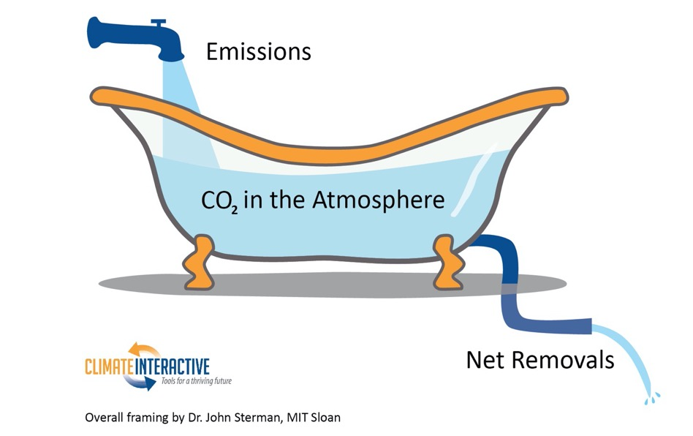
Bathtub Dynamics
Notes:
Note: The metaphor of a bathtub helps explain the dynamics of rising CO₂ concentration in the atmosphere. If more CO₂ enters the atmosphere (like water flowing into a tub) than is removed (like water draining from the tub), then the amount of CO₂ in the atmosphere (the amount of water in the tub) will continue to increase. To flatten CO₂ concentration, we need to bring CO₂ emissions down to equal removals. If your bathtub is overflowing, you turn off the tap before you go get a mop and bucket.
To understand more about stocks, flows, and the bathtub framing below, watch our video as part of our Climate Leader learning series.

Slide 63

En-ROADS Core Structure
Temperature
Impacts
Total greenhouse gases (GHGs)
Energy CO₂ emissions
Land use CO₂ emissions
CO₂ removal
Other greenhouse gases
(N₂O, methane,
f-gases)
Population
Consumption
Energy Intensity
Carbon Intensity
Notes:
*This slide is animated.

Slide 64
Suluhusho la Pamoja

Slide 65
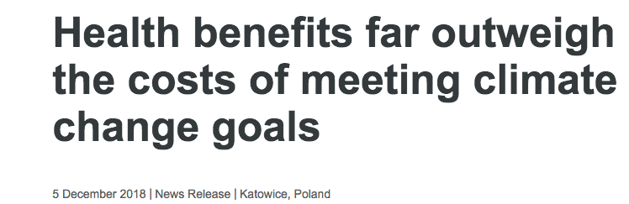
“Madhara ya vyanzo nishati chafuzi kwa sekta ya afya yameongezeka kwa sasa, hivyo jitihada kuelekea kutumia nishati safi na chaguo la usambazaji nishati endelevu, na mifumo thabiti ya chakula kwa pamoja vitaisaidia sekta ,” Amesema Dr Maria Neira, WHO Director of Public Health, Environmental and Social Determinants of Health.
“Suala la afya lipewa uzito unaostahili, jitihada kukabili mabadiliko ya tabiachi, si gharama”
Notes:
Chanzo: https://www.who.int/news-room/detail/05-12-2018-health-benefits-far-outweigh-the-costs-of-meeting-climate-change-goals

Slide 66
Nishati safi na Afya
Faida za kiafya kutokana na matumizi ya upepo na nishati ya jua kwa Marekani kuanzia mwaka 2007 hadi 2015 zimekuwa kubwa zaidi kuliko zile za hali ya tabianchi
Chanzo: Millstein, et al (2017)
Notes:
Sources: Millstein, et al (2017). The climate and air-quality benefits of wind and solar power in the United States. NATURE ENERGY 2, 17134. DOI: 10.1038/nenergy.2017.134. http://rdcu.be/uZwc
These figures specifically come from Table 3: Cumulative and 2015 benefits from avoided air pollution and avoided GHG emissions. 2015 US dollars.

Slide 67
Nishati safi na Ajira
Ikiwa dola za kimarekani bilioni 200 zitawekezwa kila mwaka katika matumizi ya nishati banifu na nishati safi kwa mazingira nchini Marekani, ajira milioni 4.2 zinatazalishwa ifikapo mwaka 2030, na ukosefu wa ajira kwa mwaka 2030 unataraji kupungua kwa asilimia 1.5.
Chanzo: Pollin, et al (2014)
Notes:
Sources: Pollin et al (2014). Green Growth: A U.S. Program for Controlling Climate Change and Expanding Job Opportunities. Center for American Progress & Political Economy Research Institute. https://www.americanprogress.org/issues/green/reports/2014/09/18/96404/green-growth/

Slide 68

Faida ya Kiafya za Jitihada kuhimili na kukabili mabadiliko ya tabianchi: Duniani
Kuzuia ongezeko la joto kutoka nyuzi joto 1.5-2 sentigredi kwa kuzuia uzalishaji wa gesi joto kutapelekea:
Kupunguza vifo vya mapema vya tatribani watu 153 ifikapo mwaka 2100¹
Kuokoa takribani dola za kimarekani bilioni 800 kwa mwaka kutokana na faida za kiafya za kutumia nishati safi na dola za kimarekani bilioni 400 kwa mwaka kutokana na huduma ya usafirishaji rafiki kwa mazingira
Takribani dola za kimarekani 1.2 kwa mwaka²
Chanzo: Shindell et al., 2018; Shindell et al., 2016
Notes:
Sources:
1. Shindell, D., Faluvegi, G., Seltzer, K. et al. Quantified, localized health benefits of accelerated carbon dioxide emissions reductions. Nature Clim Change 8, 291–295 (2018). https://doi.org/10.1038/s41558-018-0108-y
2. Shindell, Drew T., Yunha Lee, and Greg Faluvegi. "Climate and Health Impacts of US Emissions Reductions Consistent with 2 °C." Nature Climate Change Nature Climate Change 6.5 (2016): 503-507.
Photo: https://unsplash.com/photos/4NhqyQeErP8

Slide 69
Faida za kiafya za kuhimili na kukabili mabadilikko ya tabianchi: Marekani.
Marekani inaweza kuokoa billioni za gharama za huduma ya afya kwa mwaka 2030²
Kuzuia takribani 295,000 ya vifo vya mapema ifikapo 2030 kutokana auchafuzi wa hewa unaosababishwa na makaa ya mawe, gesi na mafuta
Kuzuia takribani vyumba 29,000 vya dharura vinavyo tembelewa kwa mwaka kwa asthma ya utotoni
Kuzuia masaa milioni 15 ya kazi kwa watu wazima lyanayopotea kwa mwaka
Chanzo: Shindell et al., 2016
Notes:
Sources:
1. Shindell, D., Faluvegi, G., Seltzer, K. et al. Quantified, localized health benefits of accelerated carbon dioxide emissions reductions. Nature Clim Change 8, 291–295 (2018). https://doi.org/10.1038/s41558-018-0108-y
2. Shindell, Drew T., Yunha Lee, and Greg Faluvegi. "Climate and Health Impacts of US Emissions Reductions Consistent with 2 °C." Nature Climate Change Nature Climate Change 6.5 (2016): 503-507.
Photos:
Power station: https://pixabay.com/images/id-374097/
Emergency room: https://pixabay.com/images/id-3323451/
Clock: https://pixabay.com/images/id-650753/

Slide 70
Matokeo katika hatua mbali mbali za ongezeko la joto

Slide 71
Ongezeko la joto la sentigredi tano (au 2.7ºF)
Ongezeko la 3.0 - 4.5°C (5.4 - 8.1°F) la joto lililokithiri katika baadhi ya kanda¹
Asilimia sabini ya matumbawe yamepoteza uhalisia wake²
Ukame: Kurefuka kwa miezi miwili
Huongeza wastani wa urefu wa ukame³
Asilimia kumi tatu ya watu wanakabiliwa na joto lililo kithiri kwa takribani miaka mitano⁴
Notes:
Script: By limiting warming to 1.5ºC, you have achieved our collective goal! This is no small feat and something we should all be proud of.
Congratulations!!! We have arrived at a set of policies that will avert the worst impacts of climate change, especially for the world’s most vulnerable.
While there are still impacts that we will need to adapt to, look at how significantly the impacts were reduced compared to a 4ºC scenario of warming:
[Review bullets on the slide]
Notes:
Increase in temperature extremes: The overall message is that there is no single 1.5-degree world; many regions will experience much greater warming than 1.5 degrees. During the summer in mid-latitudes, increases of up to 3 degrees C in extreme temperature may occur, with the strongest warming happening in central and eastern North America, central and southern Europe, the Mediterranean, western and central Asia, and southern Africa. During the winter in high-latitudes, increases of up to 4.5 degrees C may occur.
Coral bleaching: Many societies depend on coral reefs for fisheries and tourism. Reefs protect the shoreline from storm surge and erosion, among other benefits.
Severe heat waves: defined as having a Heat Wave Magnitude Index daily greater than 20. The Heat Wave Magnitude Index takes into account both heat wave duration and intensity
Updated: September 2020
Sources:
1. IPCC, 2018: Summary for Policymakers. In: Global Warming of 1.5°C. An IPCC Special Report on the impacts of global warming of 1.5°C above pre-industrial levels and related global greenhouse gas emission pathways, in the context of strengthening the global response to the threat of climate change, sustainable development, and efforts to eradicate poverty [Masson-Delmotte, V., P. Zhai, H.-O. Pörtner, D. Roberts, J. Skea, P.R. Shukla, A. Pirani, W. Moufouma-Okia, C. Péan, R. Pidcock, S. Connors, J.B.R. Matthews, Y. Chen, X. Zhou, M.I. Gomis, E. Lonnoy, T. Maycock, M. Tignor, and T. Waterfield (eds.)]. World Meteorological Organization, Geneva, Switzerland, 32 pp.
2. Schleussner, C.-F., Lissner, T. K., Fischer, E. M., Wohland, J., Perrette, M., Golly, A., Rogelj, J., Childers, K., Schewe, J., Frieler, K., Mengel, M., Hare, W., and Schaeffer, M.: Differential climate impacts for policy-relevant limits to global warming: the case of 1.5 °C and 2 °C, Earth Syst. Dynam., 7, 327–351, https://doi.org/10.5194/esd-7-327-2016, 2016.
3. Naumann, G. et al. (2018) Global Changes in Drought Conditions Under Different Levels of Warming, Geophysical Research Letters
4. Dosio, A., L. Mentaschi, E.M. Fischer, and K. Wyser, 2018: Extreme heat waves under 1.5°C and 2°C global warming. Environmental Research Letters, 13(5), 054006, doi:10.1088/1748-9326/aab827.
Photos:
Fan: https://pixabay.com/images/id-3571028/
Thermometer: https://pixabay.com/images/id-4767444/
Trees: https://pixabay.com/images/id-947331/
Dead coral: https://unsplash.com/photos/l77WKwkDpWQ
Live coral: https://unsplash.com/photos/0G01UI1MQhg

Slide 72
Ongezeko la joto la sentigredi mbili (2ºC) au 3.6ºF
Hatari ya mito kufurika imeongezeka kwa zaidi ya mara mbili¹
Wastani wa asilimia mia sabini ya kufurika kwa mito, ina hatari kubwa katika nchi za Marekani, Asia, and ulaya
Asimilia tisini ya matumbawe yamepoteza asilia yake²
Ukame: Kurefuka kwa miezi minne
Kuongezeka kwa wastani wa urefu wa ukame³
Zaidi ya asilimia hamsini ya idadi ya watu wote duniani wanaelekea kukabiliwa na kifo kitokanacho na ongezeko la joto kwa zaidi ya siku ishirini kwa mwaka
Notes:
Script: By limiting warming to 2ºC, you have come very close to our stated goal and should be very proud of the progress you have made! While there are still some serious impacts that the world will need to adapt to and prepare for, the impacts are FAR less severe than we would have seen under a baseline scenario.
Let’s take a look at the impacts we would expect to see in a 2ºC world: [Read bullets on the slide]
Notes:
Flooding: This does not include impacts from flash floods, pluvial floods (when extreme rainfall means that the ground cannot absorb the water), and coastal floods.
Coral bleaching: Many societies depend on coral reefs for fisheries and tourism. Reefs protect the shoreline from storm surge and erosion, among other benefits.
Updated: September 2020
Sourcess:
1. Alfieri, L., Bisselink, B., Dottori, F., Naumann, G., de Roo, A., Salamon, P., Wyser, K. and Feyen, L. (2017), Global projections of river flood risk in a warmer world. Earth's Future, 5: 171-182. doi:10.1002/2016EF000485
2. Schleussner, C.-F., Lissner, T. K., Fischer, E. M., Wohland, J., Perrette, M., Golly, A., Rogelj, J., Childers, K., Schewe, J., Frieler, K., Mengel, M., Hare, W., and Schaeffer, M.: Differential climate impacts for policy-relevant limits to global warming: the case of 1.5 °C and 2 °C, Earth Syst. Dynam., 7, 327–351, https://doi.org/10.5194/esd-7-327-2016, 2016.
3. Naumann, G. et al. (2018) Global Changes in Drought Conditions Under Different Levels of Warming, Geophysical Research Letters
4. Mora, C., Dousset, B., Caldwell, I. et al. Global risk of deadly heat. Nature Clim Change 7, 501–506 (2017). https://doi.org/10.1038/nclimate3322
Photos:
Flood: https://unsplash.com/photos/_whs7FPfkwQ
Thermometer: https://pixabay.com/images/id-4767444/
Trees: https://pixabay.com/images/id-947331/
Dead coral: https://unsplash.com/photos/l77WKwkDpWQ
Live coral: https://unsplash.com/photos/0G01UI1MQhg

Slide 73
Ongezeko la joto la 3ºC (au 5.4ºF)
Barafu ya bahari ukanda wa Arctic imepotea kwa mbili ya tatu kwa kila kipindi cha joto¹
Asilimia hamsini ya aina ya wadudu hupotea kwa zaidi ya asilimia hamsini ya kiwango cha makazi yao²
Ukame: Kurefuka kwa mwezi wa kumi na moja
huongeza wastani wa urefu wa ukame³
Eneo la misitu lililochomwa na joto katika kipindi cha joto limeongezeka mara mbili katika Mediterania ⁴
^{ikilinganishwa na sasa}
Notes:
Script: However, I want to be clear. A 3-4 degree future is still very bleak – especially for the world’s most vulnerable nations and communities who experience the impacts of climate change disproportionately. We need to do better. Far better. Here’s what a 3 degree future means for our world: [Read bullets from the slide].
Notes:
Arctic sea ice: Melting of Arctic sea ice has a positive feedback effect on global warming, as ice and snow reflect energy from the sun back into space. Without sea ice, more of the energy is absorbed, contributing to further warming. A warming Arctic and lessening sea ice are linked to extreme weather effects in other parts of world, as a result of the global atmospheric circulation. For more on this topic, see https://www.carbonbrief.org/qa-how-is-arctic-warming-linked-to-polar-vortext-other-extreme-weather
Insects: Insects are important as pollinators, for nutrient cycling, and for breaking down waste, among other services. They are the major or sole food source for many amphibian, reptile, bird, and mammal species.⁵
Updated: September 2020
Sourcess:
1. Sigmond, M., Fyfe, J.C. & Swart, N.C. Ice-free Arctic projections under the Paris Agreement. Nature Clim Change 8, 404–408 (2018). https://doi.org/10.1038/s41558-018-0124-y
2. Warren, R., et al. "The projected effect on insects, vertebrates, and plants of limiting global warming to 1.5 C rather than 2 C." Science 360.6390 (2018): 791-79
3. Naumann, G. et al. (2018) Global Changes in Drought Conditions Under Different Levels of Warming, Geophysical Research Letters
4. Turco, M. et al. (2018) Exacerbated fires in Mediterranean Europe due to anthropogenic warming projected with nonstationary climate-fire models, Nature Communications. https://www.nature.com/articles/s41467-018-06358-z
5. https://www.si.edu/spotlight/buginfo/benefits
Photos:
Arctic: https://pixabay.com/images/id-1913559/
Trees: https://pixabay.com/images/id-947331/
Bee: https://pixabay.com/images/id-4243850/
Wildfire: https://www.flickr.com/photos/slworking/29034137667

Slide 74
Ongezeko la joto la 4+ºC (au 7.2+ºF)
Kuongezeka kina cha bahari katika karne hii: Mita ~1.2 meters (Futi ~4)¹
Zaidi ya mbili ya tatu ya barafu katika milima ya Himalaya²
Moja kati ya sita ya viumbe vinaelekea kupotea³
Tatu ya nne ya idadi ya watu wote duniani wanakabiliwa na kuelekea kwenye kifo kitokanacho na ongezeko la joto kwa zaidi ya siku ishirini kwa mwaka⁴
Notes:
Script: If we do not take to reduce our fossil fuel use, we could see severe impacts by the end of the century. For example…
Notes:
Glaciers: The Hindu Kush Himalaya mountains provide water for two billion people. Water from Himalayan glaciers accounts for a significant part of the water in major rivers, including the Indus and Ganges. Estimates for the contribution of glacial melt to the Indus, for example, range from 21% to 80% based on different studies.²
Lethal heat: Populations in tropical areas will be exposed to much more lethal heat. “By 2100, mid-latitudes (for example, 40° N or S) will be exposed to ∼60 deadly days per year compared to almost the entire year in humid tropical areas under RCP 8.5.”⁴
Updated: September 2020
Sources:
1. Vermeer, M. & Rahmstorf, S. (2009). Global sea level linked to global temperature. Proceedings of the National Academy of Sciences. 106(51) 21527-21532. https://www.pnas.org/content/106/51/21527
2. P. Wester, A. Mishra, A. Mukherji, A. B. Shrestha (eds) (2019) The Hindu Kush Himalaya Assessment—Mountains, Climate Change, Sustainability and People. Springer Nature Switzerland AG, Cham.
3. Urban, M. Accelerating extinction risk from climate change. Science.348.6234 (2015), 571-573. https://science.sciencemag.org/content/348/6234/571
4. Mora, C., Dousset, B., Caldwell, I. et al. Global risk of deadly heat. Nature Clim Change 7, 501–506 (2017). https://doi.org/10.1038/nclimate3322
Photos:
Wave: https://pixabay.com/images/id-1913559/
Glacier: https://pixabay.com/images/id-276995/
Thermometer: https://pixabay.com/images/id-4767444/
Skeleton: https://pixabay.com/images/id-433340/

Slide 75







Nchi zilizo endelea
Viongozi wa:
Australia
Canada
Umoja wa Ulaya
Japani
New Zealand
Urusi & jamuhuri ya Sovieti ya Zamani
Korea Kusini
Marekani

Slide 76






Nchi zinazo kua kwa kasi
Viongozi wa:
China
India
Indonesia
Brazil
Mexico
Afrika kusini

Slide 77





Nchi zinazoendelea
Viongozi zaidi ya mataifa 100
Afrika
Amerika ya kati na Latini
Asia ya kusini na kusini mashariki
Mashariki ya kati
Majimbo ya Visiwa Vidogo vidogo

