Slide 1

Climate Solutions Workshop
Notes:
Welcome the participants to this workshop

Slide 2
How to use these slides
Note for the facilitator
These slides are provided as a guide and introduction to climate science for the En-ROADS Climate Solutions Workshop, if they are helpful.
Use what works: You don’t need to use every slide (and you don’t need to use the slides at all!) Select and adapt the ones that best suit your audience’s background and context.
Focus on the interactive simulation: A guideline is to start moving sliders within the first 10 minutes of your workshop. This will keep your audience engaged and focus them on the goal: solutions to keep climate change below 2°C.
Credits: The En-ROADS Simulator and these materials were developed by Climate Interactive and MIT Sloan (www.en-roads.org). They’re free to use, as long as you give appropriate credit for the original creation of the materials.
Red slides = facilitator only: Slides with a red background are for facilitator guidance—don’t share them with participants. The speaker notes at the bottom of the screen give detailed instructions for each slide.
Notes:
Dear Facilitator, these slides can support your facilitation of the En-ROADS Climate Solutions Workshop, which complements the En-Roads simulation model. You may pick and choose from these slides and adjust them to suit your audience and setting.
For detailed instructions on how to run a successful workshop, take the Mastering En-ROADS training at https://learn.climateinteractive.org/, and read the Facilitator Guide.

Slide 3



En-ROADS and the Workshop were developed by…
en-roads.org
Notes:
Script:
We will be using a powerful climate simulator tool called En-ROADS, developed by Climate Interactive and MIT Sloan.
En-ROADS helps people learn about and assess the impacts of different approaches to addressing climate change.
En-ROADS is:
Powered by the best available research on climate science and solutions
Transparent: All equations and model assumptions are open source
Dynamic: Assumptions are adjustable
Fast: Runs in real time
Updated: Aug 2025

Slide 4
Today’s facilitator
Your Name
Your title and affiliation
Your contact information
Notes:
Use this template to introduce yourself as a facilitator. Here are some guidelines:
You may customize this slide to include your own logo, a headshot, or a picture of yourself facilitating an event.
You may use the En-ROADS logo to promote your events or describe your role as an En-ROADS Climate Ambassador.
Do not use the Climate Interactive or MIT logos for general promotion unless you are directly referencing the creation of En-ROADS or its official materials. These logos are reserved for official use by the organizations and should not be used in broader promotional or marketing contexts. For more information, please see the Outline of Expectations for En-ROADS Climate Ambassadors.
You’re welcome to refer to yourself as an En-ROADS facilitator if you are actively using the simulator with audiences—or as an En-ROADS Climate Ambassador if you’ve been accepted into the Ambassador program and received a certificate. Please avoid implying official employment or endorsement by Climate Interactive or MIT. For more information, please see the Outline of Expectations for En-ROADS Climate Ambassadors.

Slide 5
AGENDA
1 | Introduction Today’s session and introduction to climate science
2 | Scenarios of Climate Success Testing actions and learning the system dynamics with En-ROADS
3 | Debrief Feelings, insights, and calls to action

Slide 6
Introduction
Notes:
Topics that might be covered in the Introduction:
Introduce yourself, as needed
[For online events] Familiarize your participants with any virtual meeting platform controls they need to participate in the session
Agenda and purpose of the event
Introduction to climate change science and any local climate impacts for context
Introduction to En-ROADS simulator
An overview of the importance of identifying equity considerations and co-benefits with actions (multisolving)

Slide 7
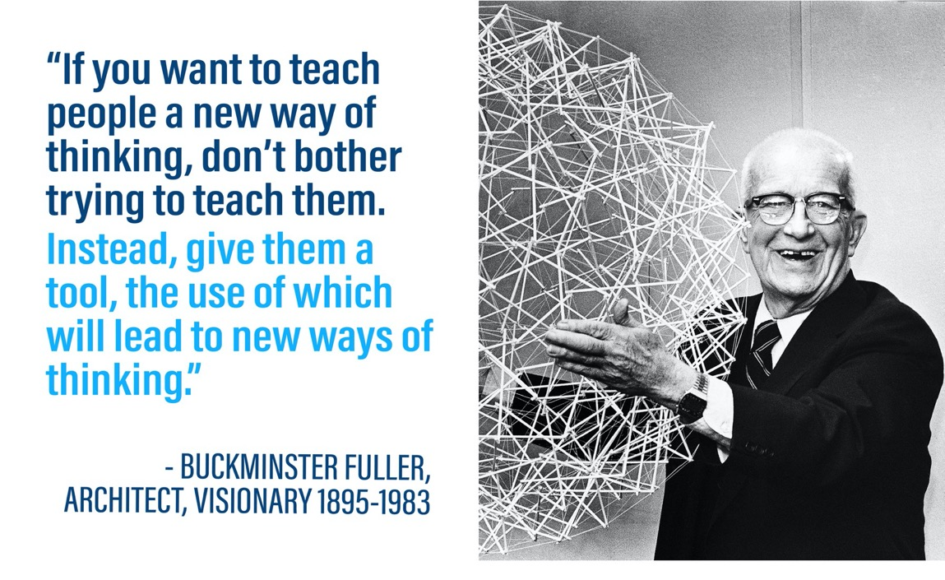

Slide 8
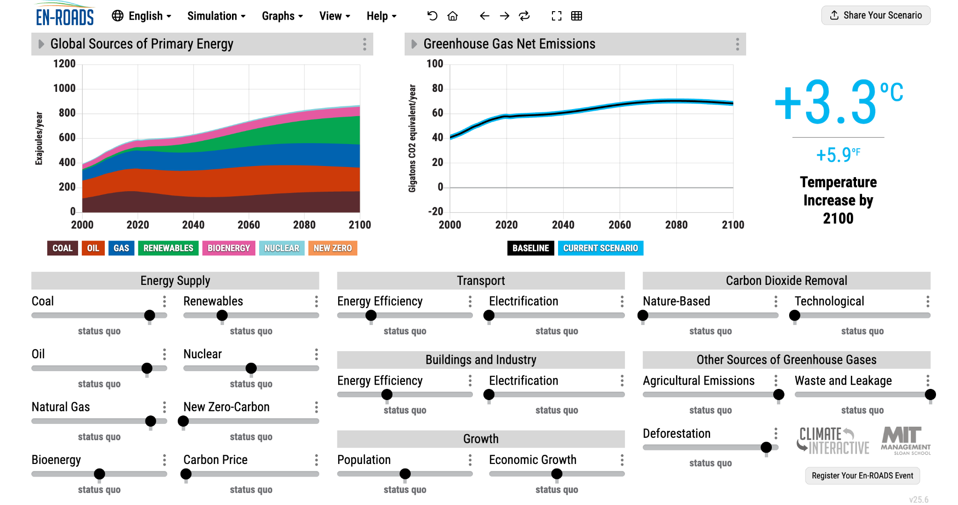

En-ROADS is a cutting-edge simulation model by Climate Interactive and MIT Sloan for testing climate solutions and exploring future scenarios.
Visit: en-roads.org
Notes:
Script:
We will be using a powerful climate simulator tool called En-ROADS. En-ROADS is a cutting-edge simulation model developed by Climate Interactive and MIT Sloan, for testing climate solutions and exploring different future scenarios. En-ROADS helps people learn about and assess the impacts of different approaches to addressing climate change.
En-ROADS is:
Powered by the best available research on climate science and solutions
Transparent: All equations and model assumptions are available online in the Technical Reference
Dynamic: Assumptions are adjustable
Fast: Runs in real time
Updated: August 2025

Slide 9
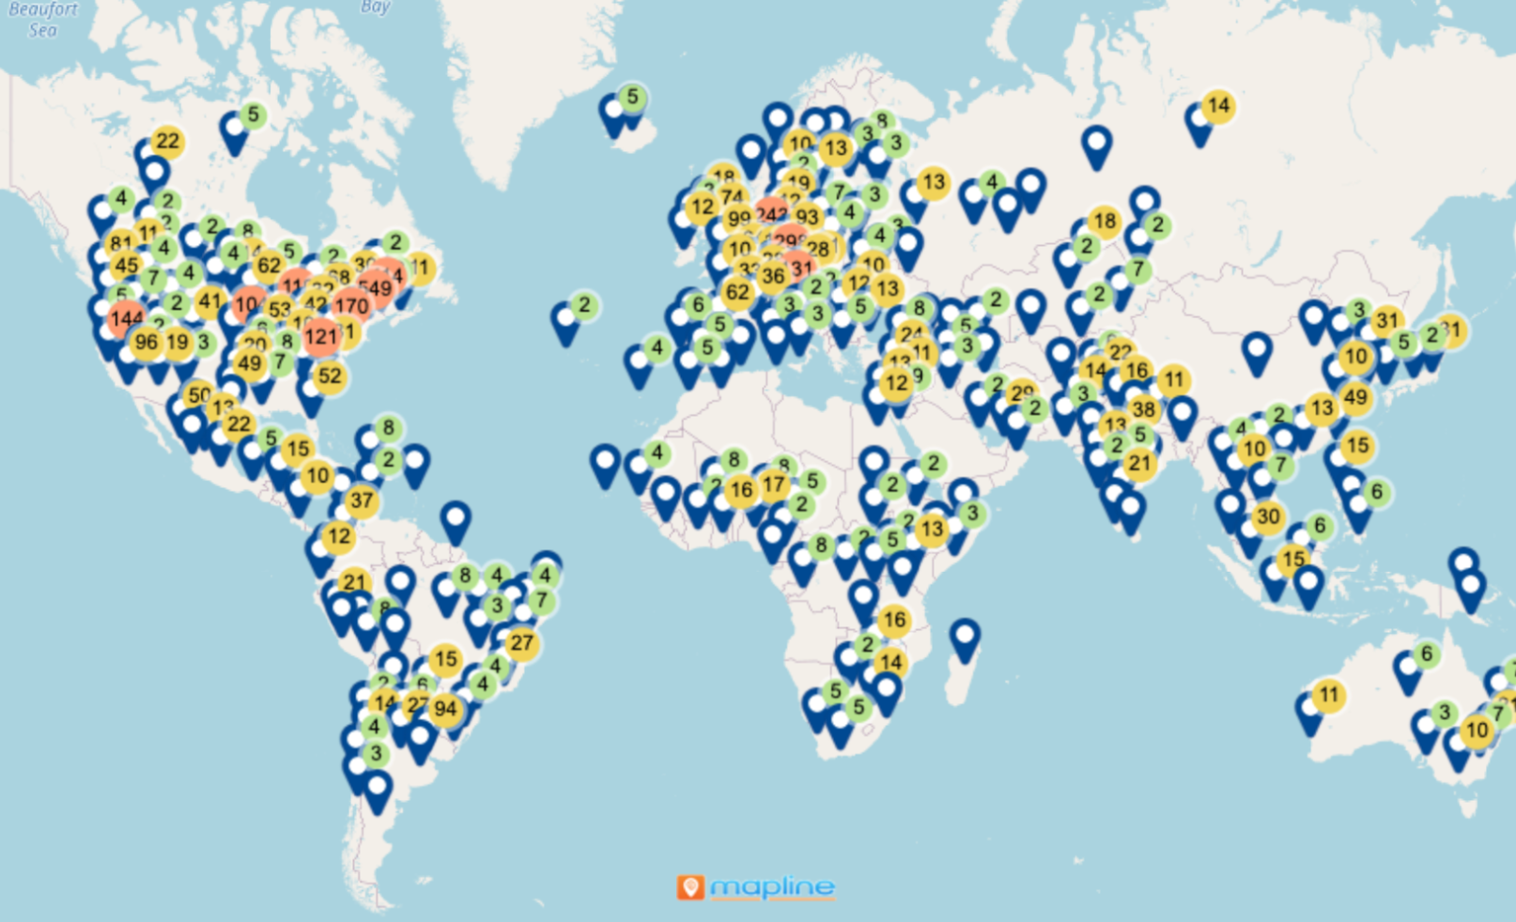
En-ROADS events around the world
Over 372,000 Participants
In 168 countries
Our Impact
As of January 31, 2026
See the latest impacts at climateinteractive.org/strategy-and-impact/

Slide 10
Introduction to Climate Science
Note for the facilitator
The following slides can be skipped if your audience is familiar with basic climate science and the impacts.
Climate impact slides following this could be directly addressed by showing the impact graphs and maps in En-ROADS instead.

Slide 11
Climate Science

Slide 12
Let’s briefly review the science and what’s at stake….

Slide 13
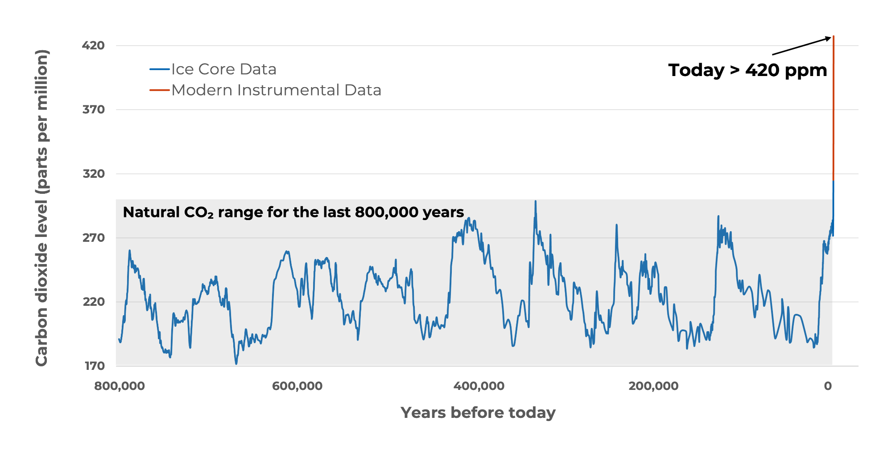
Co₂ concentration in the atmosphere
Atmospheric carbon dioxide is higher than at any point in the last 800,000 years and it is rising faster than at any time in millions of years.
Source: NASA (2025) climate.nasa.gov
Notes:
Script (from NASA): Earth's climate has changed throughout history. Just in the last 800,000 years, there have been eight cycles of ice ages and warmer periods, with the end of the last ice age about 11,700 years ago marking the beginning of the modern climate era — and of human civilization. Most of these climate changes are attributed to very small variations in Earth’s orbit that change the amount of solar energy our planet receives. The current warming trend is different because it is clearly the result of human activities since the mid-1800s, and is proceeding at a rate not seen over many recent millennia.
Source: NASA. (2025). https://science.nasa.gov/climate-change/evidence/
For a detailed view of CO2 concentration since 1960, see https://science.nasa.gov/earth/explore/earth-indicators/carbon-dioxide/

Slide 14
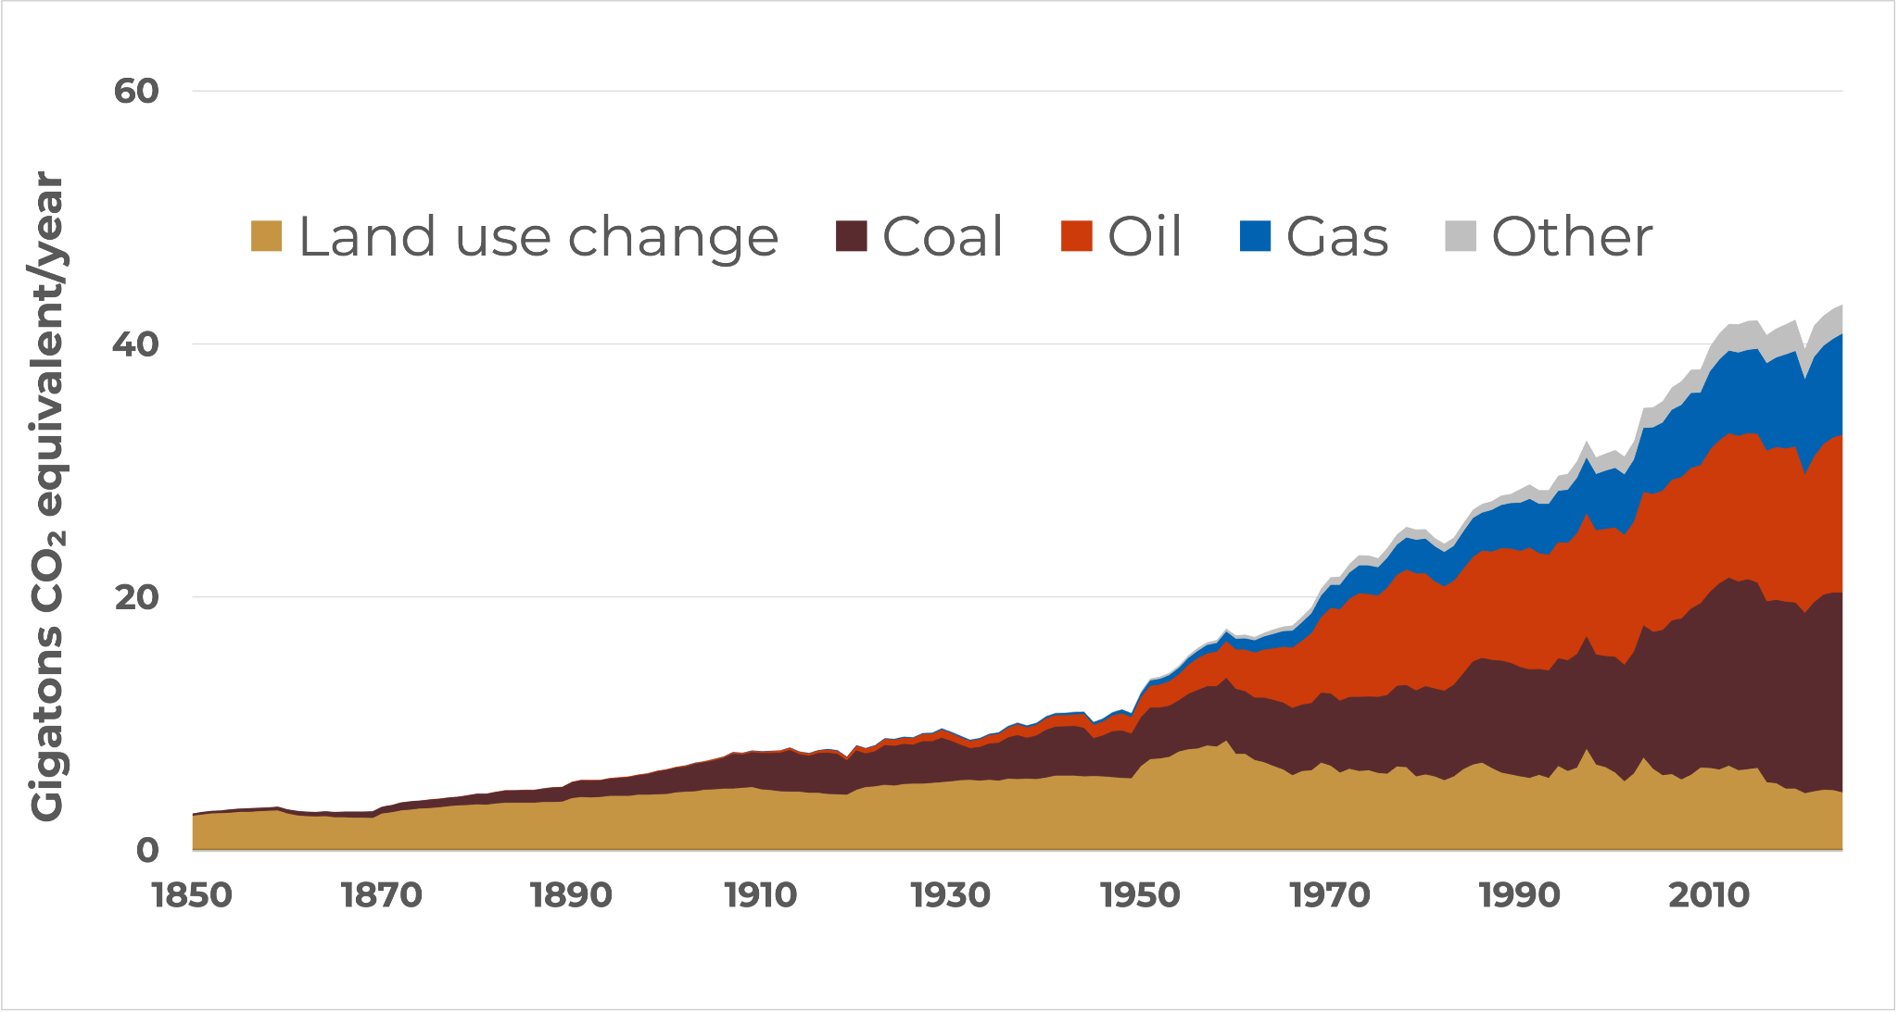
Annual global co₂ emissions
The dominant source of rising CO₂ is the burning of fossil fuels—coal, oil, and natural gas.
Sources: C-ROADS (Climate Interactive). c-roads.org
Calibrated to Global Carbon Budget (2025), PRIMAP (2025), IEA (2025), EI Statistical Review of World Energy (2025), Land Use Harmonization (2019)
Notes:
Script: But where does all the CO2 come from? Any ideas? This graph shows the sources of CO2 from the year 1850 to 2024. The primary contributors to CO2 emissions are the fossil fuels—coal (which you see in brown), oil (in red), and gas (in blue). You can see that there has been lots of growth in coal, oil, and gas over the last 170 years. The yellow wedge at the bottom is land use change, primarily deforestation. The other emissions category is mostly emissions from concrete production.
*Calibration:
CO2 emissions from fossil fuels are calibrated over 1990-2024 to Friedlingstein et al. (Global Carbon Budget, 2025), Gütschow, et al. (PRIMAP version 2.7, 2025); World Energy Balances Dataset 1990-2023 (2025), and EI Statistical Review of World Energy (2025).
Land use changes are calibrated over 1990-2100 to Land Use Harmonization2 data, LUH2 v2e Release (February 2019). Uses historical data from 1990-2015, followed by SSP2 projections thereafter.
Carbon content and CO2 emissions from land use & forestry calibrated over 1990-2024 to Friedlingstein et al. (Global Carbon Budget, 2025) data using multi-model mean.
Updated: December 2025

Slide 15
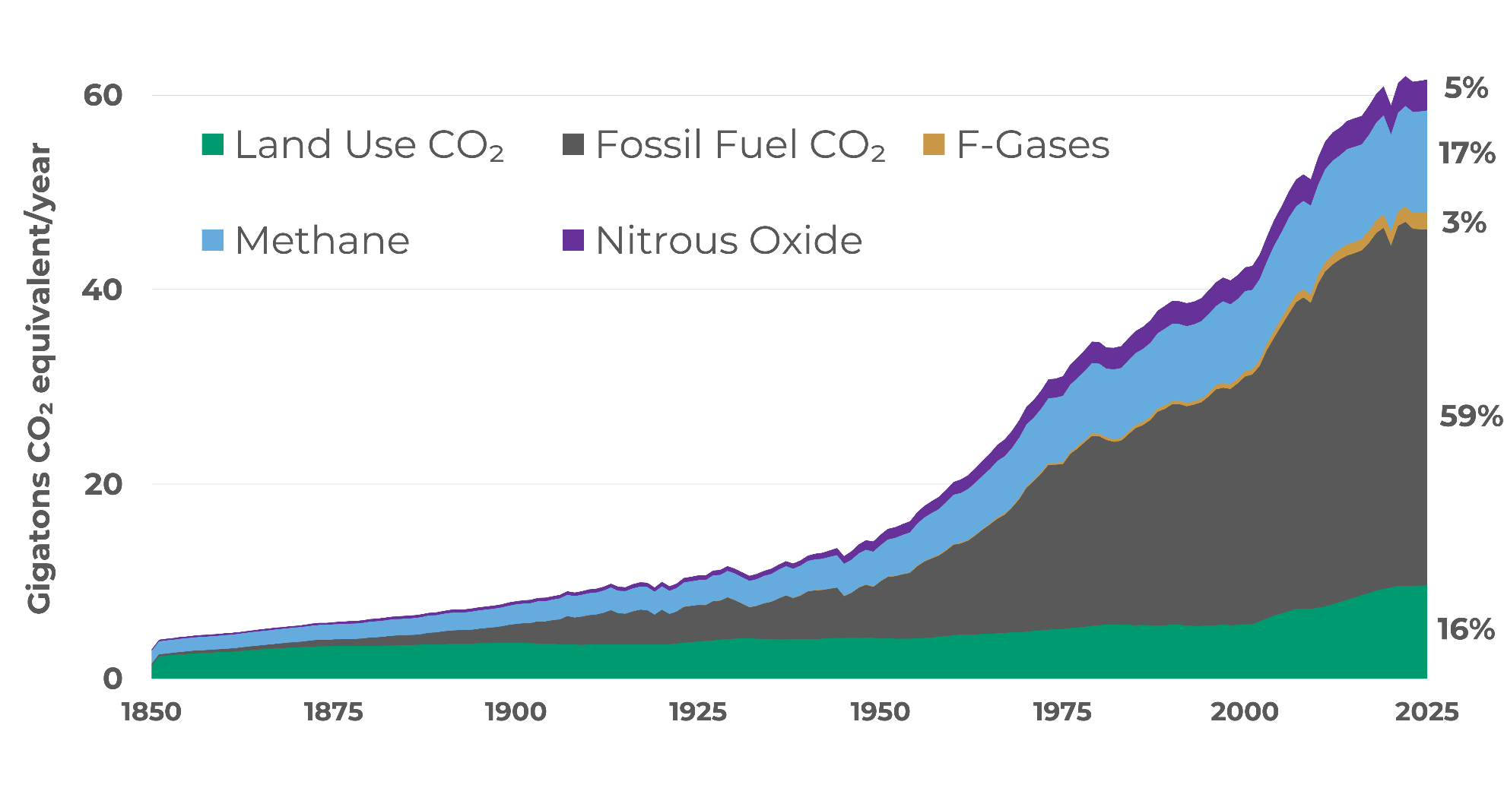
Annual global greenhouse gas emissions
CO₂ from fossil fuels is the largest driver, but methane, nitrous oxide, and fluorinated gases, along with CO₂ from land-use change, also contribute to warming.
Sources: C-ROADS (Climate Interactive). c-roads.org
Calibrated to Global Carbon Budget (2025), PRIMAP (2025), IEA (2025), EI Statistical Review of World Energy (2025), Land Use Harmonization (2019)
Notes:
Script: Carbon dioxide is not the only thing that is contributing to climate change. There are also several other greenhouse gases. Here you see the relative contribution from different gases. In black and green you can see the contribution that CO2 makes from fossil fuels and land use, then in light blue is methane (CH4), then nitrous oxide (N2O) in purple, and the F-gases (fluorinated gases) in yellow. Agriculture contributes about 40% of global methane (CH4) emissions and about 70% of global nitrous oxide (N2O) emissions. Heavy industry and manufacturing, as well as consumer goods, are sources of N2O and F-gases.
*Calibration:
CO2 emissions from fossil fuels are calibrated over 1990-2024 to Friedlingstein et al. (Global Carbon Budget, 2025), Gütschow, et al. (PRIMAP version 2.7, 2025); World Energy Balances Dataset 1990-2023 (2025), and EI Statistical Review of World Energy (2025).
Land use changes are calibrated over 1990-2100 to Land Use Harmonization2 data, LUH2 v2e Release (February 2019). Uses historical data from 1990-2015, followed by SSP2 projections thereafter.
Carbon content and CO2 emissions from land use & forestry calibrated over 1990-2024 to Friedlingstein et al. (Global Carbon Budget, 2025) data using multi-model mean.
Non-CO2 greenhouse gases are calibrated over 1990-2024 to Gütschow, et al. (PRIMAP version 2.7, 2025).
Updated: December 2025

Slide 16
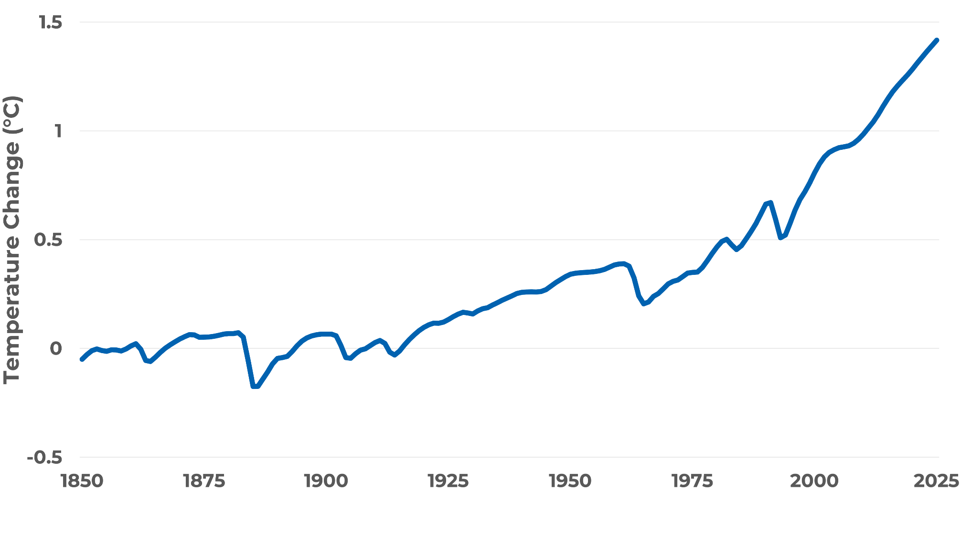
Global temperature change from pre-industrial (°C)
Global average surface temperature has increased about 1.4°C (2.5°F) since humans started burning fossil fuels on a large scale.
Sources: C-ROADS (Climate Interactive). c-roads.org
Calibrated to NASA GISS (2025), Met Office HadCRUT5 (2025)
Notes:
Script: This graph shows a closer look at global average surface temperature change over the last 175 years. Measuring from 1850, which is often used to approximate temperature in pre-industrial times, surface temperature has increased approximately 1.4 degrees C, or 2.5 degrees F.
Source: Temperature change from C-ROADS. c-roads.org. Calibrated to historical data from:
NASA GISS. (2025). GISS Surface Temperature Analysis (GISTEMP), version 4. NASA Goddard Institute for Space Studies.
Met Office: Morice, C. P., Kennedy, J. J., Rayner, N. A., Winn, J. P., Hogan, E., Killick, R. E., et al. (2020). An updated assessment of near-surface temperature change from 1850: the HadCRUT5 dataset. The data is from HadCRUT version 5.0.2.0 (2025).

Slide 17
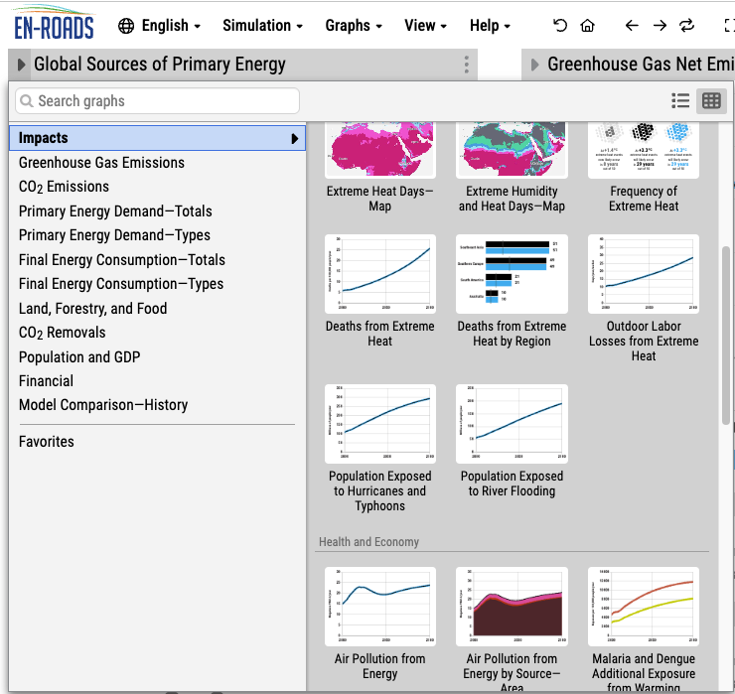
Show impacts in En-ROADS
Note for the facilitator
The next slides focus on climate impacts. You may choose to skip them and invite participants to name one or two impacts they are most concerned about, and explore those in En-ROADS (under Graphs > Impacts).
After building a more desirable scenario, revisit the same impacts to show how mitigation reduces harm, and discuss where adaptation may still be needed.

Slide 18
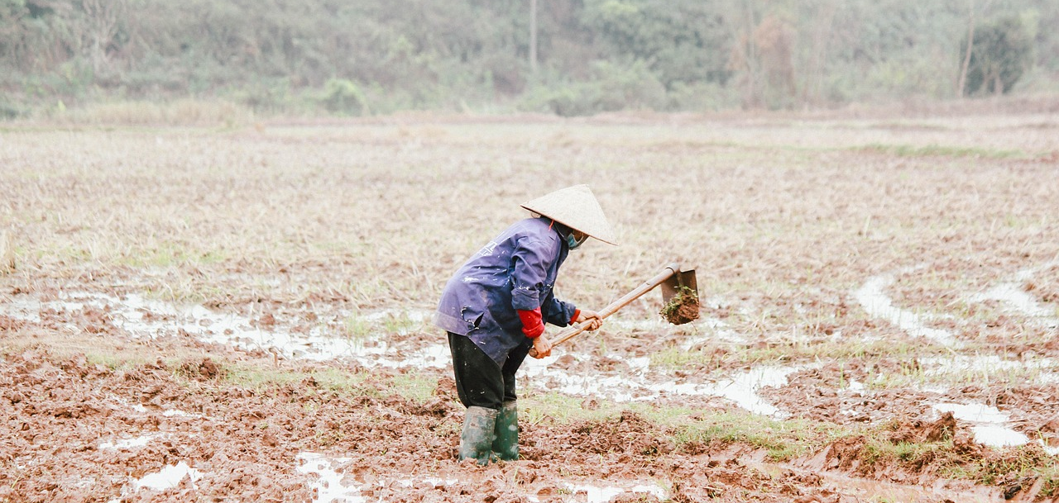
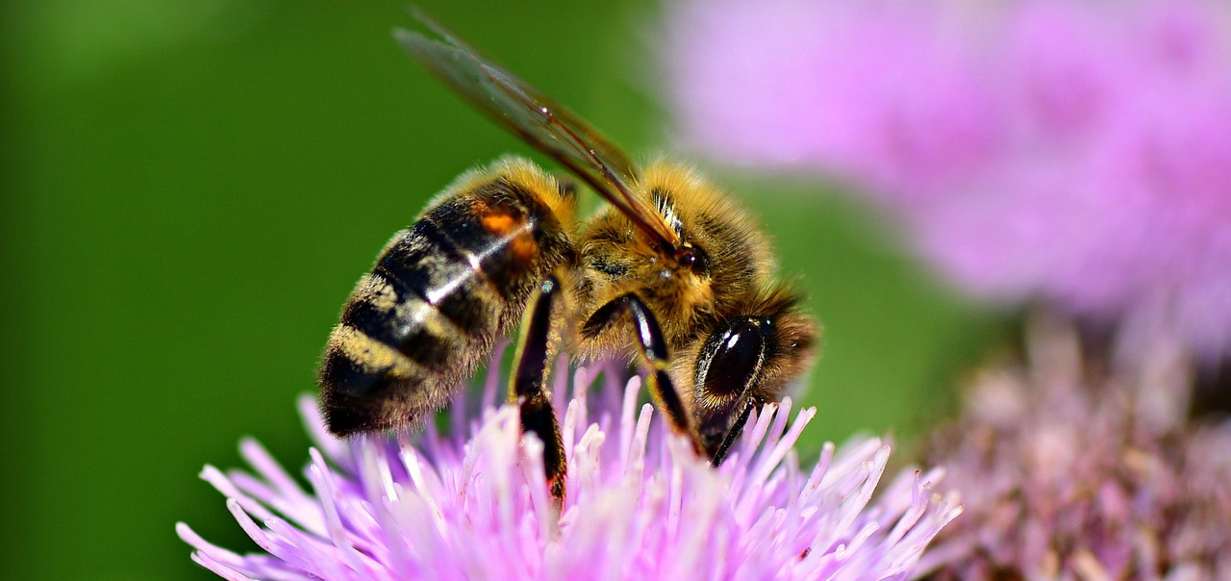
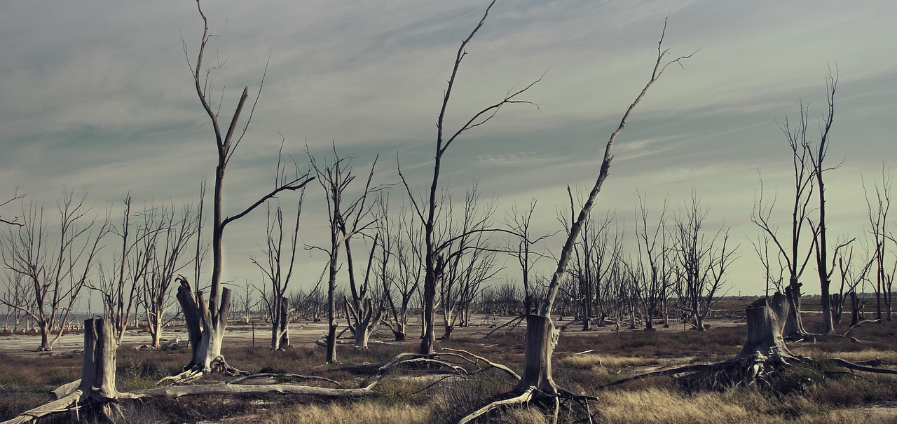
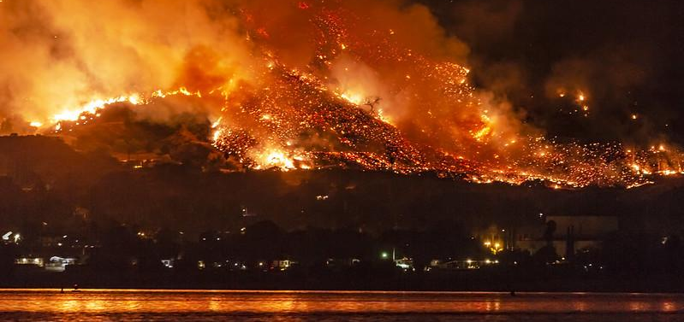
What would +3°C (or +5.3°F) of warming mean?
Outdoor workers lose nearly a month of work to extreme heat.¹
Annually
Over 40% of insect species lose >50% of their habitat.²
Likelihood of drought in central Spain doubles.³
Compared to today
Number of wildfire danger days in Hunan, China triples.⁴
Compared to today
See the impacts of your scenario in the Impacts graph section of En-ROADS.
Notes:
Script:
However, I want to be clear. A 3+ degree future is still very bleak – especially for the world’s most vulnerable nations and communities who experience the impacts of climate change disproportionately. We need to do better. Far better. Here’s what a 3 degree future means for our world: [Read bullets from the slide].
More information:
Insects: Insects are important as pollinators, for nutrient cycling, and for breaking down waste, among other services. They are the major or sole food source for many amphibian, reptile, bird, and mammal species.
Likelihood of drought: Annual likelihood of drought in central Spain doubles to 80% at 3°C, versus 40% today and 23% in the past.
Updated:
March 2026
Sources:
1. En-ROADS modeling based on Parsons, L.A., et al. (2021). Increased labor losses and decreased adaptation potential in a warmer world. Nature Communications, 12, 7286.
2. En-ROADS modeling based on Warren, R., et al. (2018). The projected effect on insects, vertebrates, and plants of limiting global warming to 1.5°C rather than 2°C. Science, 360(6390), 791–795.
3. “Likelihood of year-plus drought” map from Probable Futures, which sources data from the CORDEX-CORE regional climate modeling framework.
4. “Change in wildfire danger days” map from Probable Futures, which sources data from the CORDEX-CORE regional climate modeling framework.
Photos:
Worker, bee, and drought photos from Pixabay. Wildfire photo from “California Wildfires: The Holy Fire At Lake Elsinore On August 9, 2018” by slworking2, CC BY-NC-SA 2.0.

Slide 19
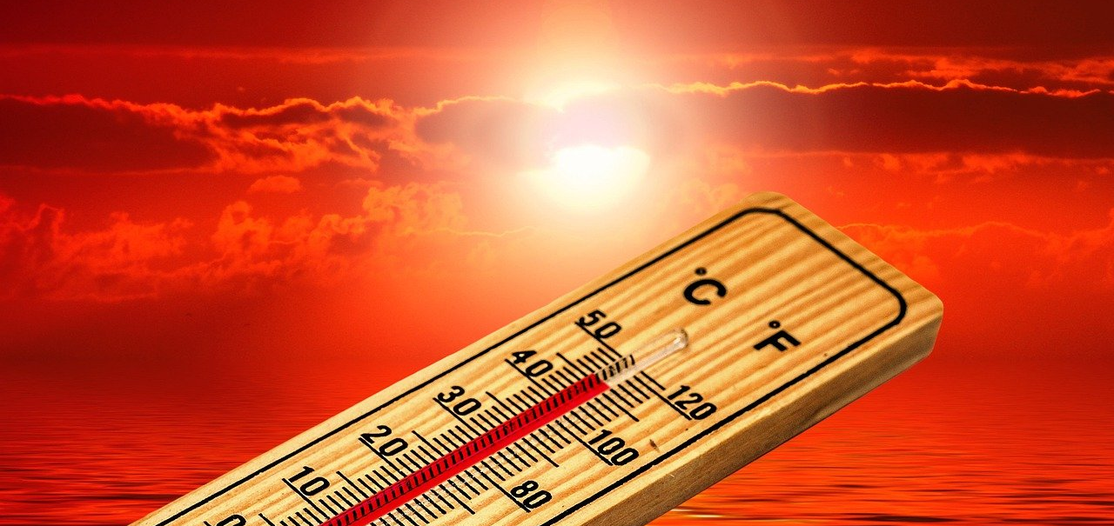
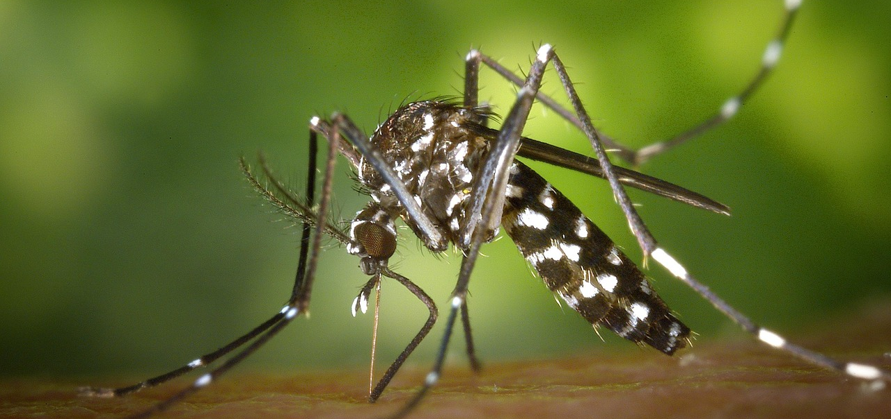
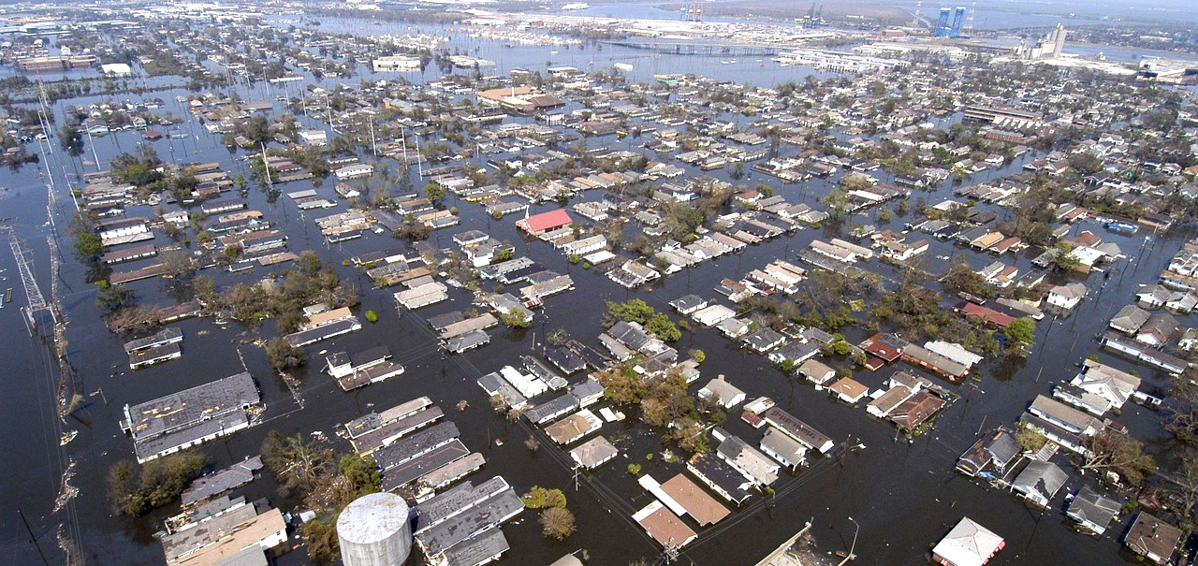
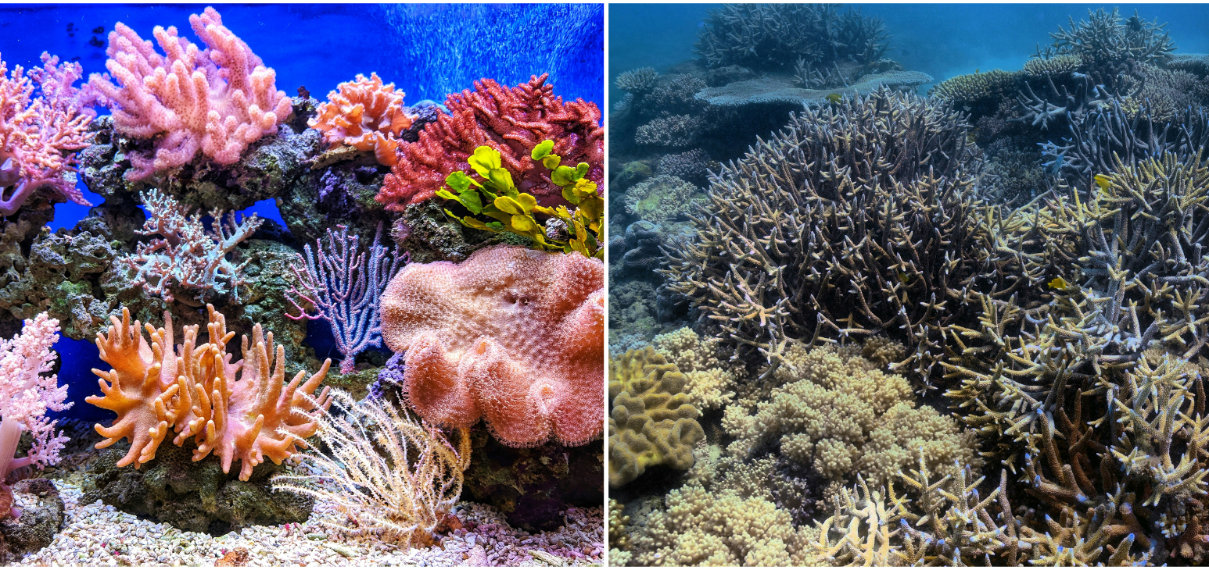
What would +1.5°C (or +2.7°F) of warming mean?
Increase of 3 – 5°C (5.4 – 9.4°F) in extreme temperatures in some regions.¹
800+ million more people exposed to dengue.²
Compared to a world without climate change
Most of Alexandria (Egypt) and Miami (USA) below high tide level after several centuries.³
70% of coral reefs bleached.⁴
See the impacts of your scenario in the Impacts graph section of En-ROADS.
Notes:
Script:
By limiting warming to 1.5ºC, you have achieved our collective goal! This is no small feat and something we should all be proud of.
Congratulations!!! We have arrived at a set of policies that will avert the worst impacts of climate change, especially for the world’s most vulnerable.
While there are still impacts that we will need to adapt to, look at how significantly the impacts were reduced compared to a 4ºC scenario of warming:
[Review bullets on the slide]
More information:
Increase in temperature extremes: The overall message is that there is no single 1.5-degree world; many regions will experience much greater warming than 1.5 degrees.
Coral bleaching: Many societies depend on coral reefs for fisheries and tourism. Reefs protect the shoreline from storm surge and erosion, among other benefits.
Updated:
March 2026
Sources:
1. General circulation model (GCM) emulator developed by Bringing Computation to the Climate Challenge (BC3), a project of the MIT Climate Grand Challenges program.
2. En-ROADS modeling based on Colón-González, F. J., et al. (2021). Projecting the risk of mosquito-borne diseases in a warmer and more populated world: a multi-model, multi-scenario intercomparison modelling study. The Lancet Planetary Health, 5(7), e404-e414.
3. En-ROADS modeling based on Strauss, B. H., et al. (2021). Unprecedented threats to cities from multi-century sea level rise. Environmental Research Letters, 16(11), 114015, via Climate Central's Coastal Risk Screening Tool.
4. Schleussner, C.-F., et al. (2016). Differential climate impacts for policy-relevant limits to global warming: the case of 1.5 °C and 2 °C. Earth System Dynamics, 7(2), 327–351.
Photos:
Thermometer, mosquito, and flooding images from Pixabay. Coral reef photos by Stefano Borghi and q u i n g u y e n from Unsplash.

Slide 20
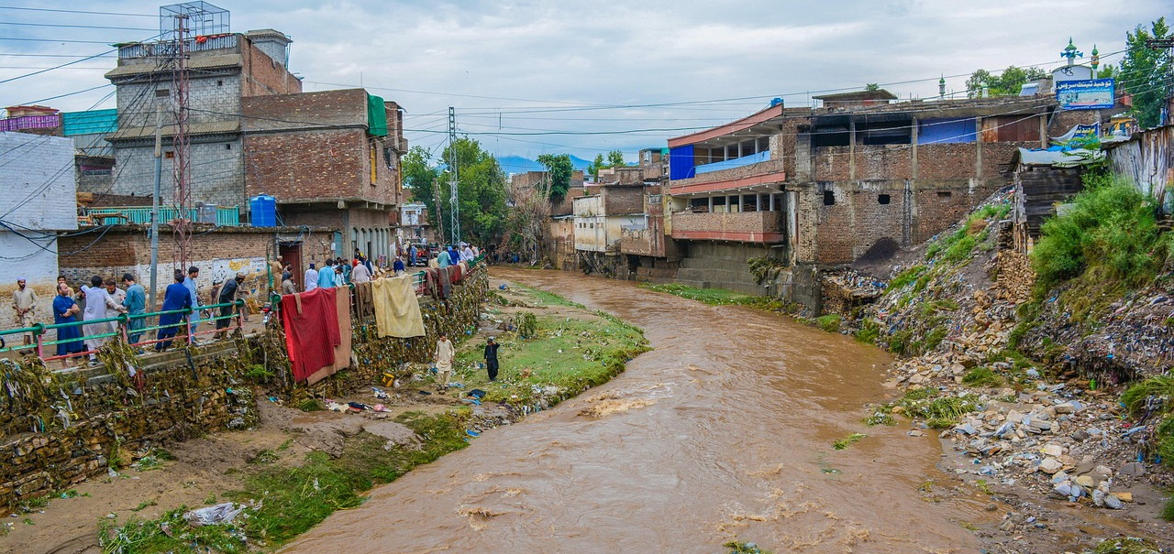

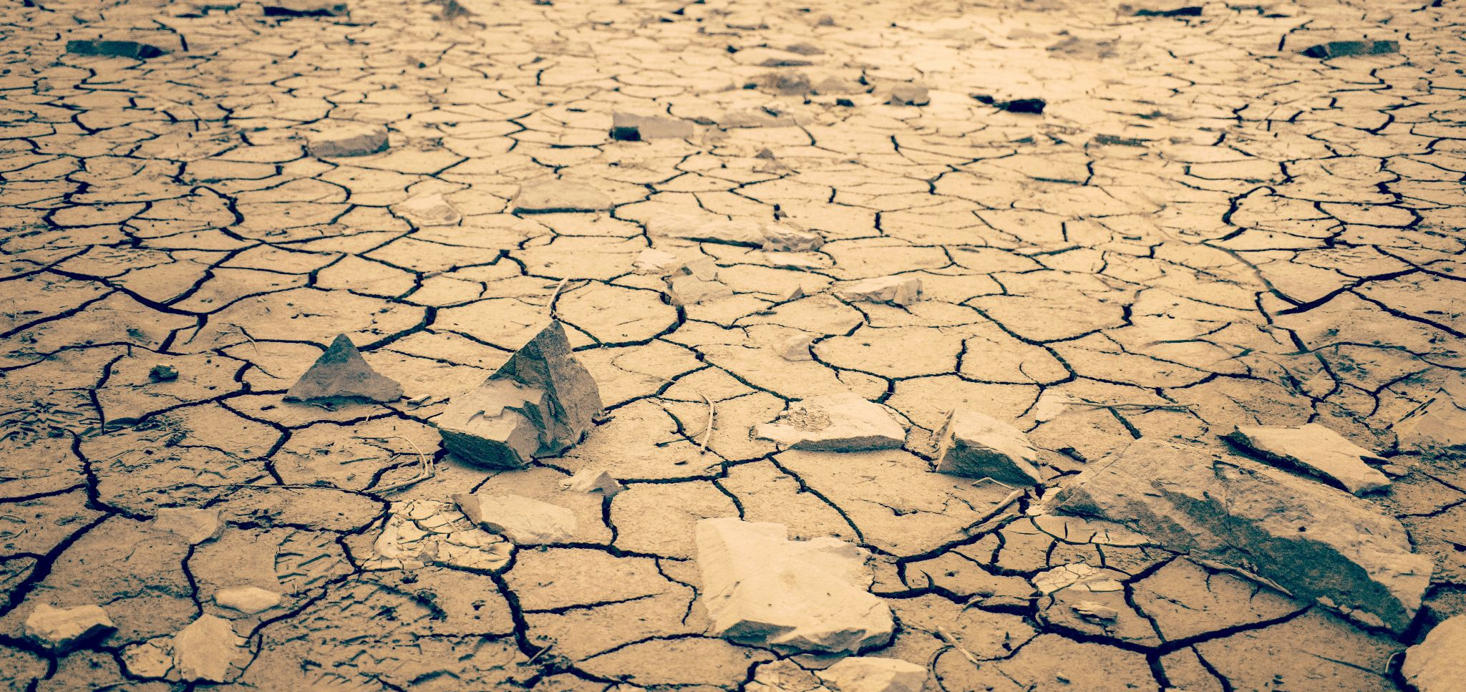
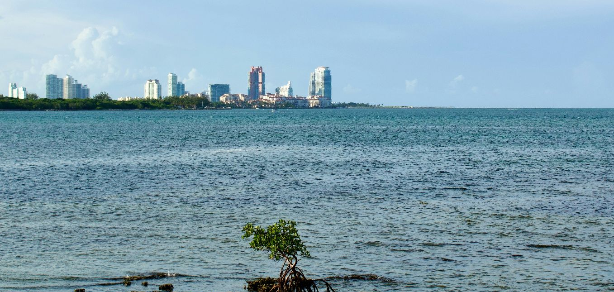
What would +2°C (or +3.6°F) of warming mean?
40+ million more people at risk of river flooding.¹
Compared to today
An additional week above 32°C (90°F) each year in Mumbai, India.²
Compared to today
An area about the size of Mongolia becomes arid.³
Compared to today
Sea levels rise by half a meter (1.5 feet) over the next 75 years, and continue to rise beyond 2100.⁴
See the impacts of your scenario in the Impacts graph section of En-ROADS.
Notes:
Script:
By limiting warming to 2ºC, you have come very close to our stated goal and should be very proud of the progress you have made! While there are still some serious impacts that the world will need to adapt to and prepare for, the impacts are FAR less severe than we would have seen under a baseline scenario.
Let’s take a look at the impacts we would expect to see in a 2ºC world:
[Read bullets on the slide]
More information:
Arid land expansion: Arid lands are those in which moisture conditions are insufficient to support abundant plant cover and are often associated with increased desertification. Increased aridity can change an area's capacity to supply ecosystem services or host biodiversity.
Updated:
March 2026
Sources:
1. En-ROADS modeling based on Alfieri, L., et al. (2017). Global projections of river flood risk in a warmer world. Earth's Future, 5(2), 171-182 and Dottori, F., et al. (2018). Increased human and economic losses from river flooding with anthropogenic warming. Nature Climate Change, 8(9), 781-786. See the En-ROADS Technical Reference for more details.
2. “Days above 32°C (90°F)” map from Probable Futures, which sources data from the CORDEX-CORE regional climate modeling framework.
3. En-ROADS modeling based on Huang, J., et al. (2016). Accelerated dryland expansion under climate change. Nature Climate Change, 6(2), 166–171.
4. En-ROADS modeling based on Vermeer and Rahmstorf (2009) and calibrated to Dangendorf, S., et al. (2019) and Beckley et al. (2021). See the En-ROADS Technical Reference for more details.
Photos:
Flood and temperature photos from Pixabay. Desert photo by Joshua Woroniecki and sea level photo by Faith Crabtree from Unsplash.

Slide 21
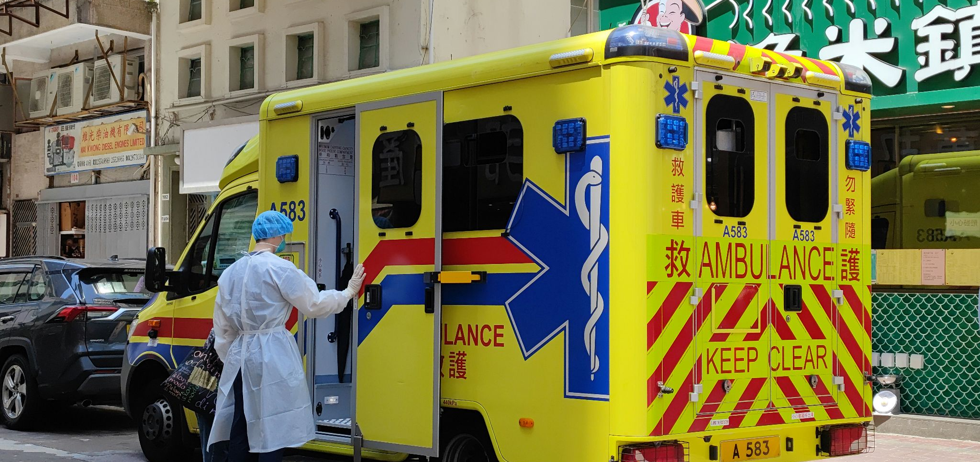
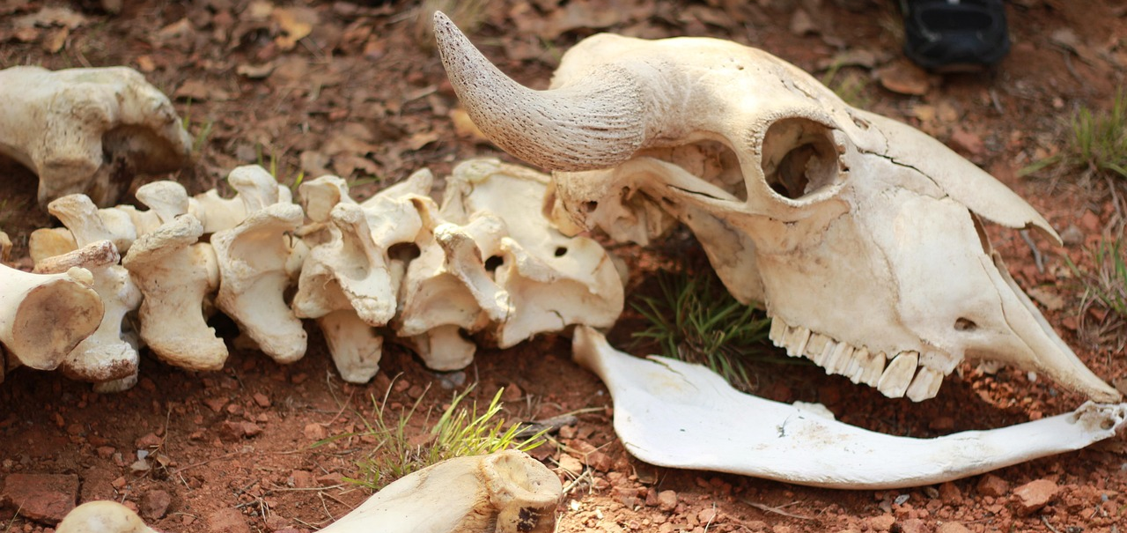
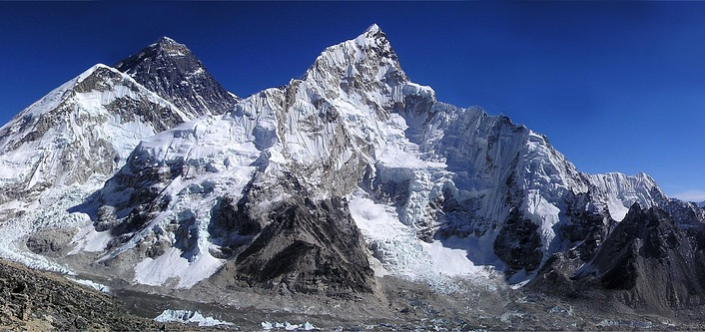
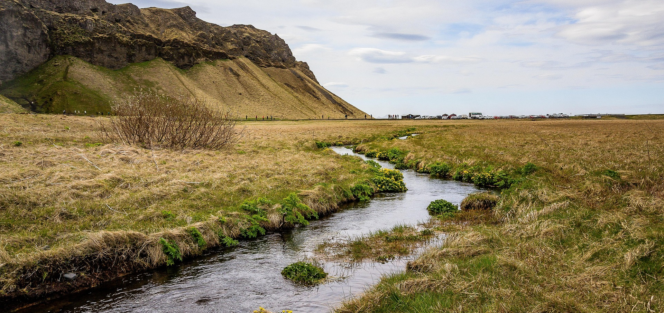
What would +4°C (or +7.3°F) of warming mean?
Five times more deaths from extreme heat.¹
Compared to today
One in six species could go extinct.²
More than two thirds of glaciers in the Himalaya Mountains melted.³
An area 3x the size of Europe undergoes ecosystem shifts.⁴
Compared to today
See the impacts of your scenario in the Impacts graph section of En-ROADS.
Notes:
Script:
If we do not take to reduce our fossil fuel use, we could see severe impacts by the end of the century. For example…
More information:
Glaciers: The Hindu Kush Himalaya mountains provide water for two billion people. Water from Himalayan glaciers accounts for a significant part of the water in major rivers, including the Indus and Ganges. Estimates for the contribution of glacial melt to the Indus, for example, range from 21% to 80% based on different studies.³
Updated:
March 2026
Sources:
1. Relationship between the percentage change in excess deaths and temperature is from: Vicedo-Cabrera, A. M., et al. (2018). Temperature-related mortality impacts under and beyond Paris Agreement climate change scenarios. Climatic Change, 150(3-4), 391–402. Population and crude death rates from World Bank Open Data (accessed 2025).
2. Urban, M. (2015). Accelerating extinction risk from climate change. Science, 348(6234), 571-573.
3. Wester, P., Mishra, A., Mukherji, A., Shrestha, A. B. (eds). (2019). The Hindu Kush Himalaya Assessment—Mountains, Climate Change, Sustainability and People. Springer Nature Switzerland AG.
4. En-ROADS modeling based on Warszawski, L., et al. (2013). A multi-model analysis of risk of ecosystem shifts under climate change. Environmental Research Letters, 8(4), 044018.
Photos:
Emergency photo by Cheung Yin from Unsplash. Skeleton, mountain, and stream photos from Pixabay.

Slide 22
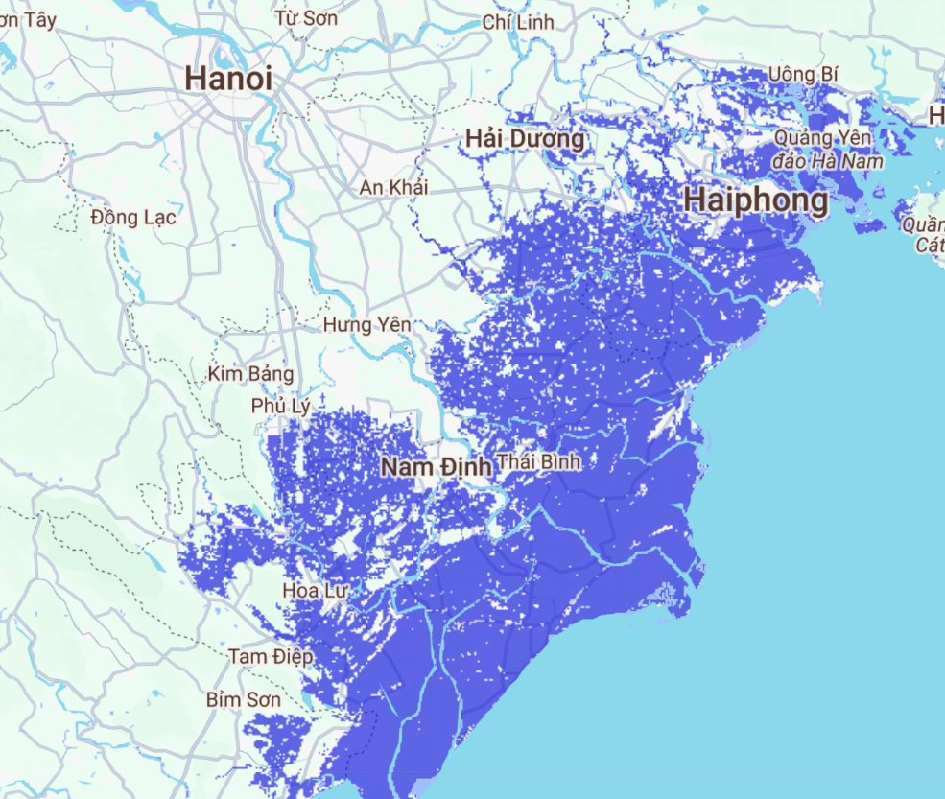
Flood risk from sea level rise
In Hanoi, Vietnam, 3.3°C in 2100
Notes:
Note: The sea level rise flood risk shown here is a projection of sea level rise by 2100. The sooner we cut carbon emissions, the lower the eventual sea level rise. Use the Sea Level Rise—Flood Risk Map in En-ROADS under “Impacts” in the Graphs menu to search for a location and see the effect of lowering temperature in your scenario.
Source: En-ROADS in collaboration with Climate Central using the Climate Central Coastal Risk Screening Tool https://coastal.climatecentral.org/

Slide 23
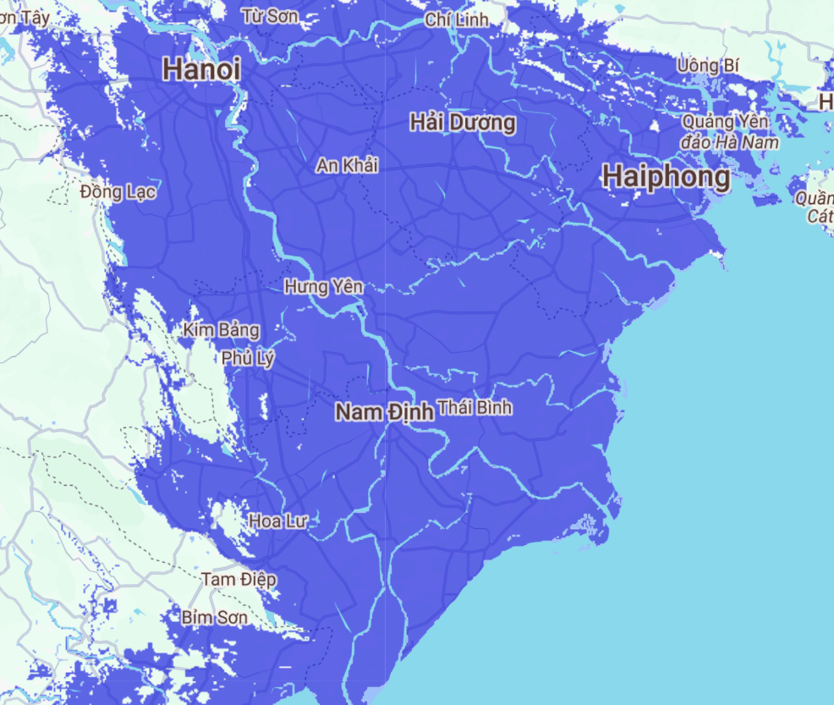
Flood risk from sea level rise
In Hanoi, Vietnam, 3.3°C over the next few centuries
Use En-ROADS to create a scenario that lowers this sea level rise. View the map under “Impacts” in the Graphs.
Notes:
Note: The sea level rise flood risk shown here is a projection of long-term (over centuries) sea level rise due to sea levels locked in by different amounts of carbon pollution. This is “committed” sea level rise – it will continue even if carbon emissions are cut. The sooner we cut carbon emissions, the lower the eventual sea level rise. Use the Sea Level Rise—Flood Risk Map in En-ROADS under “Impacts” in the Graphs menu to search for a location and see the effect of lowering temperature in your scenario.
Source: En-ROADS in collaboration with Climate Central using the Climate Central Coastal Risk Screening Tool https://coastal.climatecentral.org/

Slide 24
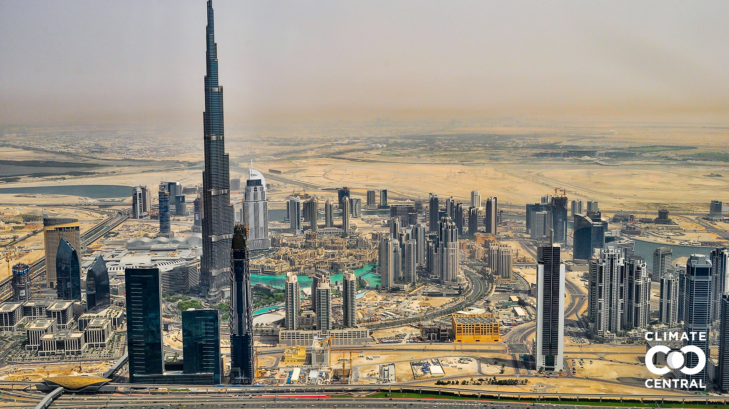
Dubai today
Notes:
Script: Here is what Burj Khalifa (the tallest skyscraper in the world) in Dubai, United Arab Emirates looks like today…
Source:
Climate Central. (2021). Picturing Our Future. https://picturing.climatecentral.org/
Strauss, B. H., et al. (2021). Unprecedented threats to cities from multi-century sea level rise. Environmental Research Letters, 16, 114015. https://doi.org/10.1088/1748-9326/ac2e6b

Slide 25
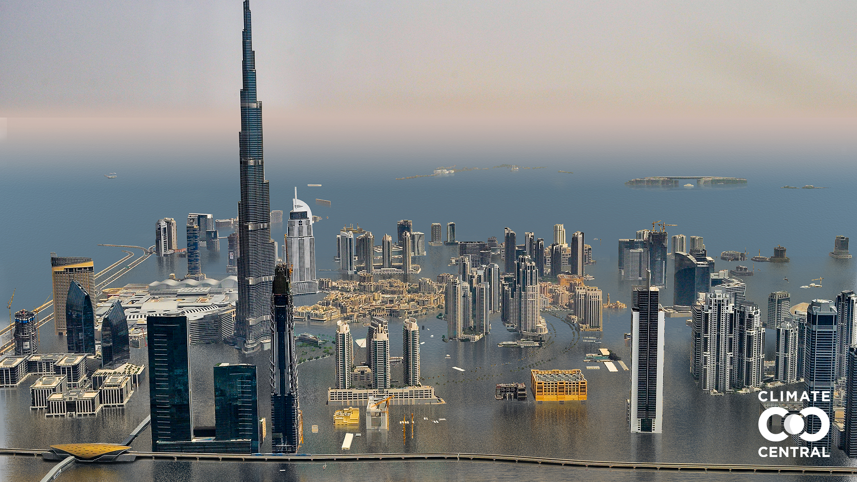
…and with 3°C of warming
Dubai today
Source: Climate Central
Notes:
…and with long-term sea level rise due to 3°C of warming.
Source:
Climate Central. (2021). Picturing Our Future. https://picturing.climatecentral.org/
Strauss, B. H., et al. (2021). Unprecedented threats to cities from multi-century sea level rise. Environmental Research Letters, 16, 114015. https://doi.org/10.1088/1748-9326/ac2e6b

Slide 26
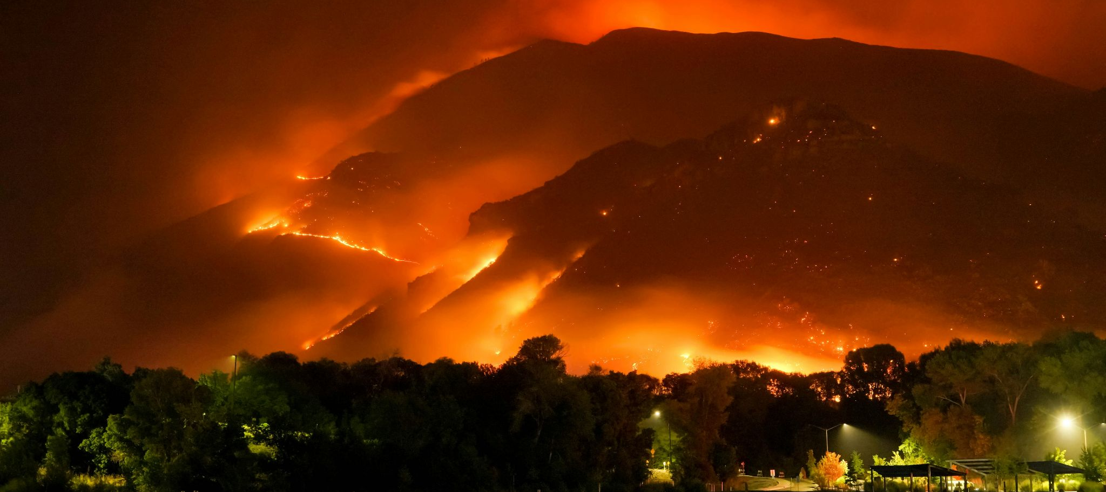
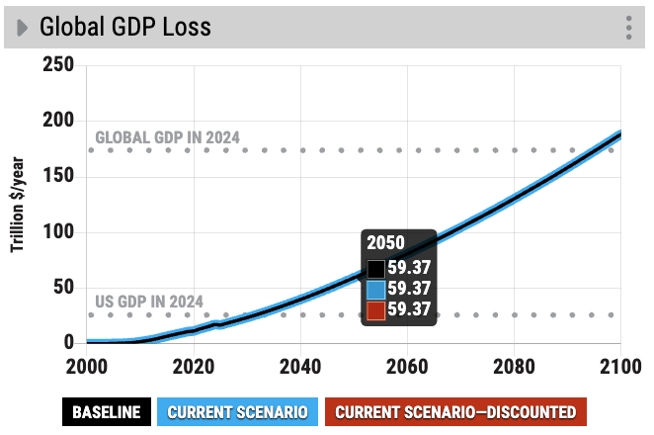
Economic losses from disaster events in 2024 reached USD 318 billion. Damages associated with global warming could exceed USD 59 trillion of Global GDP Loss by the time we reach 2°C (in 2050, En-ROADS Baseline).
Notes:
Source:
https://www.swissre.com/institute/research/sigma-research/sigma-2025-01-natural-catastrophes-trend.html
Photo from Mike Newbry via Unsplash

Slide 27
Scenarios of Climate Success

Slide 28
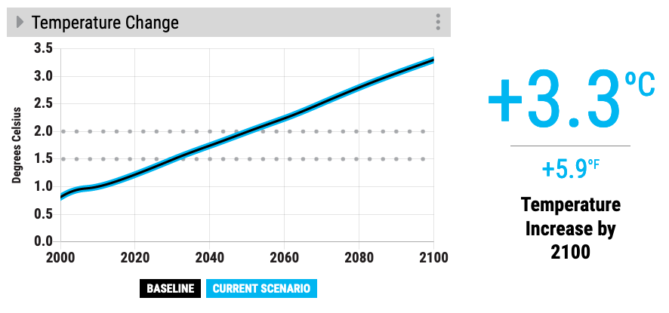
En-ROADS Baseline Scenario
Our climate goals (1.5ºC to 2ºC)
Notes:
Script: If we continue business as usual, we estimate that temperature change will reach 3.3 degrees Celsius by 2100. That’s 5.9 degrees Fahrenheit. Compare the bold line to the dotted lines where our climate goals (2 degrees C and 1.5 degrees C) are on the graph.
Updated: May 2023

Slide 29
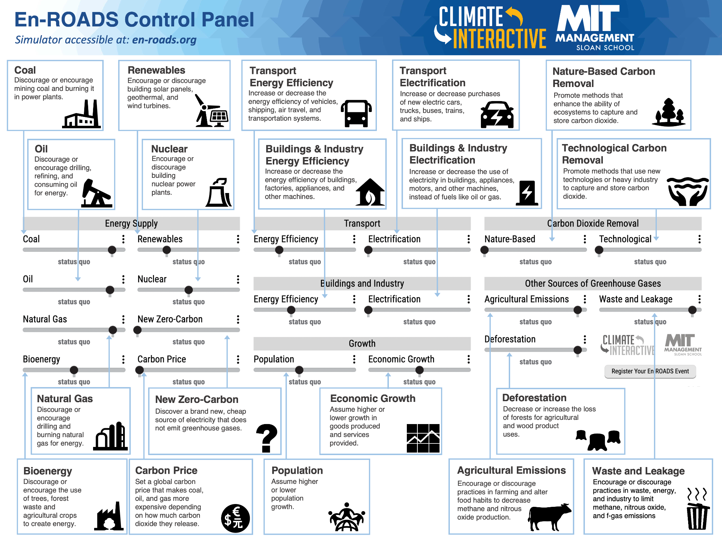
Notes:
Note – Use the En-ROADS control panel guide to help orient participants to their decision variables. Use this to also briefly orient people to the actual En-ROADS simulator, and show how this Guide relates to the En-ROADS simulator.

Slide 30
Build a scenario in En-ROADS
Note for the facilitator
Use participants’ inputs to build a shared scenario in En-ROADS (showing what would happen if the action was implemented globally). For each action (comprehensively for the first one):
Restate the action and where it appears in En-ROADS
Before moving the slider, ask participants to mentally simulate the impact
Input the action into En-ROADS
Show the graph with the most direct impact and replay the action, directing participants’ attention to where to look
Explain model behavior, and guide discussions about co-benefits and equity considerations
Summarize
Repeat these steps, adding other proposed actions.

Slide 31

What actions have you or your organization done in the last five years to help mitigate climate change?
Notes:
Note – Use this or other question as a hook to gather participants inputs. You can ask them to vote, in person, or use a polling software if online.

Slide 32
Consider a co-benefit from your proposal. How can you address more than one problem with one action?
Notes:
Note – As you ask participants for input, ask them these questions to consider in their proposed actions.
You don’t need to show this slide, but you can ask them directly.

Slide 33
What are the equity considerations related to this policy? In what ways could implementation of this policy harm communities?
Notes:
Note – As you ask participants for input, ask them these questions to consider in their proposed actions.
You don’t need to show this slide, but you can ask them directly.

Slide 34
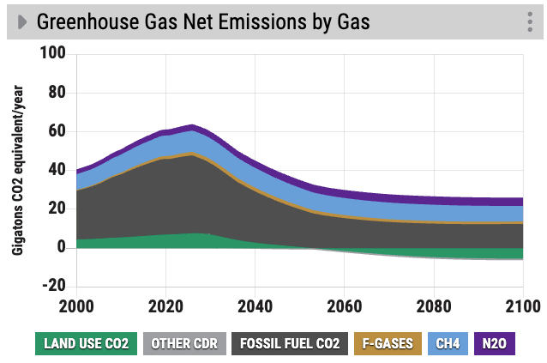
Wrapping up your Scenario
Note for the facilitator
Even after testing all the solutions suggested by participants, the scenario may fall short of our climate goals. If you have time, either as a full group or in small breakouts, discuss what additional actions would be needed to limit warming to well below 2°C, or even 1.5°C.
A helpful graph to explore this gap is “Greenhouse Gas Net Emissions by Gas.” For example, this scenario reduces fossil fuel use significantly, but includes limited action on other gases (methane, nitrous oxide, and fluorinated gases). As a result, later in the century these gases account for roughly half of remaining emissions, highlighting the need for broader mitigation strategies.

Slide 35
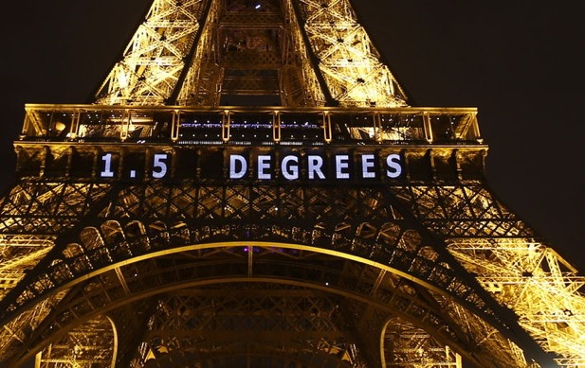
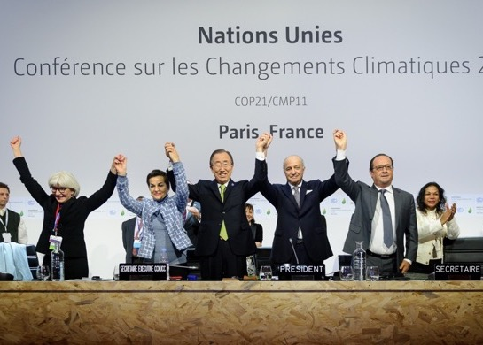
What else would it take to limit warming to less than 2°C or 1.5°C?
Reaching the Paris Agreement goals
Notes:
Image sources:
https://www.npr.org/sections/thetwo-way/2015/12/12/459502597/2-degrees-100-billion-the-world-climate-agreement-by-the-numbers
https://www.nature.com/articles/d41586-020-00834-7

Slide 36
Debrief

Slide 37
Reflection and discussions
Take 1 minute of silence…
What would you love about being part of a world on track to making this scenario happen?

Slide 38
Debriefing Discussion
How are you feeling?
What surprised you?
What were your key insights?
What will you take away from today, and how can you apply what you learned to the real world?
What are you going to do next?
Notes:
Note – These are some basic guiding questions to lead the debriefing discussion. You may choose your own and follow up with more detailed questions. We provide some options for additional discussion questions in the Facilitator’s Guide.

Slide 39
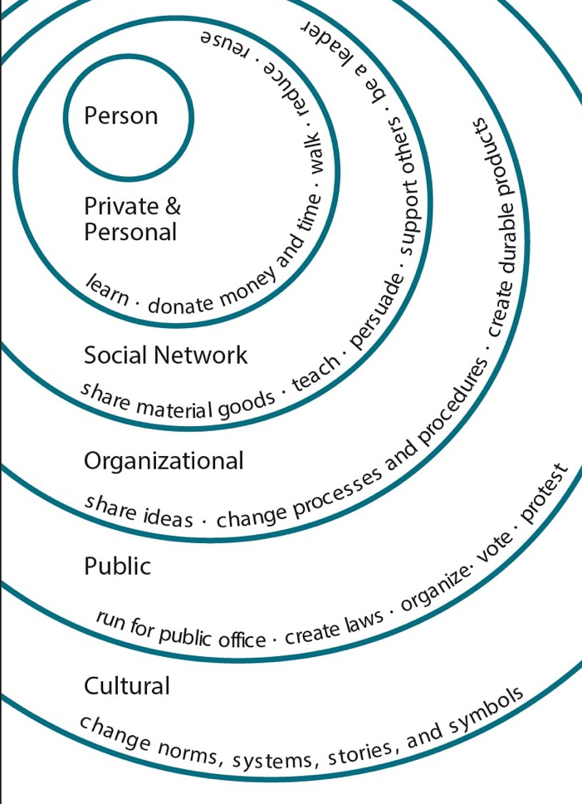
What can you do?
Illustration by Elise Amel
Notes:
Source: https://www.theguardian.com/environment/climate-consensus-97-per-cent/2017/may/19/study-inspiring-action-on-climate-change-is-more-complex-than-you-might-think

Slide 40
Looking Ahead
We have the tools
Solar and wind are growing and getting cheaper
Corporations are investing in clean tech
Countries and states are stepping up
The general public is becoming more educated and engaged

Slide 41
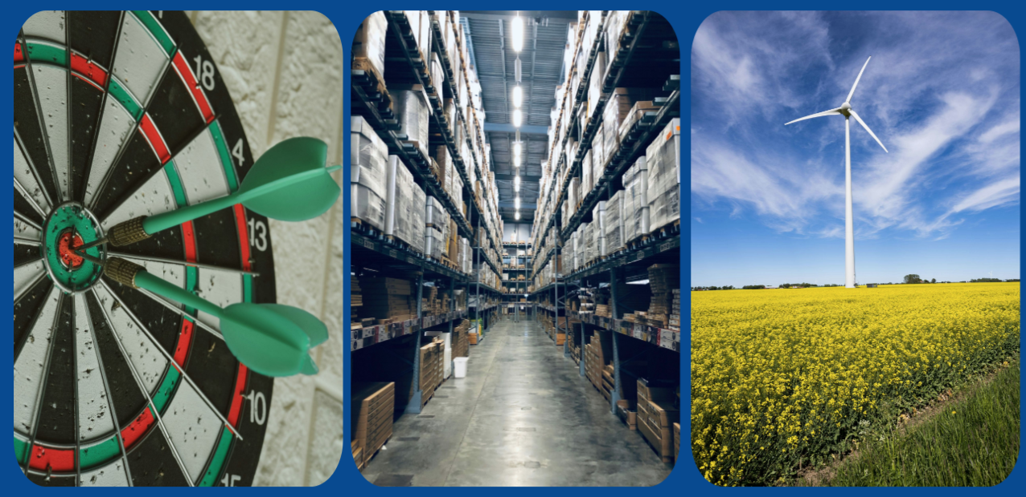

Large companies are taking action
Over 8,200 companies have their science-based climate targets validated
Large companies and investors continue to ask their suppliers and portfolio companies to report emissions and assess climate risks
Over 400 global companies have made a commitment to procure 100% renewable energy
Notes:
Sources:
https://sciencebasedtargets.org/reports/sbti-trend-tracker-2025
https://www.there100.org/re100-members
Updated: October 2025
Photos by Afif Ramdhasuma, Ruchindra Gunasekara, and Robert Gramner from Unsplash

Slide 42
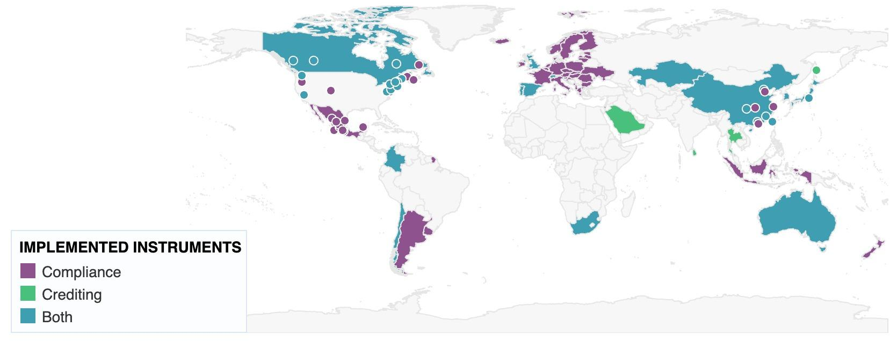
Carbon prices are being enacted around the world
113
28%
CARBON PRICING INSTRUMENTS IMPLEMENTED
in National or Subnational jurisdictions
OF GLOBAL GHG EMISSIONS
are covered by Carbon Pricing Instruments
As of August 2025
Notes:
Sources:
World Bank. (August 2025). State and Trends of Carbon Pricing Dashboard.
Updated:
August 2025

Slide 43
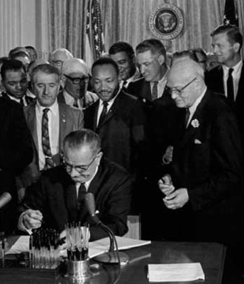

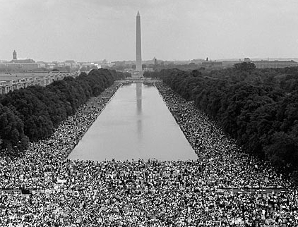
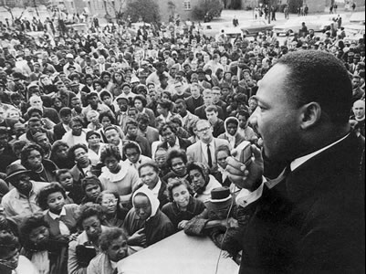
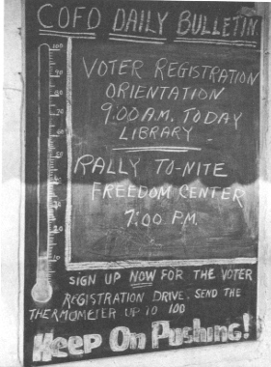
“The world as we have created it is a process of our thinking. It cannot be changed without changing our thinking.”
- Albert Einstein
“Never doubt that a small group of thoughtful, committed citizens can change the world. Indeed, it is the only thing that ever has.” - Margaret Mead

Slide 44
Thank You!
Visit: climateinteractive.org

Slide 45
Appendix

Slide 46
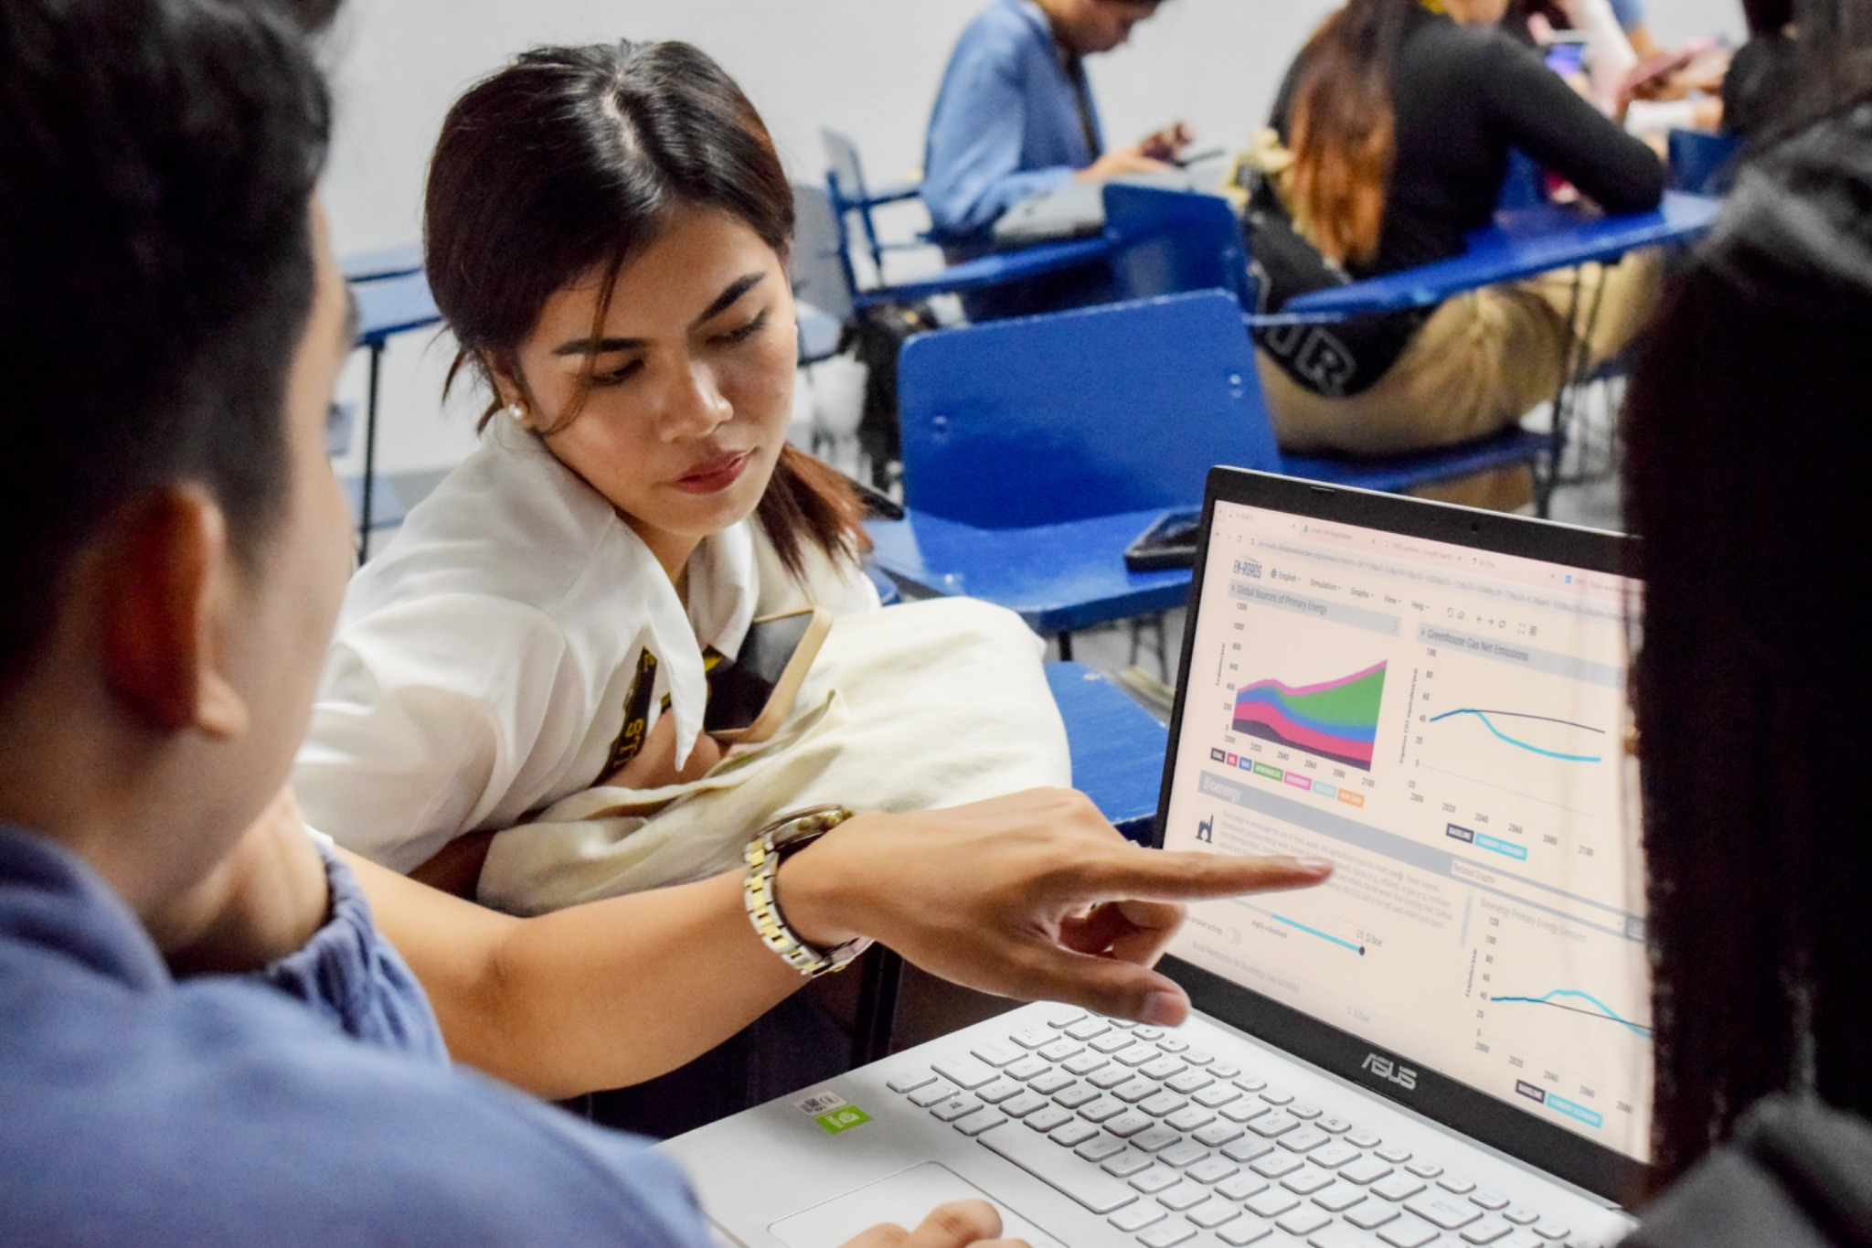
The En-ROADS Training Program
TRAINING
Join this free, self-paced online course to…
Learn more about the En-ROADS simulator.
Facilitate engaging events to spark climate action – both online and in-person.
Gain valuable insights on systems thinking, Multisolving, and advanced facilitation tips.
Begin your journey as an En-ROADS Climate Ambassador.
Register at: learn.climateinteractive.org

Slide 47

The En-ROADS Climate Ambassador Program
950+ En-ROADS Climate Ambassadors
92+ Countries
50+ Languages
A unique leadership opportunity to become a climate leader in your field, for those who complete the En-ROADS training.
From all walks of life: professors, business leaders, entrepreneurs, artists, activists, engineers, scientists, students, lawyers, & beyond
Metrics as of January 31, 2026
Notes:
Updated July 2025

Slide 48
Big Picture Insights
A combination of solutions is needed to address climate change: “It takes more than one seed to plant a garden.”
Keeping climate change to well below 2°C, and limiting it to 1.5°C, is possible. We can still avoid the worst-case scenarios — it is still physically and technologically possible.
All successful scenarios significantly cut burning of coal, oil, and gas in the next 10-20 years.
There are many lower-leverage actions that help address climate change globally but which are not as high of a priority as reducing fossil fuel use.
There are many opportunities to increase equity as we take these actions.

Slide 49
Big Picture Insights
A combination of solutions is needed to address climate change: “It takes more than one seed to plant a garden.”
Keeping climate change to well below 2°C, and limiting it to 1.5°C, is possible. We can still avoid the worst-case scenarios — it is still physically and technologically possible.
All successful scenarios significantly cut burning of coal, oil, and gas in the next 10-20 years.
There are many lower-leverage actions that help address climate change globally but which are not as high of a priority as reducing fossil fuel use.
There are many opportunities to increase equity as we take these actions.

Slide 50
More Insights from En-ROADS
The transition from high-carbon to low-carbon energy takes decades due to the long lifetime of fossil fuel capital infrastructure.
A new zero-carbon energy source takes too long to scale up to contribute much on its own.
Even when low-carbon energy sources are encouraged, we still burn fossil fuels unless they are actively discouraged.
Reducing other greenhouse gas emissions—methane, N₂O, F-gases—reduces temperature quite a bit.
A carbon price is high leverage because it changes the fuel mix and reduces energy demand.
New technologies grow via reinforcing “learning” feedback loops.
In a scenario in which many actions that limit fossil fuel demand have already been taken, more nuclear, or new zero-carbon energy, or renewables just displaces the other low-carbon sources (a dynamic known as “crowding out”).
Afforestation is lower leverage than many expect, because its carbon removal potential is delayed and much smaller than the greenhouse gas emissions that come from burning fossil fuels.

Slide 51
System Dynamics in En-ROADS
Capital Stock Turnover: Changes to infrastructure take time.
Price-Demand Feedback: Price, demand, and supply are linked.
Crowding Out: Low-carbon supplies compete for long-term market share.
Squeezing the Balloon: If one energy source is limited, another will grow via a compensating feedback.
Economies of Scale and Learning: Increasing capacity drives down costs.
Economic Damage from Climate Change: Climate change reduces GDP growth and energy consumption, balancing climate change impacts.
Drivers of Growth: Population and GDP growth drive emissions.
Bathtub Dynamics: CO₂ emissions must be lower than removals for CO₂ concentration and temperature to stop rising.
Learn more in the En-ROADS User Guide

Slide 52
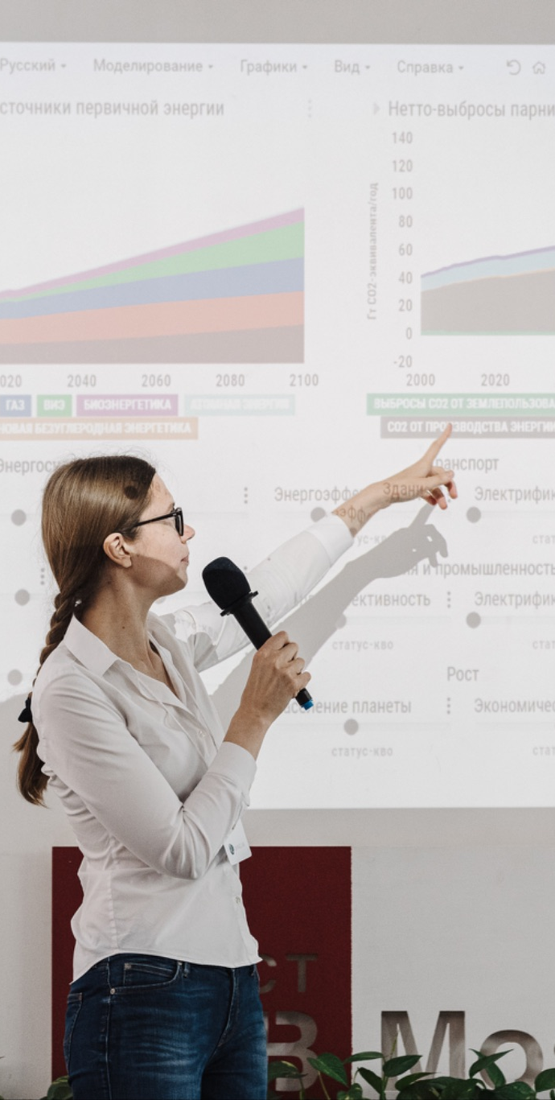




Features of En-ROADS
Transparent. All equations and structure are available in the Reference Guide.
Flexible. Assumptions are adjustable.
Globally aggregated to be fast. Designed to complement, not replace, other Integrated Assessment Models used by the IPCC.
Supports learning and strategy discussions, grounded in real data and science. However, not intended to make predictions, as the future is dependent on behavioral variables.

Slide 53
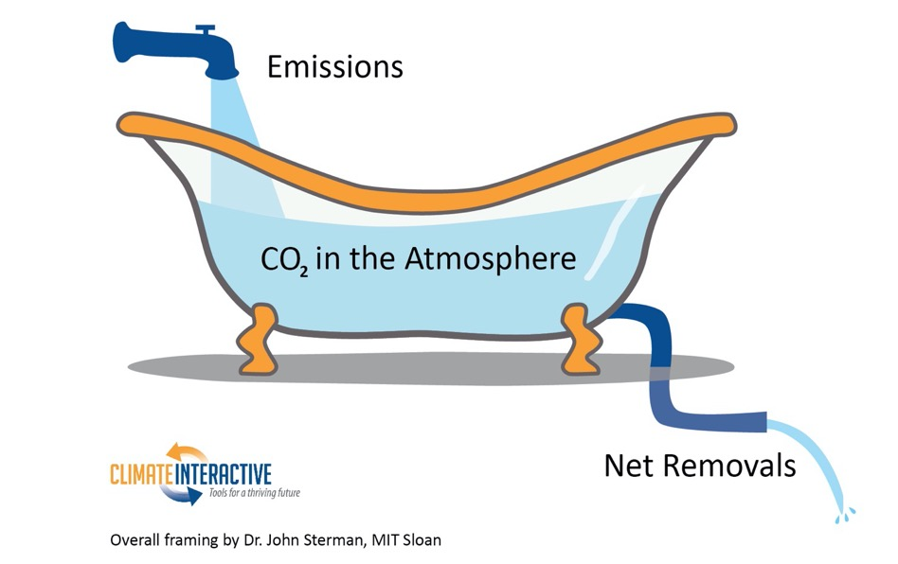
Bathtub Dynamics

Slide 54
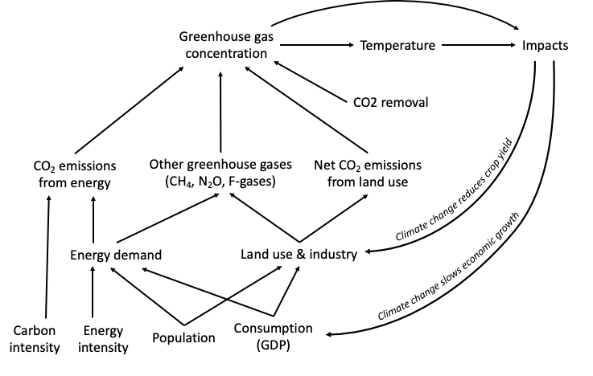
En-ROADS Core Structure
See the full model structure in the En-ROADS Reference Guide at: climateinteractive.org/en-roads-reference-guide

Slide 55
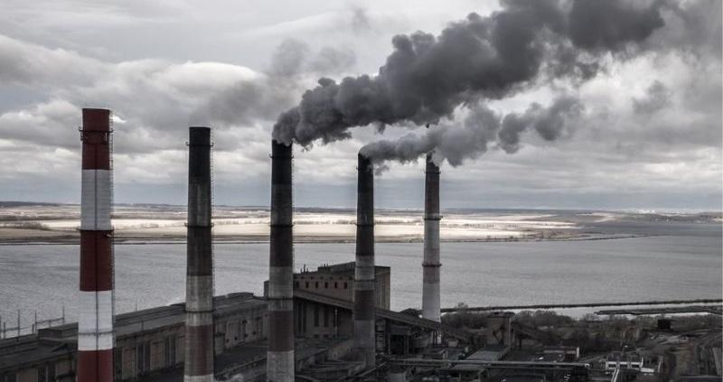
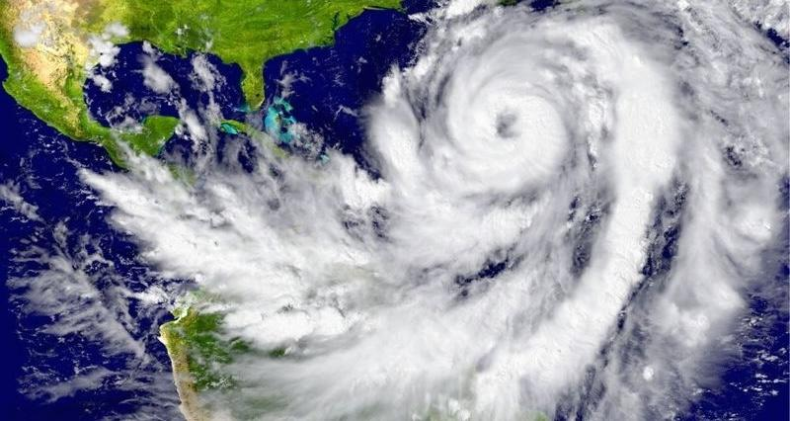
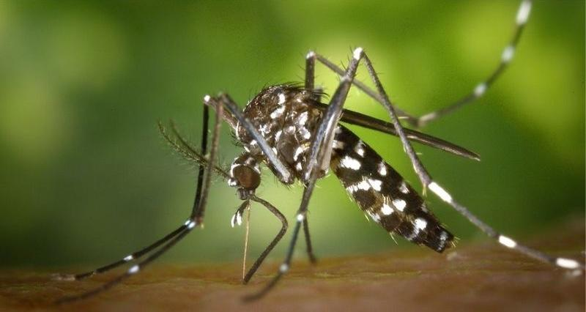
Limiting warming to 2°C in 2100 through a combination of actions would:
Climate action is health action
Save 1,449,000 lives from extreme heat
Reduce air pollution by 26.3 megatons of PM2.5
Save 69 million people from hurricanes
Limit dengue exposure to a population of 241 million people
Read more and explore the climate and health impacts in En-ROADS to create your own scenario.

