Slide 1




Climate Action Simulation
Notes:
Dear Facilitator, these slides can support your facilitation of the Climate Action Simulation roleplaying game, which complements the En-ROADS simulation model. You may pick and choose from these slides and adjust them to suit your audience and setting.
These slides were last updated in March 2026.
Script: Welcome everyone! I am [introduce yourself] and I’ll be facilitating the Climate Action Simulation today. This game was developed by Climate Interactive, MIT Sloan, and the UMass Lowell Climate Change Initiative.

Slide 2
How to use these slides
Note for the facilitator
These slides support the Climate Action Simulation game, powered by the interactive En-ROADS Climate Solutions Simulator—developed by Climate Interactive and MIT Sloan (www.en-roads.org).
Use what works: You don’t need to use every slide. Select and adapt the ones that best suit your audience’s background and context.
Credits: These materials were developed by Climate Interactive, MIT Sloan, and the UMass Lowell Climate Change Initiative. They’re freely available under a Creative Commons license. See the guidelines for giving proper credit.
Facilitator required: This game should be led by a trained facilitator. If you’re new, complete the training at learn.climateinteractive.org/ and read the Facilitator Guide.
Red slides = facilitator only: Slides with a red background are for facilitator guidance—don’t share them with participants. The speaker notes at the bottom of the screen give detailed instructions for each slide.

Slide 3
Roles in the game
Note for the facilitator
Facilitator roles: The game is most effective with two facilitators (three for online sessions), but it can also be managed by a single person. Roles can be shared or rotated:
Yourself — You, as a facilitator, guiding the game’s opening and debriefing.
UN Secretary General — Role-played by a facilitator, to welcome participants to the UN Summit and moderate negotiations.
Science Advisor — An experienced En-ROADS facilitator who can implement the actions in En-ROADS and explain the dynamics after each slider move.
Technical Support — You or a co-facilitator helping with game logistics, especially if online.

Slide 4
Roles in the game
Note for the facilitator
Participant roles: This game can be played with 6 or 8 teams, depending on the number of participants. This deck includes slides for all 8 teams, but show only the slides relevant to your chosen configuration.
6-team version:
Clean Tech
Climate Justice Hawks
Conventional Energy
Industry and Commerce
Land, Agriculture, and Forestry
World Governments
8-team version:
Clean Tech
Climate Justice Hawks
Conventional Energy
Industry and Commerce
Land, Agriculture, and Forestry
Developed Nations
Developing Nations
Emerging Nations
Note: depending on your audience and how much time you have, you can opt to add one or both additional teams: Health Advocates and Banking and Finance
Explore all game materials at https://www.climateinteractive.org/climate-action-simulation/cas-materials/

Slide 5
Today’s facilitator
Your Name
Your title and affiliation
Your contact information
Notes:
Use this template to introduce yourself as a facilitator. Here are some guidelines:
You may customize this slide to include your own logo, a headshot, or a picture of yourself facilitating an event.
You may use the En-ROADS logo to promote your events or describe your role as an En-ROADS Climate Ambassador.
Do not use the Climate Interactive or MIT logos for general promotion unless you are directly referencing the creation of En-ROADS or its official materials. These logos are reserved for official use by the organizations and should not be used in broader promotional or marketing contexts. For more information, please see the Outline of Expectations for En-ROADS Climate Ambassadors.
You’re welcome to refer to yourself as an En-ROADS facilitator if you are actively using the simulator with audiences—or as an En-ROADS Climate Ambassador if you’ve been accepted into the Ambassador program and received a certificate. Please avoid implying official employment or endorsement by Climate Interactive or MIT. For more information, please see the Outline of Expectations for En-ROADS Climate Ambassadors.

Slide 6
Agenda
Introduction to the game and instructions
Playing the game
Welcome to the Summit
Plenary rounds
Debrief

Slide 7
Introduction to the game

Slide 8



A group roleplaying game to explore solutions for mitigating climate change
What is the Climate Action Simulation?
Real Data
Computer Simulator
Mock UN Summit
Notes:
Script: “Today you will experience the Climate Action Simulation, which is an interactive group roleplaying game that helps you learn about the solutions for mitigating climate change. You will engage with:
the latest research on climate science and solutions
brought together into one powerful and dynamic computer simulator model called En-ROADS, abbreviated for “Energy Rapid Overview and Decision Support”
and you will be roleplaying a mock United Nations climate summit”

Slide 9
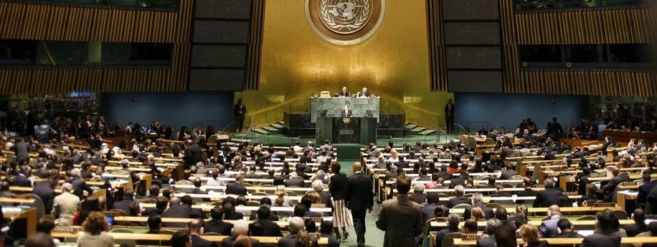
“Global leaders” from sectors across business, government, and civil society gather to negotiate a climate solutions plan to limit global warming to less than 2ºC and ideally 1.5ºC above pre-industrial levels.
How the Climate Action Simulation game works…
Notes:
Script: “You will all act as global leaders from different sectors across business, government, and civil society. Our goal will be to negotiate a climate solutions plan to limit global warming to less than 2°C (3.6°F) and ideally 1.5°C (2.7°F) above pre-industrial levels.”

Slide 10
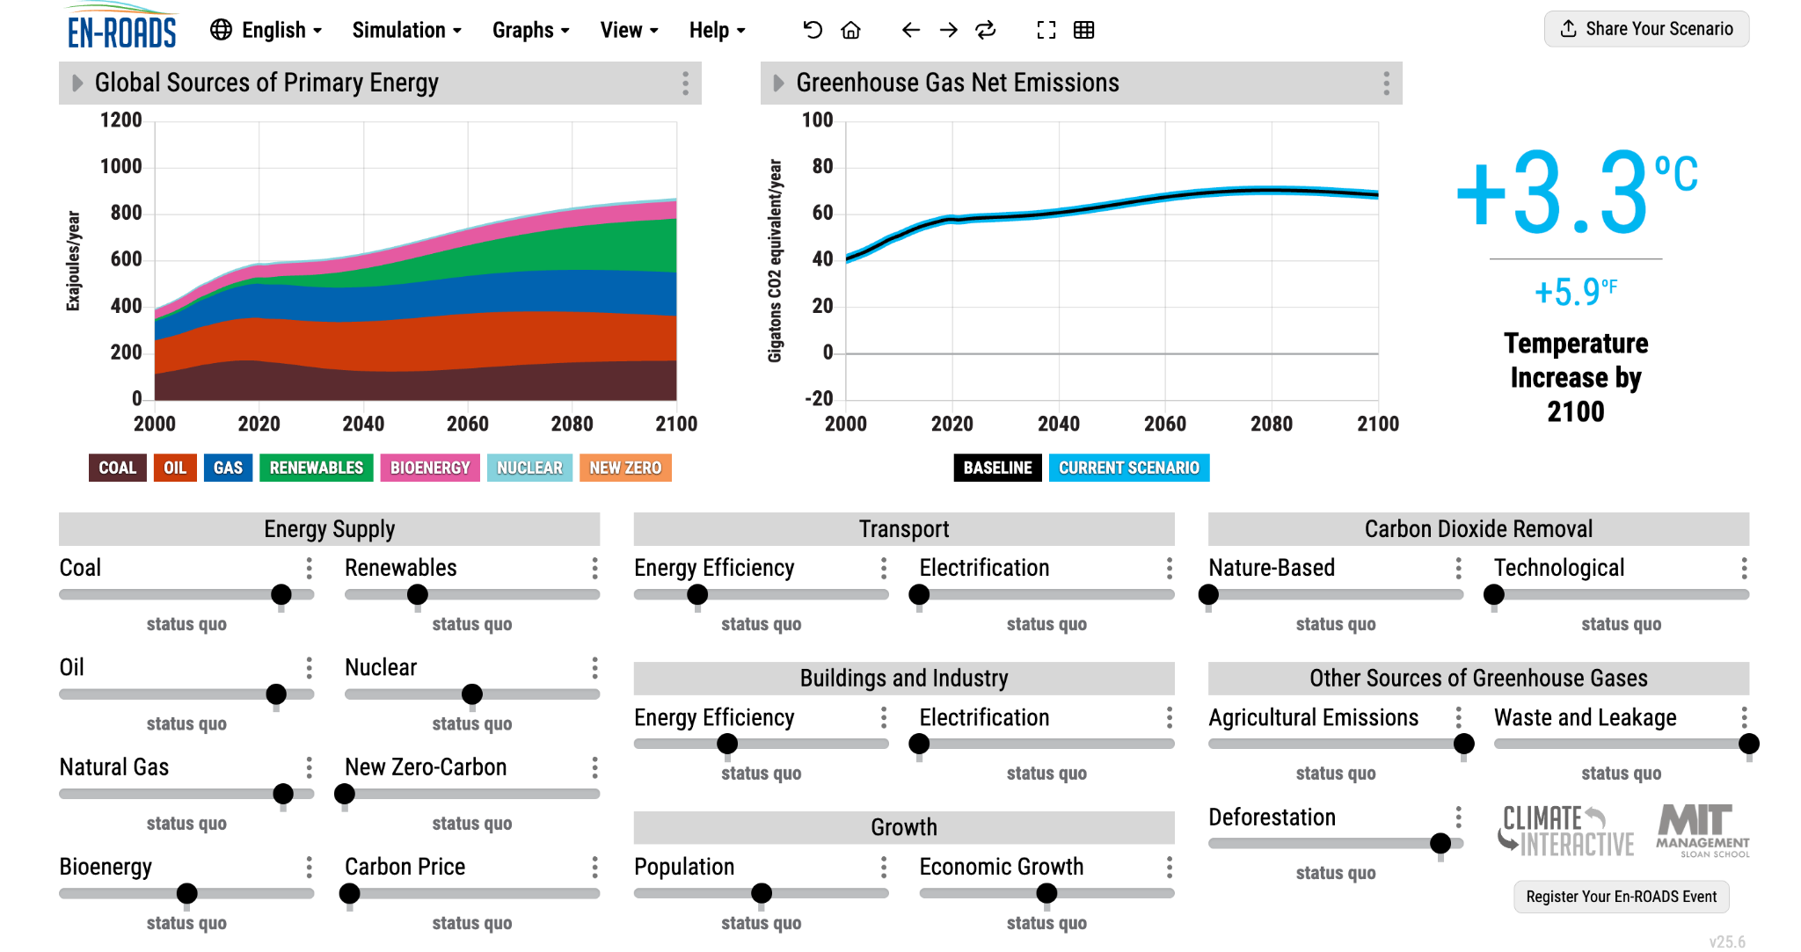

En-ROADS is a cutting-edge simulation model by Climate Interactive and MIT Sloan for testing climate solutions and exploring future scenarios.
Visit: en-roads.org
Notes:
Script:
We will be using a powerful climate simulator tool called En-ROADS. En-ROADS is a cutting-edge simulation model developed by Climate Interactive and MIT Sloan, for testing climate solutions and exploring different future scenarios. En-ROADS helps people learn about and assess the impacts of different approaches to addressing climate change.
En-ROADS is:
Powered by the best available research on climate science and solutions
Transparent: All equations and model assumptions are available online in the Technical Reference
Dynamic: Assumptions are adjustable
Fast: Runs in real time
Updated: August 2025

Slide 11
Overall Process
Game Instructions
Round 1 team negotiations — Teams identify priorities and review their materials.
Round 1 speeches — Each team proposes one action per round. You may propose to: add a new solution – OR – remove a previous action. We will input each action into En-ROADS to build our climate scenario.
Round 2 team negotiations — Teams adjust their strategies based on the updated scenario.
Round 2 speeches — Each team proposes one final action.
Closing — Reflect on the outcome of the summit.
Notes:
Note: If time allows, you can add a third round of negotiations and speeches to deepen the discussion and improve the scenario.

Slide 12
Guidelines for Respectful Roleplay
Game Instructions
Please be respectful to your fellow participants and the group you are representing. In particular, please follow these guidelines:
Accents: Do not pretend to have an accent or similar speech characteristics of the group of people you are portraying. This could be offensive to other participants or observers and detracts from the goals of the game.
Clothing & head coverings: Do not wear the traditional or religious clothing or head coverings of any nation or culture as part of your role, unless you yourself are of that culture or religion and it is a part of your personal practice.
Adapted from the American Model UN guidance
Notes:
Read the guidelines for respectful role-playing.

Slide 13
Game begins

Slide 14
Role-playing begins
Note for the facilitator
Step into character: Enter the room (or screen) as the UN Secretary General. Wear a formal jacket or suit, and adjust your tone to deliver a serious opening speech (~3 minutes). Here’s an example.
If online, use a virtual background to set the scene of the UN chamber.
For your speech, there are slides that you can show as you speak (see speaker notes for detailed guidance). During your speech:
State the goal for today’s session.
Address each stakeholder group present at the mock UN Summit. Only show the slides of the groups you’re using—hide or delete the rest.
Introduce the climate science. If your audience is an expert in this topic, you can shorten or skip this part.
Introduce the En-ROADS Baseline. Show where we’re headed and the temperature goal. (You may choose to show this directly in En-ROADS, rather than the slides.)
Show some of the impacts of inaction. (You may choose to show some impact graphs/maps directly in the Simulator, rather than the slides.)

Slide 15
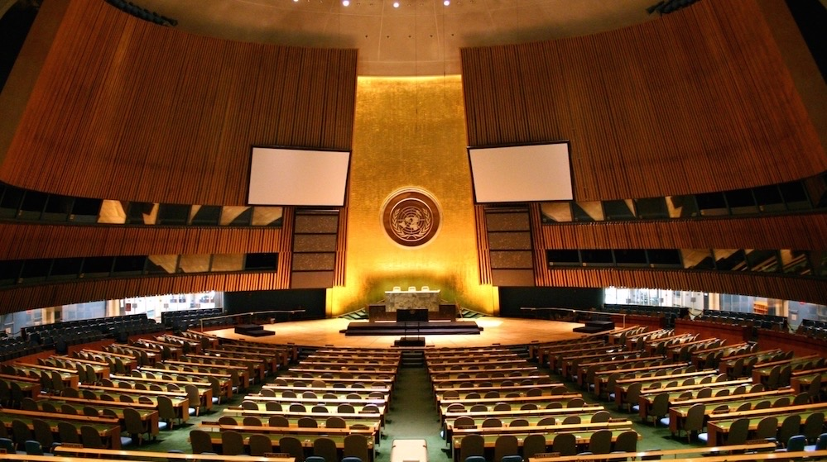
Welcome to the
UN Climate Action Summit
Notes:
Note: Open the role playing period. Enter the room as the UN Secretary General and deliver your opening speech!
(Example speech from UN Secretary General Antonio Guterres: https://www.youtube.com/watch?v=f6b9CGx9uio&t=197s)

Slide 16
UN Secretary General Speech BEGINS
Note for the facilitator

Slide 17
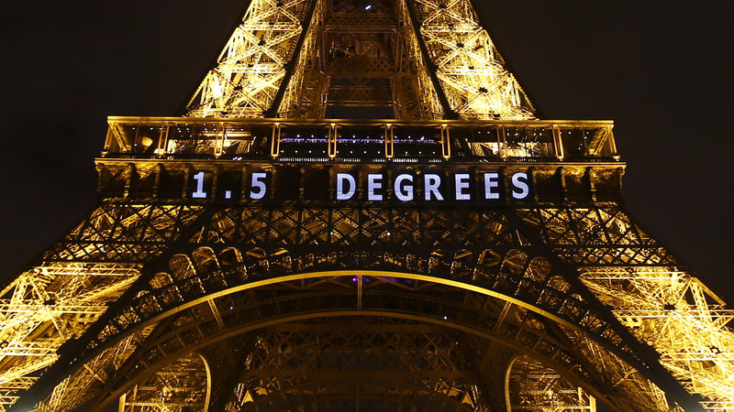
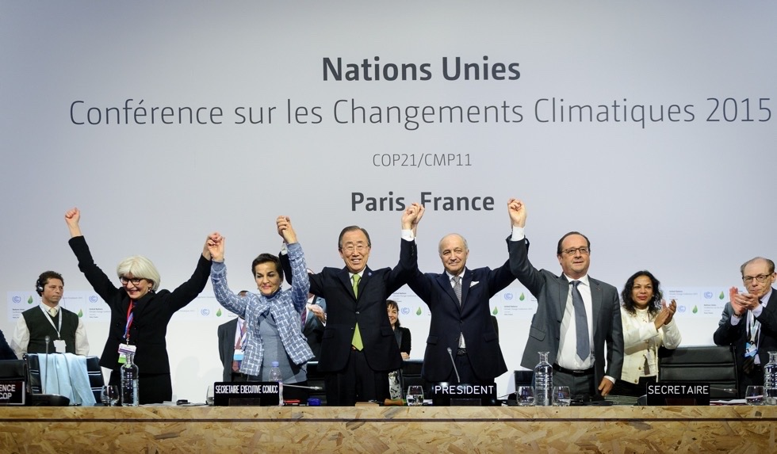
Our Goal Today
Limit global warming to less than 2ºC, and as close to 1.5ºC as possible, above pre-industrial levels.
Notes:
Note: you can show this slide while saying your speech. For example:
Script: “Excellencies, our goal today is clear: we need to limit temperature rise to well below 2 degrees and strive for 1.5 degrees just to avoid the worst impacts of climate change.”
Image credits:
Francois Mori/AP
https://www.nature.com/articles/d41586-020-00834-7

Slide 18
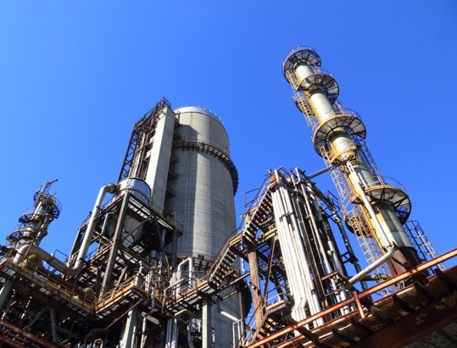
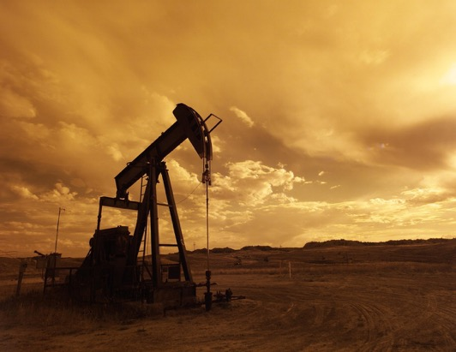



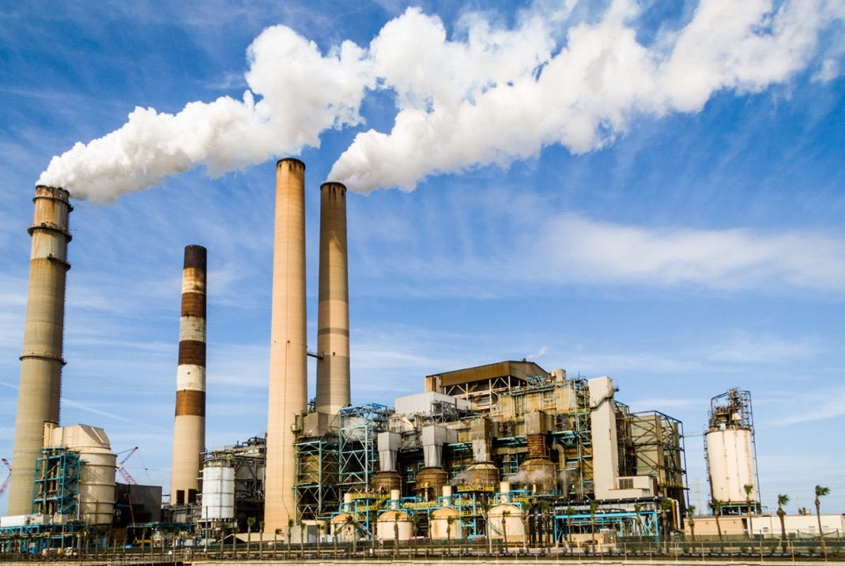
Conventional Energy
Largest energy suppliers in the world:
Coal
Oil
Gas
Nuclear
Electric Utilities
Notes:
Note: Introduce the groups in the room. Talk directly to them. For example:
Script: “So I look around this room and see a diversity of voices—and each of you has a responsibility in this global challenge. Conventional Energy group, we can’t deny the role you’ve played in driving rapid development across many nations. But now, as the stakeholder group with the biggest responsibility, we count on you to lead the transition toward a clean energy future.”

Slide 19
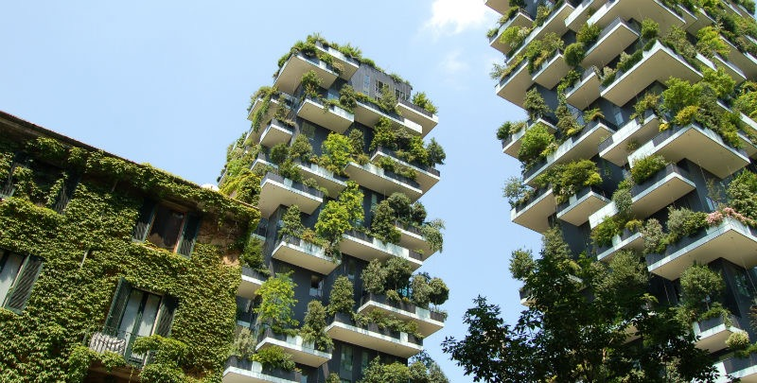



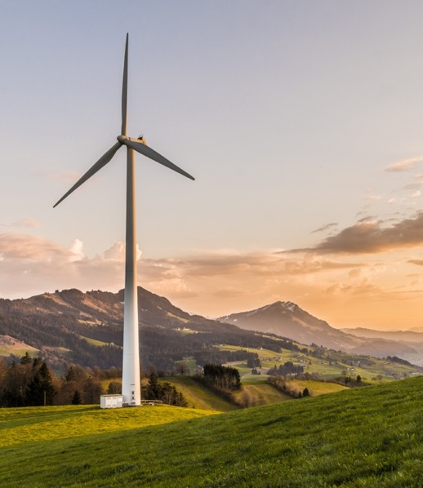
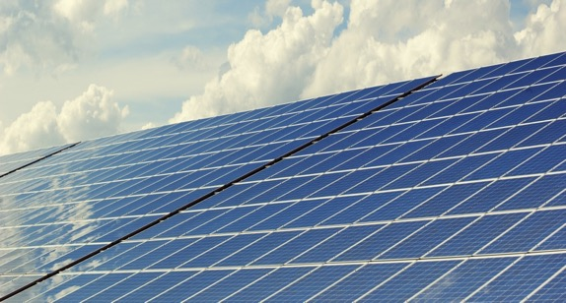
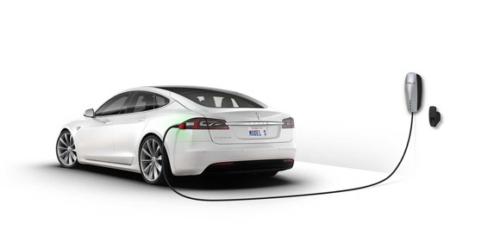
Clean Tech
Global leaders in clean tech:
Wind, solar, and other renewable energy sources
Energy storage, electric vehicles
Energy efficiency, green buildings
Technological carbon removal
New energy for the future
Notes:
Script: “Clean Tech group, you have the power to provide universal, affordable, and sustainable energy for all.”

Slide 20
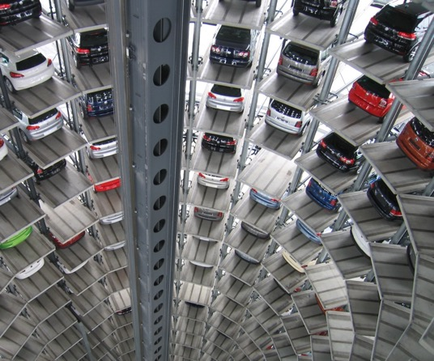
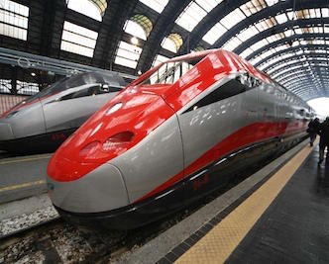


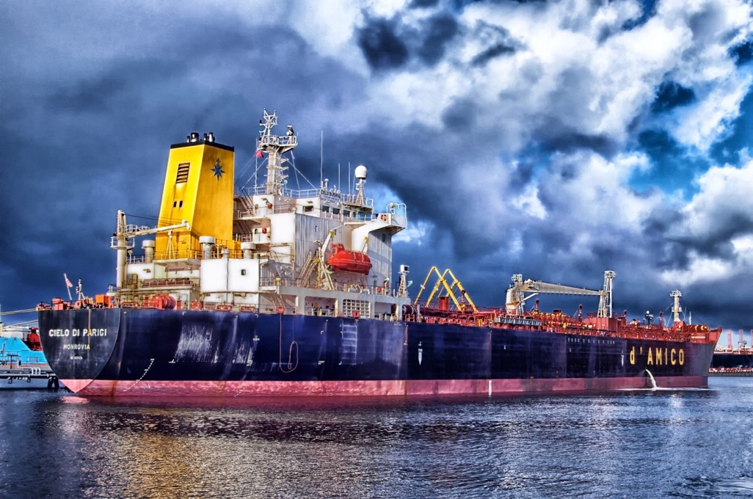
Industry & Commerce
Largest energy-consuming corporations:
Automakers, airlines, shipping & freight, other transport
Construction
Industrial machinery
Manufacturing
Consumer products
High tech
Notes:
Script: “Industry and Commerce representatives, Paul Polman—Unilever CEO—said it well… ‘there’s no profit in a dead planet.’”

Slide 21
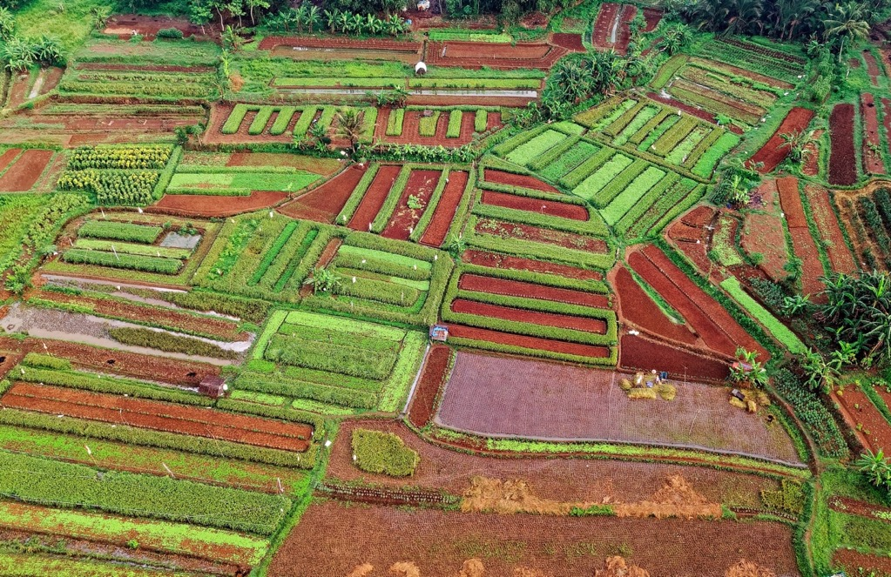



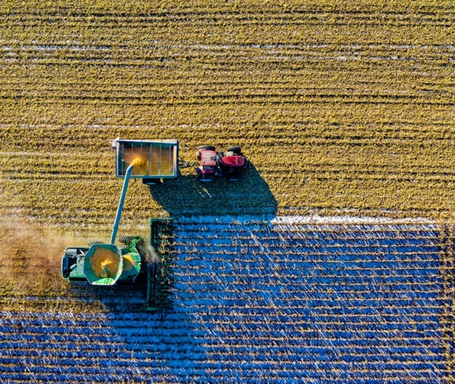
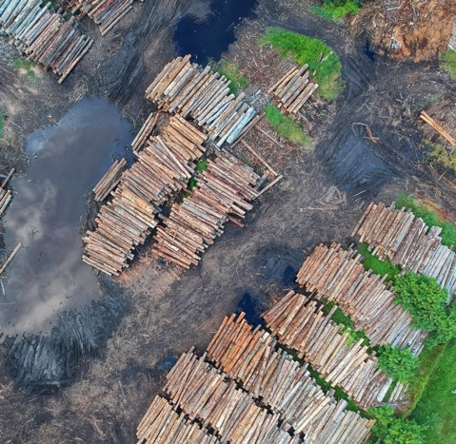
Land, Agriculture, & Forestry
Global alliance of:
Food & agriculture companies
Large landowners and farmer advocacy groups
Logging companies
Land conservation groups
Notes:
Script: “Land, Ag and Forestry group, we count on you to ensure a supply of sustainable food systems, while preserving our forests and ecosystem services.”

Slide 22
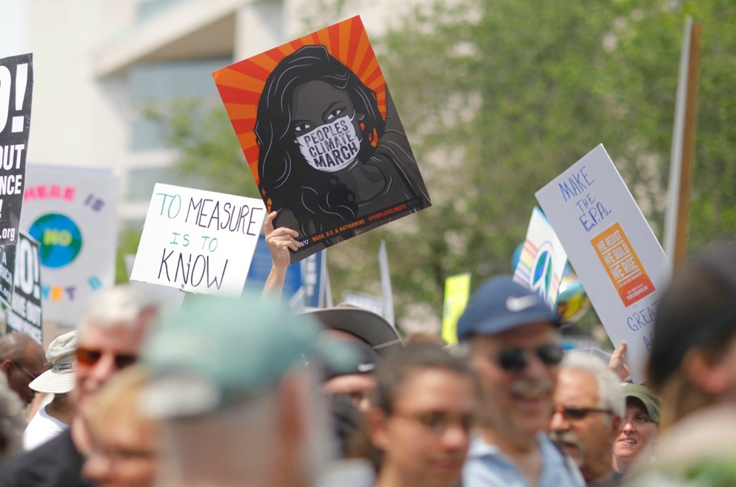



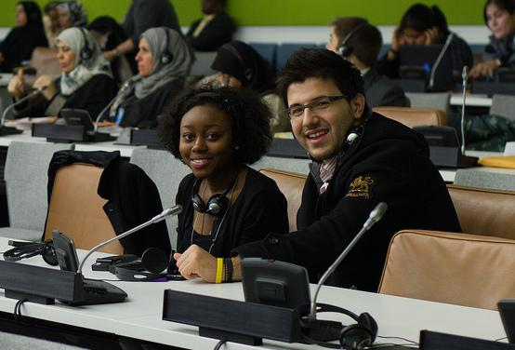
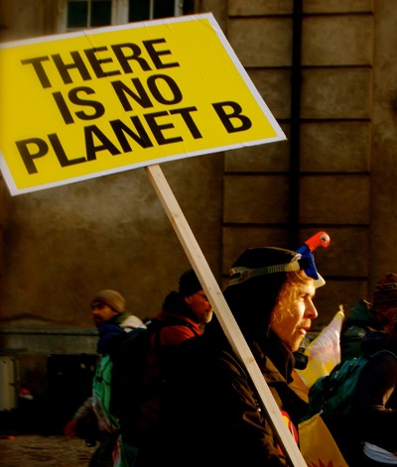
Climate Justice Hawks
Leaders of:
Environmental nonprofits
Climate justice organizations
Grassroots & youth movements
Global citizens from communities harmed by climate change
Notes:
Script: “Climate Justice hawks, you represent our vision for the world we want to live in. Keep on fighting for the most vulnerable.”

Slide 23


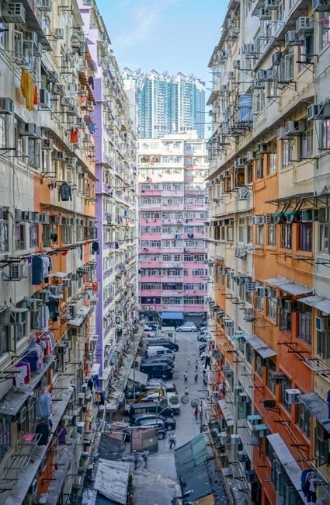
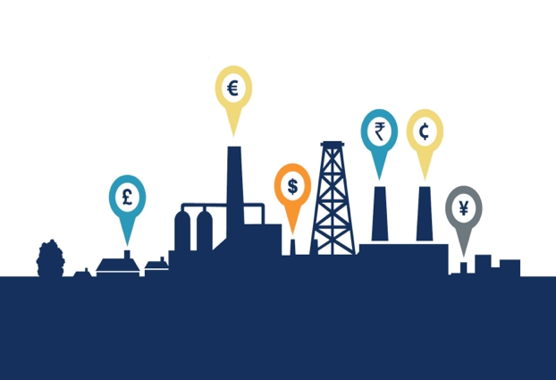
World Governments
Government leaders from around the world representing:
Developed countries – EU, USA, Canada, etc.
Rapidly developing countries – China, India, etc.
Small island nations
Notes:
Script: “Governments of the world: it’s time to set aside the past and act in the interest of our shared well-being. Let us recognize our common but differentiated responsibilities—and embrace the greatest challenge humanity has ever known as an opportunity to build a clean, just, and sustainable future for all nations.”

Slide 24
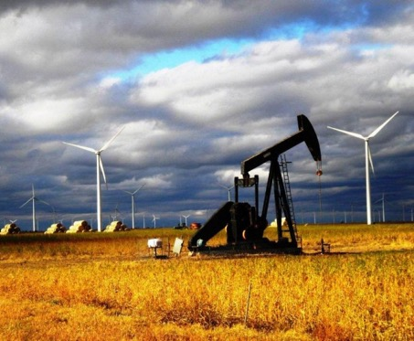
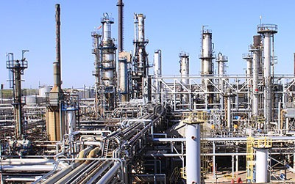
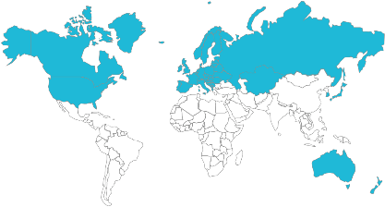
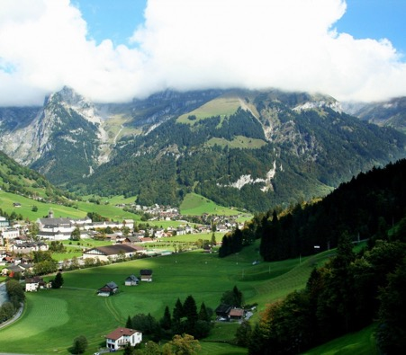
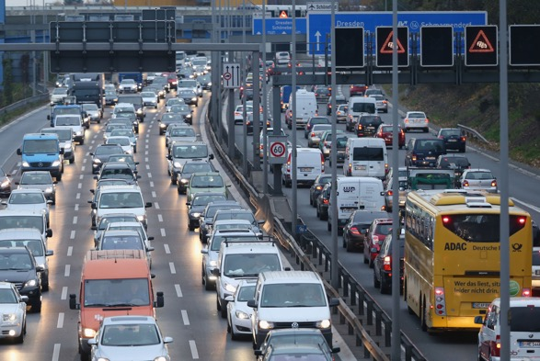
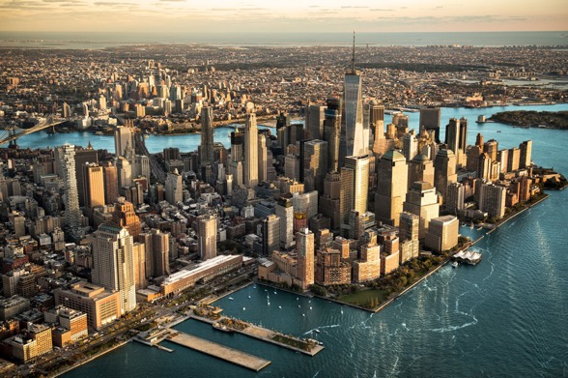
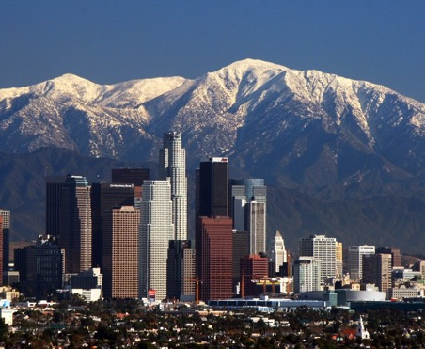
Developed Nations
Leaders of:
Australia
Canada
European Union
Japan
New Zealand
Russia & Former Soviet Republics
South Korea
USA
Notes:
Script: “Developed nations, you’re expected to lead in climate mitigation due to your high historical emissions.”

Slide 25
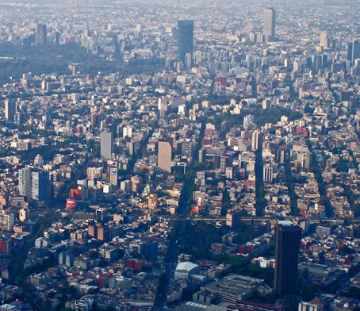
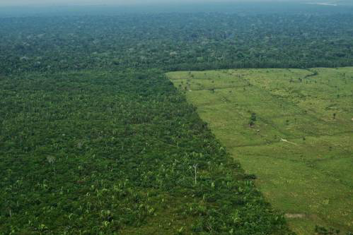
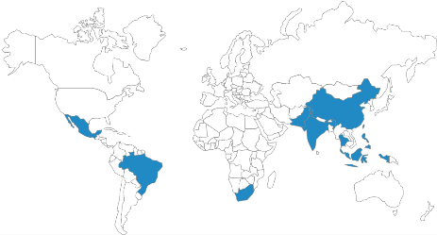
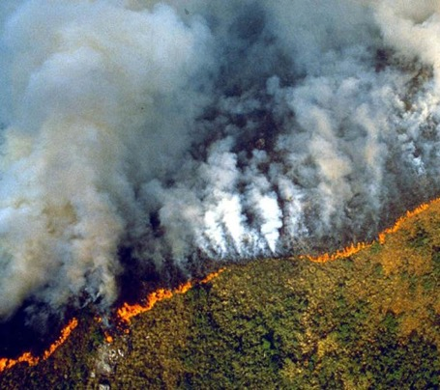
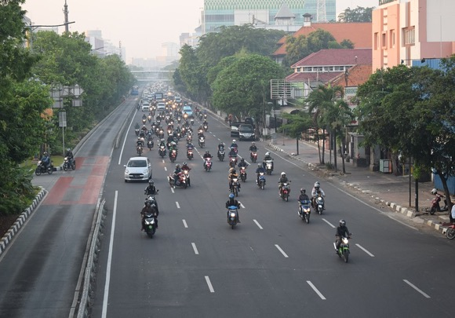
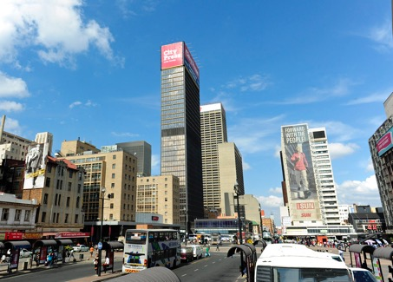
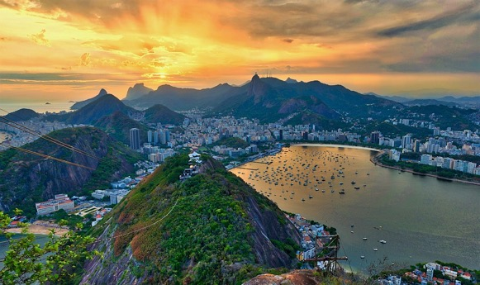
Rapidly Emerging Nations
Leaders of:
China
India
Indonesia
Brazil
Mexico
South Africa
Notes:
Script: “Emerging economies you’re also critical to bending the global emissions curve.”

Slide 26
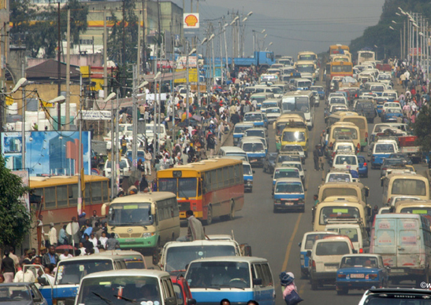
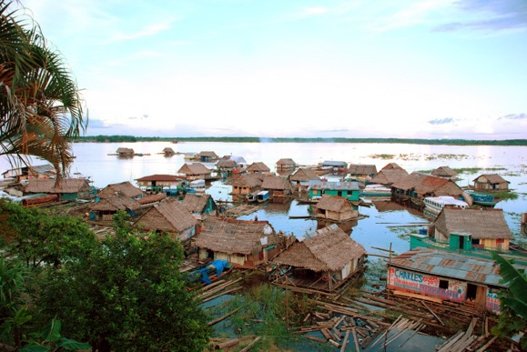
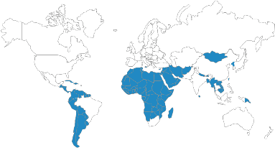
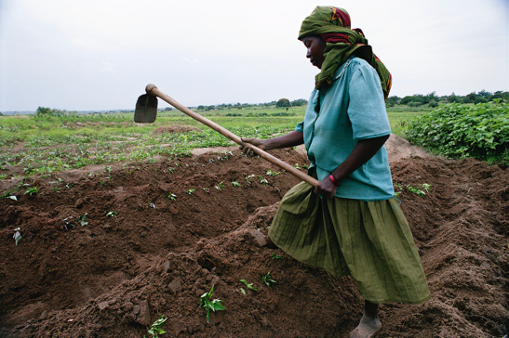
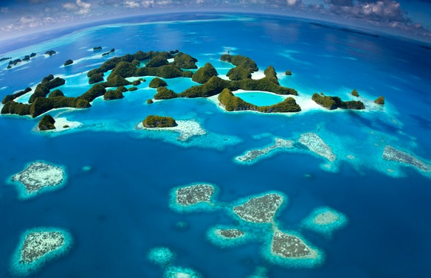

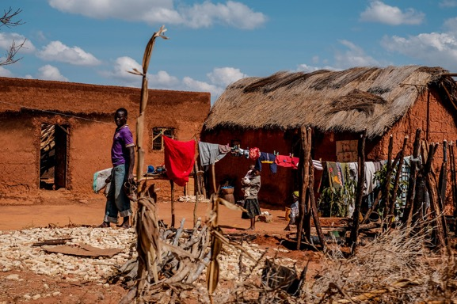
Developing Nations
Leaders of over 100 nations in:
Africa
Central and Latin America
South and Southeast Asia
Middle East
Small Island States
Notes:
Script: “Developing nations, you contributed the least, yet are disproportionately impacted. However, we need to look forward—it is time for international solidarity across the board.”

Slide 27

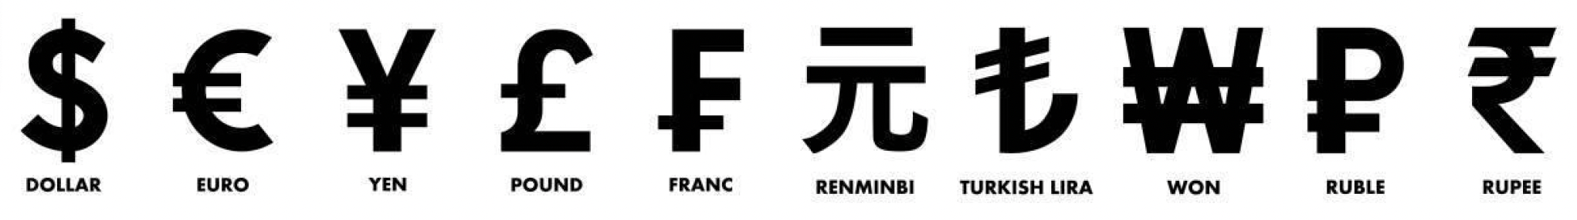
Banking and Finance
Leaders of:
Public and private financial institutions (e.g., World Bank)
Insurance firms
Commercial banks,
Investment banks
Asset managers (e.g., BlackRock)
Asset owners
Notes:
Script: “Banking and Finance leaders, you hold the levers of the global economy; we count on you to shift the trillions from the stranded assets of the past toward the sustainable infrastructure of tomorrow—because you can’t manage a portfolio on a dead planet.”

Slide 28


Health Advocates
Global alliance of:
Doctors
Healthcare professionals
Community health workers
Researchers
Global health NGOs
Hospitals
Government health systems
Notes:
Script: “Health Advocates, you care for the billions of people already experiencing the consequences of climate change—from deadly heatwaves and wildfire smoke-induced asthma to malnutrition and the spread of infectious disease. Hold us accountable today and remind us what’s at stake”

Slide 29
Climate Science
Notes:
Note — Show the following slides if they support your Secretary General speech and if your audience has limited knowledge about climate change.

Slide 30
Let’s briefly review the science and what’s at stake….
Notes:
Note — Show the following slides if they support your Secretary General speech and if your audience has limited knowledge about climate change.
If your audience is knowledgeable about climate change, we suggest skipping this section and instead highlighting a few recent climate news stories to bring attention to the issue and reinforce the urgency for action.

Slide 31
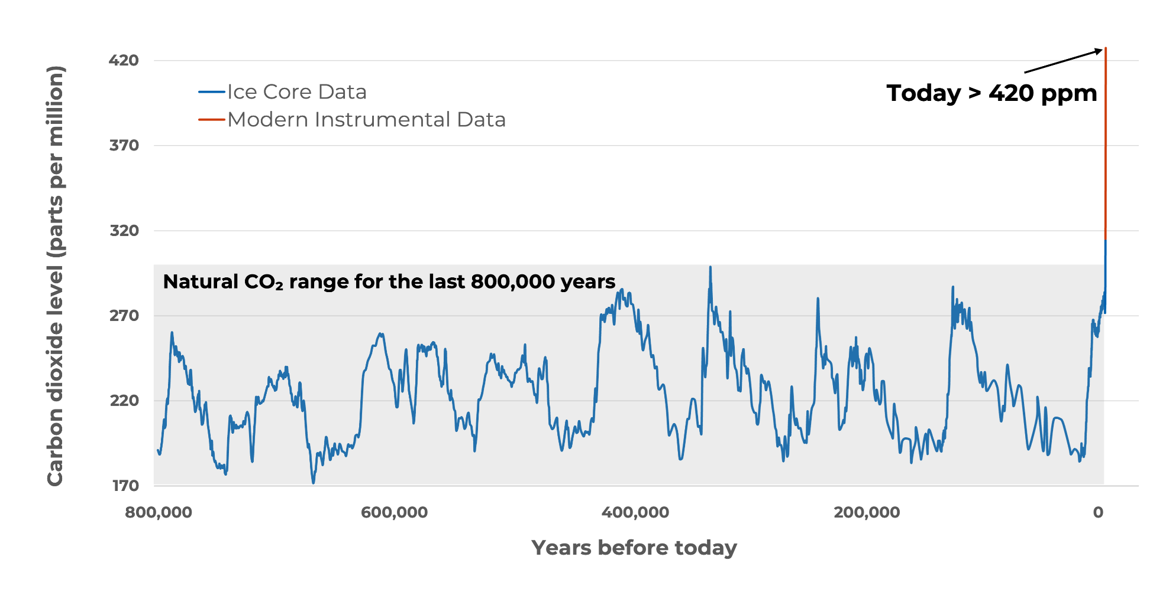
Co₂ concentration in the atmosphere
Atmospheric carbon dioxide is higher than at any point in the last 800,000 years and it is rising faster than at any time in millions of years.
Source: NASA (2025) climate.nasa.gov
Notes:
Script (from NASA): Earth's climate has changed throughout history. Just in the last 800,000 years, there have been eight cycles of ice ages and warmer periods, with the end of the last ice age about 11,700 years ago marking the beginning of the modern climate era — and of human civilization. Most of these climate changes are attributed to very small variations in Earth’s orbit that change the amount of solar energy our planet receives. The current warming trend is different because it is clearly the result of human activities since the mid-1800s, and is proceeding at a rate not seen over many recent millennia.
Source: NASA. (2025). https://science.nasa.gov/climate-change/evidence/
For a detailed view of CO2 concentration since 1960, see https://science.nasa.gov/earth/explore/earth-indicators/carbon-dioxide/

Slide 32
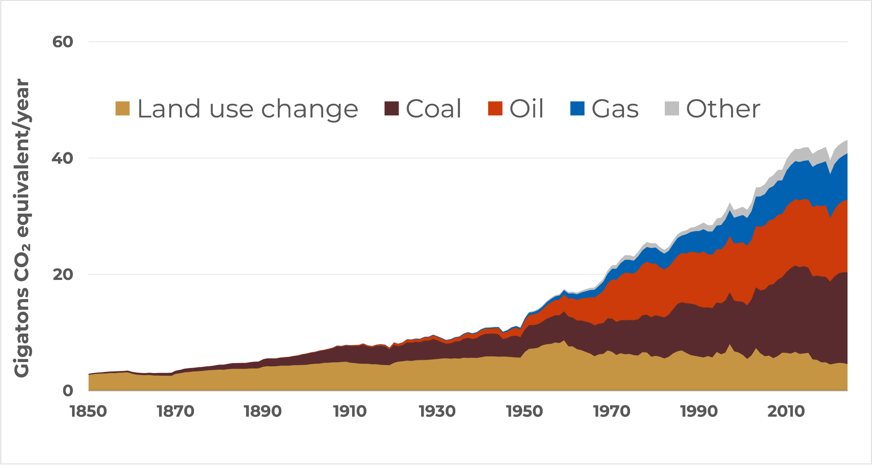
Annual global co₂ emissions
The dominant source of rising CO₂ is the burning of fossil fuels—coal, oil, and natural gas.
Sources: C-ROADS (Climate Interactive). c-roads.org
Calibrated to Global Carbon Budget (2025), PRIMAP (2025), IEA (2025), EI Statistical Review of World Energy (2025), Land Use Harmonization (2019)
Notes:
Script: But where does all the CO2 come from? Any ideas? This graph shows the sources of CO2 from the year 1850 to 2024. The primary contributors to CO2 emissions are the fossil fuels—coal (which you see in brown), oil (in red), and gas (in blue). You can see that there has been lots of growth in coal, oil, and gas over the last 170 years. The yellow wedge at the bottom is land use change, primarily deforestation. The other emissions category is mostly emissions from concrete production.
*Calibration:
CO2 emissions from fossil fuels are calibrated over 1990-2024 to Friedlingstein et al. (Global Carbon Budget, 2025), Gütschow, et al. (PRIMAP version 2.7, 2025); World Energy Balances Dataset 1990-2023 (2025), and EI Statistical Review of World Energy (2025).
Land use changes are calibrated over 1990-2100 to Land Use Harmonization2 data, LUH2 v2e Release (February 2019). Uses historical data from 1990-2015, followed by SSP2 projections thereafter.
Carbon content and CO2 emissions from land use & forestry calibrated over 1990-2024 to Friedlingstein et al. (Global Carbon Budget, 2025) data using multi-model mean.
Updated: December 2025

Slide 33
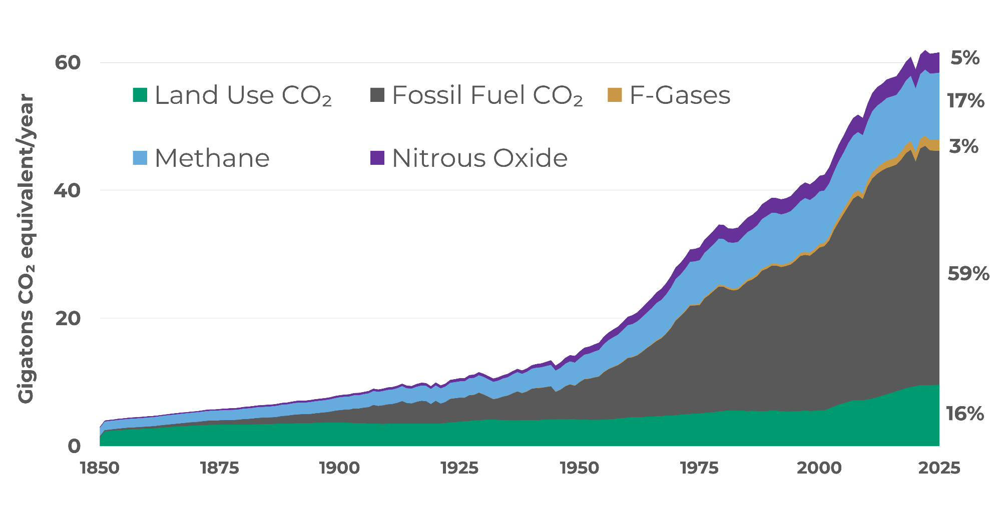
Annual global greenhouse gas emissions
CO₂ from fossil fuels is the largest driver, but methane, nitrous oxide, and fluorinated gases, along with CO₂ from land-use change, also contribute to warming.
Sources: C-ROADS (Climate Interactive). c-roads.org
Calibrated to Global Carbon Budget (2025), PRIMAP (2025), IEA (2025), EI Statistical Review of World Energy (2025), Land Use Harmonization (2019)
Notes:
Script: Carbon dioxide is not the only thing that is contributing to climate change. There are also several other greenhouse gases. Here you see the relative contribution from different gases. In black and green you can see the contribution that CO2 makes from fossil fuels and land use, then in light blue is methane (CH4), then nitrous oxide (N2O) in purple, and the F-gases (fluorinated gases) in yellow. Agriculture contributes about 40% of global methane (CH4) emissions and about 70% of global nitrous oxide (N2O) emissions. Heavy industry and manufacturing, as well as consumer goods, are sources of N2O and F-gases.
*Calibration:
CO2 emissions from fossil fuels are calibrated over 1990-2024 to Friedlingstein et al. (Global Carbon Budget, 2025), Gütschow, et al. (PRIMAP version 2.7, 2025); World Energy Balances Dataset 1990-2023 (2025), and EI Statistical Review of World Energy (2025).
Land use changes are calibrated over 1990-2100 to Land Use Harmonization2 data, LUH2 v2e Release (February 2019). Uses historical data from 1990-2015, followed by SSP2 projections thereafter.
Carbon content and CO2 emissions from land use & forestry calibrated over 1990-2024 to Friedlingstein et al. (Global Carbon Budget, 2025) data using multi-model mean.
Non-CO2 greenhouse gases are calibrated over 1990-2024 to Gütschow, et al. (PRIMAP version 2.7, 2025).
Updated: December 2025

Slide 34
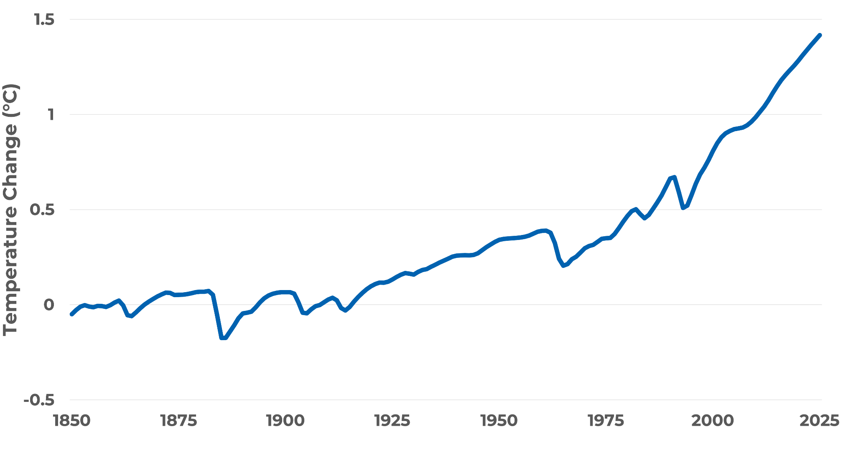
Global temperature change from pre-industrial (°C)
Global average surface temperature has increased about 1.4°C (2.5°F) since humans started burning fossil fuels on a large scale.
Sources: C-ROADS (Climate Interactive). c-roads.org
Calibrated to NASA GISS (2025), Met Office HadCRUT5 (2025)
Notes:
Script: This graph shows a closer look at global average surface temperature change over the last 175 years. Measuring from 1850, which is often used to approximate temperature in pre-industrial times, surface temperature has increased approximately 1.4 degrees C, or 2.5 degrees F.
Source: Temperature change from C-ROADS. c-roads.org. Calibrated to historical data from:
NASA GISS. (2025). GISS Surface Temperature Analysis (GISTEMP), version 4. NASA Goddard Institute for Space Studies.
Met Office: Morice, C. P., Kennedy, J. J., Rayner, N. A., Winn, J. P., Hogan, E., Killick, R. E., et al. (2020). An updated assessment of near-surface temperature change from 1850: the HadCRUT5 dataset. The data is from HadCRUT version 5.0.2.0 (2025).

Slide 35
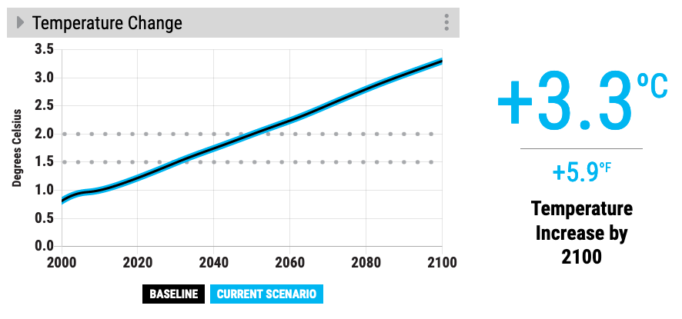
En-ROADS Baseline Scenario
Our climate goals (1.5ºC to 2ºC)
Notes:
Script: If we continue business as usual, we estimate that temperature change will reach 3.3 degrees Celsius by 2100. That’s 5.9 degrees Fahrenheit. Compare the bold line to the dotted lines where our climate goals (2 degrees C and 1.5 degrees C) are on the graph.
Updated: May 2023

Slide 36
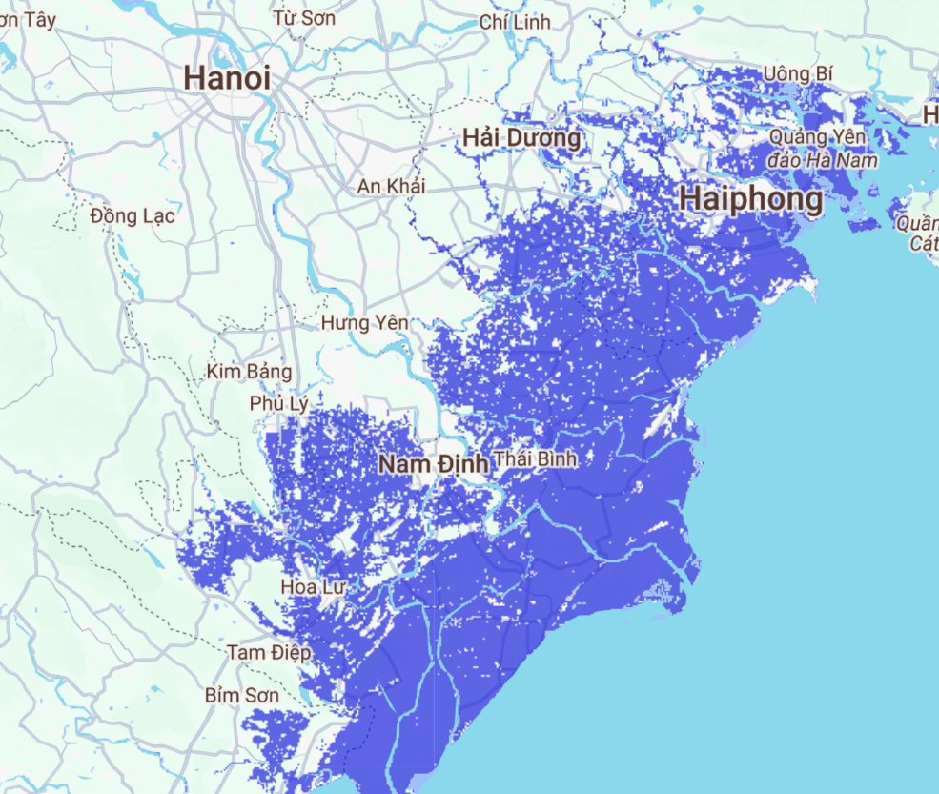
Flood risk from sea level rise
In Hanoi, Vietnam, 3.3°C in 2100
Notes:
Note: The sea level rise flood risk shown here is a projection of sea level rise by 2100. The sooner we cut carbon emissions, the lower the eventual sea level rise. Use the Sea Level Rise—Flood Risk Map in En-ROADS under “Impacts” in the Graphs menu to search for a location and see the effect of lowering temperature in your scenario.
Source: En-ROADS in collaboration with Climate Central using the Climate Central Coastal Risk Screening Tool https://coastal.climatecentral.org/

Slide 37

Flood risk from sea level rise
In Hanoi, Vietnam, 3.3°C over the next few centuries
Use En-ROADS to create a scenario that lowers this sea level rise. View the map under “Impacts” in the Graphs.
Notes:
Note: The sea level rise flood risk shown here is a projection of long-term (over centuries) sea level rise due to sea levels locked in by different amounts of carbon pollution. This is “committed” sea level rise – it will continue even if carbon emissions are cut. The sooner we cut carbon emissions, the lower the eventual sea level rise. Use the Sea Level Rise—Flood Risk Map in En-ROADS under “Impacts” in the Graphs menu to search for a location and see the effect of lowering temperature in your scenario.
Source: En-ROADS in collaboration with Climate Central using the Climate Central Coastal Risk Screening Tool https://coastal.climatecentral.org/

Slide 38

Dubai today
Notes:
Script: Here is what Burj Khalifa (the tallest skyscraper in the world) in Dubai, United Arab Emirates looks like today…
Source:
Climate Central. (2021). Picturing Our Future. https://picturing.climatecentral.org/
Benjamin H Strauss et al. (2021). Unprecedented threats to cities from multi-century sea level rise. Environ. Res. Lett. 16 114015. https://doi.org/10.1088/1748-9326/ac2e6b

Slide 39

…and with 3°C of warming
Dubai today
Source: Climate Central
Notes:
Script: …and with long-term sea level rise due to 3°C of warming.
Source:
Climate Central. (2021). Picturing Our Future. https://picturing.climatecentral.org/
Benjamin H Strauss et al. (2021). Unprecedented threats to cities from multi-century sea level rise. Environ. Res. Lett. 16 114015. https://doi.org/10.1088/1748-9326/ac2e6b

Slide 40


Economic losses from disaster events in 2024 reached USD 318 billion. Damages associated with global warming could exceed USD 59 trillion of Global GDP Loss by the time we reach 2°C (in 2050, En-ROADS Baseline).
Notes:
Source:
https://www.swissre.com/institute/research/sigma-research/sigma-2025-01-natural-catastrophes-trend.html
Photo from Mike Newbry via Unsplash

Slide 41
UN Secretary General Speech ENDS
Note for the facilitator

Slide 42
Team Discussions & Plenary Rounds
Note for the facilitator
The next slides will guide participants through each stage of the game. You may project them as a visual aid, but keep the focus on interaction: role-playing, team discussions, and exploring the En-ROADS model. Feel free to switch between slides and the simulator on screen.
During these rounds, participants will…
Start role-playing: Step into their stakeholder roles
Read their team’s briefing statements
Discuss in teams and agree on one action per round
Propose the actions during the plenary speeches
See the impact of their proposals in En-ROADS—and learn why those outcomes occur.
Note: if you have more time, you can add a 3rd round of negotiations and plenary presentations.

Slide 43

Notes:
Note – Use the En-ROADS control panel guide to help orient participants to their decision variables. Use this to also briefly orient people to the actual En-ROADS simulator, and show how this Guide relates to the En-ROADS simulator.

Slide 44
Team Meetings
Round 1
Instructions:
Discuss with your team and choose your top action to propose (or remove).
Agree on two back-up options in case your first choice is taken.
Think about how to implement the action without causing social or environmental problems.
Select one person to give a 1-minute speech explaining your team’s action and how it will be implemented.
10-15 minutes
Notes:
Note – The following slides will help guide the group through the stages of the game. They may be projected as a helpful reminder in the background, although the focus of the room should be on the interactive roleplaying, with each other and the model. You may alternate between the slides and the En-ROADS model on the projected screen.

Slide 45
Plenary Presentations
Round 1
Instructions:
One group at a time, your spokesperson will present one action and explain how it will be implemented in a 1-minute speech.
We will enter all actions into En-ROADS, one by one, building up a single scenario that reflects the combined global action plan.
10-15 minutes

Slide 46

Team Meetings
Round 2
Instructions:
Discuss your follow-up actions as a team, based on the current scenario.
Negotiate with other teams and lobby them to change their position if needed.
15-20 minutes

Slide 47
Plenary Presentations
Round 2
Instructions:
Again, one group at a time, the teams’ spokesperson present one action and explain how it will be implemented in a 30-second speech.
We will keep building our En-ROADS Scenario with your proposed actions.
Will we reach the climate goal? Are these actions bold enough? Let’s find out—together.
10-15 minutes

Slide 48
Role-playing ends, debriefing starts
Note for the facilitator
Step out of your role — remove your jacket or virtual background to signal the shift.
Reflect — Do the one minute of silence. It’s a powerful way to reflect and reset.
Debrief — Use the basic guiding questions to lead the debrief, or create your own.
Deeper discussion — see the Additional Discussion Questions in the Facilitator Guide.

Slide 49
Debrief

Slide 50
Reflection and discussions
Take 1 minute of silence…
What would you love about being part of a world on track to making this scenario happen?

Slide 51
Debriefing Discussion
How are you feeling?
What surprised you?
What were your key insights?
What will you take away from today, and how can you apply what you learned to the real world?
What are you going to do next?
Notes:
Note – These are some basic guiding questions to lead the debriefing discussion. You may choose your own and follow up with more detailed questions. We provide some options for additional discussion questions in the Facilitator’s Guide.

Slide 52
Looking Ahead
We have the tools
Solar and wind are growing and getting cheaper
Corporations are investing in clean tech
Countries and states are stepping up
The general public is becoming more educated and engaged

Slide 53


Large companies are taking action
Over 8,200 companies have their science-based climate targets validated
Large companies and investors continue to ask their suppliers and portfolio companies to report emissions and assess climate risks
Over 400 global companies have made a commitment to procure 100% renewable energy
Notes:
Sources:
https://sciencebasedtargets.org/reports/sbti-trend-tracker-2025
https://www.there100.org/re100-members
Updated: October 2025
Photos by Afif Ramdhasuma, Ruchindra Gunasekara, and Robert Gramner from Unsplash

Slide 54

Carbon prices are being enacted around the world
113
28%
CARBON PRICING INSTRUMENTS IMPLEMENTED
in National or Subnational jurisdictions
OF GLOBAL GHG EMISSIONS
are covered by Carbon Pricing Instruments
As of August 2025
Notes:
Sources:
World Bank. (August 2025). State and Trends of Carbon Pricing Dashboard.
Updated:
August 2025

Slide 55





“The world as we have created it is a process of our thinking. It cannot be changed without changing our thinking.”
- Albert Einstein
“Never doubt that a small group of thoughtful, committed citizens can change the world. Indeed, it is the only thing that ever has.” - Margaret Mead

Slide 56

What can you do?
Illustration by Elise Amel
Notes:
Source: https://www.theguardian.com/environment/climate-consensus-97-per-cent/2017/may/19/study-inspiring-action-on-climate-change-is-more-complex-than-you-might-think

Slide 57
Thank You!
Visit: climateinteractive.org

Slide 58
Appendix

Slide 59

En-ROADS events around the world
Over 372,000 Participants
In 168 countries
Our Impact
As of January 31, 2026
See the latest impacts at climateinteractive.org/strategy-and-impact/

Slide 60

The En-ROADS Climate Ambassador Program
950+ En-ROADS Climate Ambassadors
92+ Countries
50+ Languages
A unique leadership opportunity to become a climate leader in your field, for those who complete the En-ROADS training.
From all walks of life: professors, business leaders, entrepreneurs, artists, activists, engineers, scientists, students, lawyers, & beyond
Metrics as of January 31, 2026
Notes:
Updated July 2025

Slide 61

The En-ROADS Training Program
TRAINING
Join this free, self-paced online course to…
Learn more about the En-ROADS simulator.
Facilitate engaging events to spark climate action – both online and in-person.
Gain valuable insights on systems thinking, Multisolving, and advanced facilitation tips.
Begin your journey as an En-ROADS Climate Ambassador.
Register at: learn.climateinteractive.org

Slide 62
Big Picture Insights
A combination of solutions is needed to address climate change: “It takes more than one seed to plant a garden.”
Keeping climate change to well below 2°C, and limiting it to 1.5°C, is possible. We can still avoid the worst-case scenarios — it is still physically and technologically possible.
All successful scenarios significantly cut burning of coal, oil, and gas in the next 10-20 years.
There are many lower-leverage actions that help address climate change globally but which are not as high of a priority as reducing fossil fuel use.
There are many opportunities to increase equity as we take these actions.

Slide 63
More Insights from En-ROADS
The transition from high-carbon to low-carbon energy takes decades due to the long lifetime of fossil fuel capital infrastructure.
A new zero-carbon energy source takes too long to scale up to contribute much on its own.
Even when low-carbon energy sources are encouraged, we still burn fossil fuels unless they are actively discouraged.
Reducing other greenhouse gas emissions—methane, N₂O, F-gases—reduces temperature quite a bit.
A carbon price is high leverage because it changes the fuel mix and reduces energy demand.
New technologies grow via reinforcing “learning” feedback loops.
In a scenario in which many actions that limit fossil fuel demand have already been taken, more nuclear, or new zero-carbon energy, or renewables just displaces the other low-carbon sources (a dynamic known as “crowding out”).
Afforestation is lower leverage than many expect, because its carbon removal potential is delayed and much smaller than the greenhouse gas emissions that come from burning fossil fuels.

Slide 64
System Dynamics in En-ROADS
Capital Stock Turnover: Changes to infrastructure take time.
Price-Demand Feedback: Price, demand, and supply are linked.
Crowding Out: Low-carbon supplies compete for long-term market share.
Squeezing the Balloon: If one energy source is limited, another will grow via a compensating feedback.
Economies of Scale and Learning: Increasing capacity drives down costs.
Economic Damage from Climate Change: Climate change reduces GDP growth and energy consumption, balancing climate change impacts.
Drivers of Growth: Population and GDP growth drive emissions.
Bathtub Dynamics: CO₂ emissions must be lower than removals for CO₂ concentration and temperature to stop rising.
Learn more in the En-ROADS User Guide

Slide 65





Features of En-ROADS
Transparent. All equations and structure are available in the Reference Guide.
Flexible. Assumptions are adjustable.
Globally aggregated to be fast. Designed to complement, not replace, other Integrated Assessment Models used by the IPCC.
Supports learning and strategy discussions, grounded in real data and science. However, not intended to make predictions, as the future is dependent on behavioral variables.

Slide 66

Bathtub Dynamics

Slide 67

En-ROADS Core Structure
See the full model structure in the En-ROADS Reference Guide at: climateinteractive.org/en-roads-reference-guide

Slide 68
Impacts at different levels of warming

Slide 69




What would +3°C (or +5.3°F) of warming mean?
Outdoor workers lose nearly a month of work to extreme heat.¹
Annually
Over 40% of insect species lose >50% of their habitat.²
Likelihood of drought in central Spain doubles.³
Compared to today
Number of wildfire danger days in Hunan, China triples.⁴
Compared to today
See the impacts of your scenario in the Impacts graph section of En-ROADS.
Notes:
Script:
However, I want to be clear. A 3+ degree future is still very bleak – especially for the world’s most vulnerable nations and communities who experience the impacts of climate change disproportionately. We need to do better. Far better. Here’s what a 3 degree future means for our world: [Read bullets from the slide].
More information:
Insects: Insects are important as pollinators, for nutrient cycling, and for breaking down waste, among other services. They are the major or sole food source for many amphibian, reptile, bird, and mammal species.
Likelihood of drought: Annual likelihood of drought in central Spain doubles to 80% at 3°C, versus 40% today and 23% in the past.
Updated:
March 2026
Sources:
1. En-ROADS modeling based on Parsons, L.A., et al. (2021). Increased labor losses and decreased adaptation potential in a warmer world. Nature Communications, 12, 7286.
2. En-ROADS modeling based on Warren, R., et al. (2018). The projected effect on insects, vertebrates, and plants of limiting global warming to 1.5°C rather than 2°C. Science, 360(6390), 791–795.
3. “Likelihood of year-plus drought” map from Probable Futures, which sources data from the CORDEX-CORE regional climate modeling framework.
4. “Change in wildfire danger days” map from Probable Futures, which sources data from the CORDEX-CORE regional climate modeling framework.
Photos:
Worker, bee, and drought photos from Pixabay. Wildfire photo from “California Wildfires: The Holy Fire At Lake Elsinore On August 9, 2018” by slworking2, CC BY-NC-SA 2.0.

Slide 70




What would +2°C (or +3.6°F) of warming mean?
40+ million more people at risk of river flooding.¹
Compared to today
An additional week above 32°C (90°F) each year in Mumbai, India.²
Compared to today
An area about the size of Mongolia becomes arid.³
Compared to today
Sea levels rise by half a meter (1.5 feet) over the next 75 years, and continue to rise beyond 2100.⁴
See the impacts of your scenario in the Impacts graph section of En-ROADS.
Notes:
Script:
By limiting warming to 2ºC, you have come very close to our stated goal and should be very proud of the progress you have made! While there are still some serious impacts that the world will need to adapt to and prepare for, the impacts are FAR less severe than we would have seen under a baseline scenario.
Let’s take a look at the impacts we would expect to see in a 2ºC world:
[Read bullets on the slide]
More information:
Arid land expansion: Arid lands are those in which moisture conditions are insufficient to support abundant plant cover and are often associated with increased desertification. Increased aridity can change an area's capacity to supply ecosystem services or host biodiversity.
Updated:
March 2026
Sources:
1. En-ROADS modeling based on Alfieri, L., et al. (2017). Global projections of river flood risk in a warmer world. Earth's Future, 5(2), 171-182 and Dottori, F., et al. (2018). Increased human and economic losses from river flooding with anthropogenic warming. Nature Climate Change, 8(9), 781-786. See the En-ROADS Technical Reference for more details.
2. “Days above 32°C (90°F)” map from Probable Futures, which sources data from the CORDEX-CORE regional climate modeling framework.
3. En-ROADS modeling based on Huang, J., et al. (2016). Accelerated dryland expansion under climate change. Nature Climate Change, 6(2), 166–171.
4. En-ROADS modeling based on Vermeer and Rahmstorf (2009) and calibrated to Dangendorf, S., et al. (2019) and Beckley et al. (2021). See the En-ROADS Technical Reference for more details.
Photos:
Flood and temperature photos from Pixabay. Desert photo by Joshua Woroniecki and sea level photo by Faith Crabtree from Unsplash.

Slide 71




What would +1.5°C (or +2.7°F) of warming mean?
Increase of 3 – 5°C (5.4 – 9.4°F) in extreme temperatures in some regions.¹
800+ million more people exposed to dengue.²
Compared to a world without climate change
Most of Alexandria (Egypt) and Miami (USA) below high tide level after several centuries.³
70% of coral reefs bleached.⁴
See the impacts of your scenario in the Impacts graph section of En-ROADS.
Notes:
Script:
By limiting warming to 1.5ºC, you have achieved our collective goal! This is no small feat and something we should all be proud of.
Congratulations!!! We have arrived at a set of policies that will avert the worst impacts of climate change, especially for the world’s most vulnerable.
While there are still impacts that we will need to adapt to, look at how significantly the impacts were reduced compared to a 4ºC scenario of warming:
[Review bullets on the slide]
More information:
Increase in temperature extremes: The overall message is that there is no single 1.5-degree world; many regions will experience much greater warming than 1.5 degrees.
Coral bleaching: Many societies depend on coral reefs for fisheries and tourism. Reefs protect the shoreline from storm surge and erosion, among other benefits.
Updated:
March 2026
Sources:
1. General circulation model (GCM) emulator developed by Bringing Computation to the Climate Challenge (BC3), a project of the MIT Climate Grand Challenges program.
2. En-ROADS modeling based on Colón-González, F. J., et al. (2021). Projecting the risk of mosquito-borne diseases in a warmer and more populated world: a multi-model, multi-scenario intercomparison modelling study. The Lancet Planetary Health, 5(7), e404-e414.
3. En-ROADS modeling based on Strauss, B. H., et al. (2021). Unprecedented threats to cities from multi-century sea level rise. Environmental Research Letters, 16(11), 114015, via Climate Central's Coastal Risk Screening Tool.
4. Schleussner, C.-F., et al. (2016). Differential climate impacts for policy-relevant limits to global warming: the case of 1.5 °C and 2 °C. Earth System Dynamics, 7(2), 327–351.
Photos:
Thermometer, mosquito, and flooding images from Pixabay. Coral reef photos by Stefano Borghi and q u i n g u y e n from Unsplash.

Slide 72




What would +4°C (or +7.3°F) of warming mean?
Five times more deaths from extreme heat.¹
Compared to today
One in six species could go extinct.²
More than two thirds of glaciers in the Himalaya Mountains melted.³
An area 3x the size of Europe undergoes ecosystem shifts.⁴
Compared to today
See the impacts of your scenario in the Impacts graph section of En-ROADS.
Notes:
Script:
If we do not take to reduce our fossil fuel use, we could see severe impacts by the end of the century. For example…
More information:
Glaciers: The Hindu Kush Himalaya mountains provide water for two billion people. Water from Himalayan glaciers accounts for a significant part of the water in major rivers, including the Indus and Ganges. Estimates for the contribution of glacial melt to the Indus, for example, range from 21% to 80% based on different studies.³
Updated:
March 2026
Sources:
1. Relationship between the percentage change in excess deaths and temperature is from: Vicedo-Cabrera, A. M., et al. (2018). Temperature-related mortality impacts under and beyond Paris Agreement climate change scenarios. Climatic Change, 150(3-4), 391–402. Population and crude death rates from World Bank Open Data (accessed 2025).
2. Urban, M. (2015). Accelerating extinction risk from climate change. Science, 348(6234), 571-573.
3. Wester, P., Mishra, A., Mukherji, A., Shrestha, A. B. (eds). (2019). The Hindu Kush Himalaya Assessment—Mountains, Climate Change, Sustainability and People. Springer Nature Switzerland AG.
4. En-ROADS modeling based on Warszawski, L., et al. (2013). A multi-model analysis of risk of ecosystem shifts under climate change. Environmental Research Letters, 8(4), 044018.
Photos:
Emergency photo by Cheung Yin from Unsplash. Skeleton, mountain, and stream photos from Pixabay.

