Slide 1
The New IRA Bill: an En-ROADS Workshop
Andrew P. Jones
Krystal Noiseux
9 August 2022

Slide 2

With
Notes:
Logo blurry

Slide 3
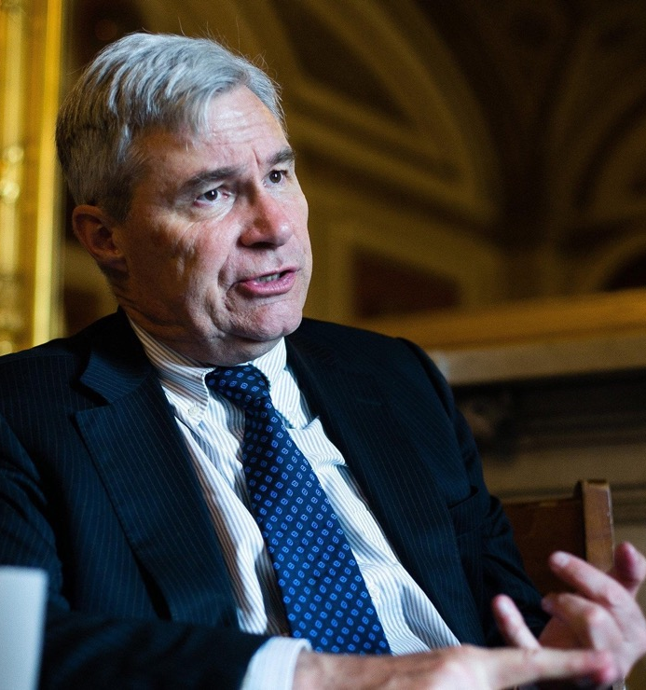
“Engaging with the En-ROADS climate simulation has been one of the best ways for me, as a policy maker, to learn about how solutions to tackle climate change can reinforce or interfere with one another.”
Sheldon Whitehouse
U.S. Senator
Rhode Island

Slide 4
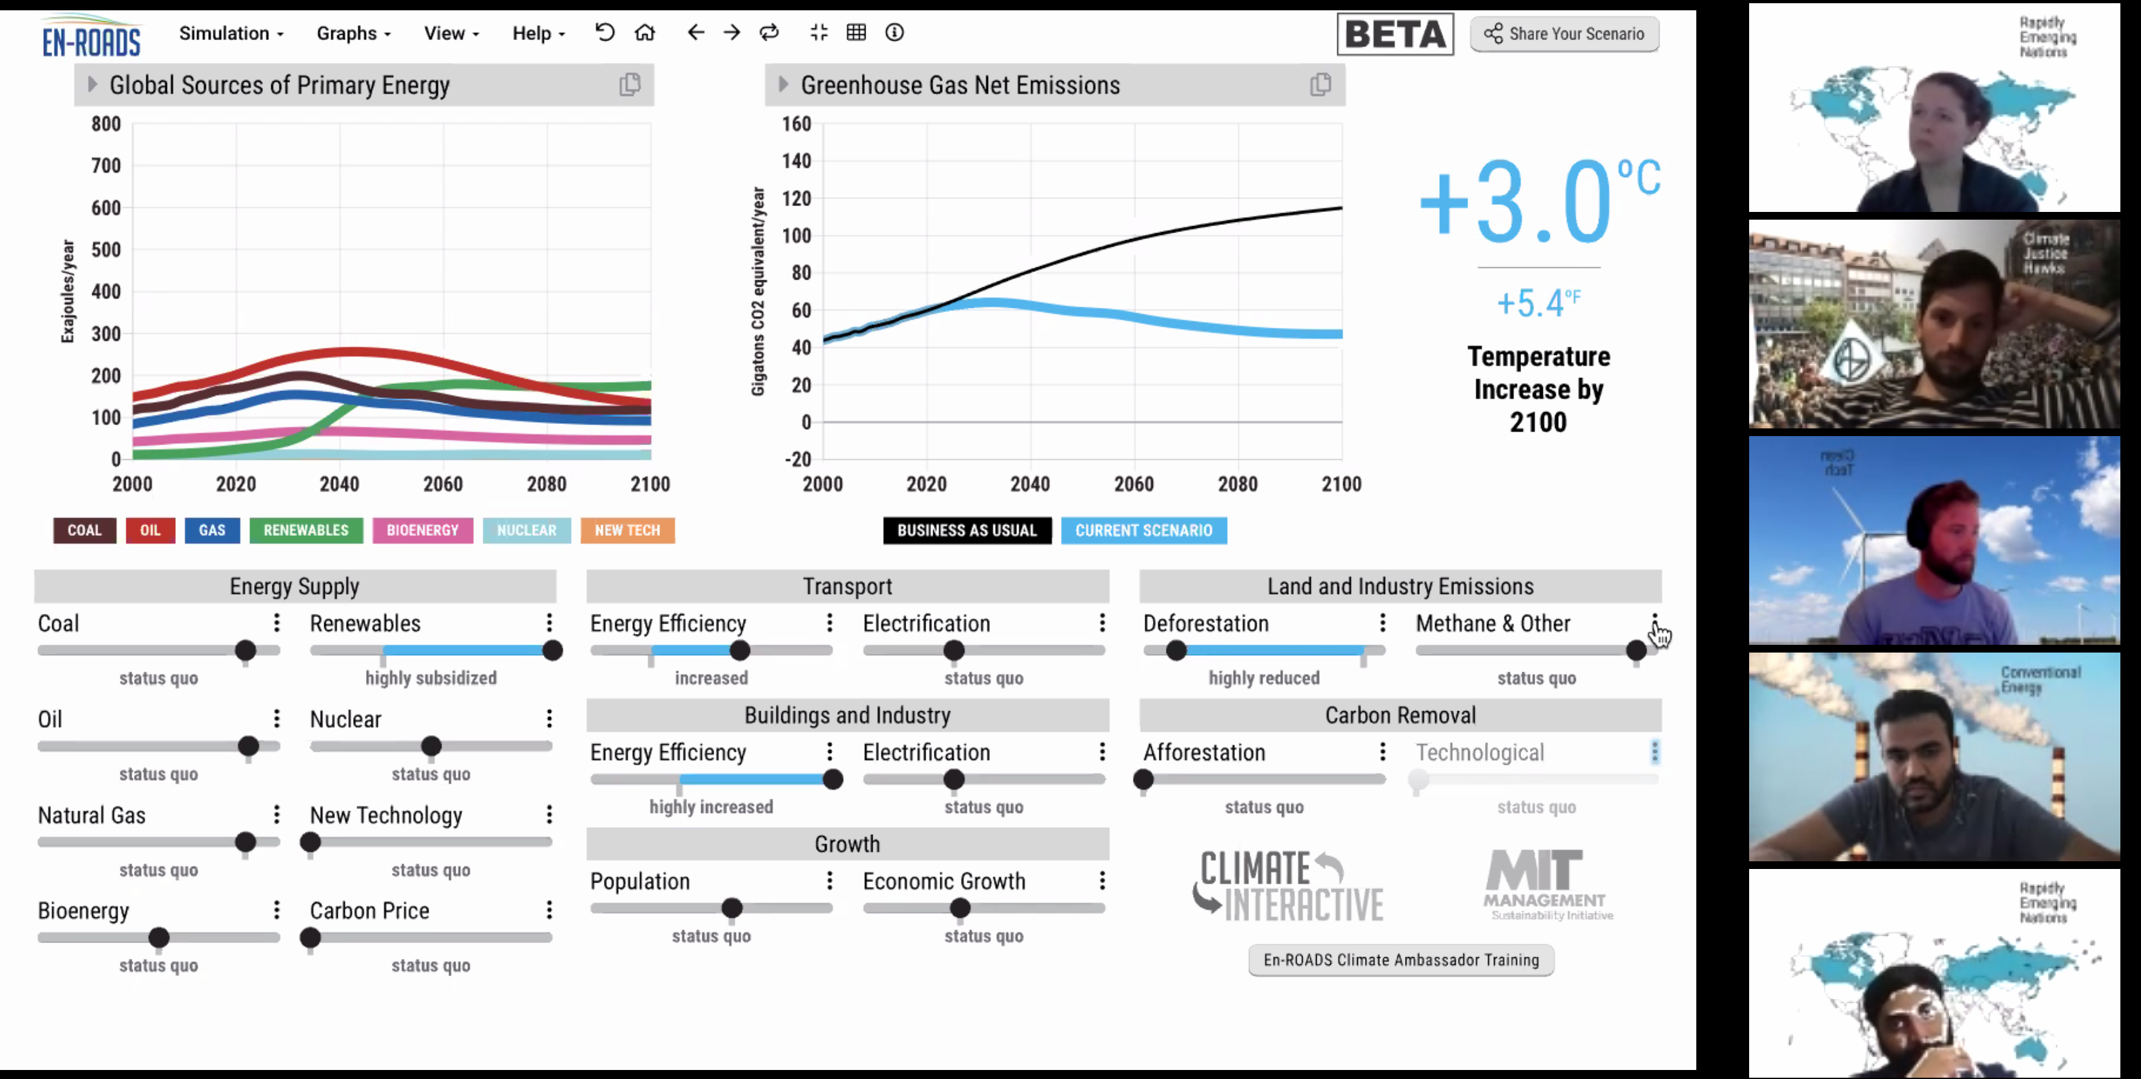
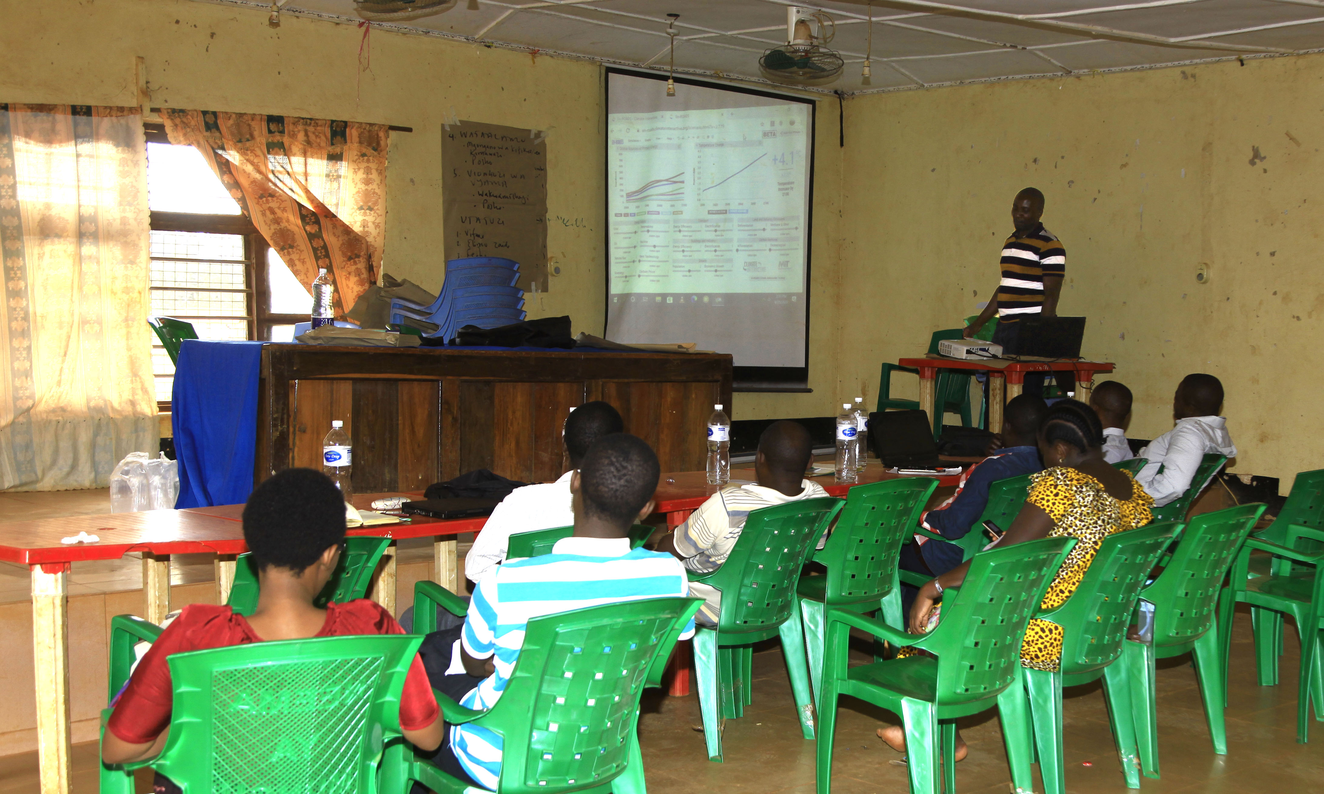
The Mastering En-ROADS Training Program
Free training series to:
Learn more about the En-ROADS simulator
Facilitate engaging events to spark climate action – both online and in-person
Gain valuable insights on systems thinking, multisolving, advanced facilitation tips, and more
learn.climateinteractive.org

Slide 5
The Plan
Brief Intro to the Bill
Gratitude
Concerns
Systems Insights
Momentum

Slide 6
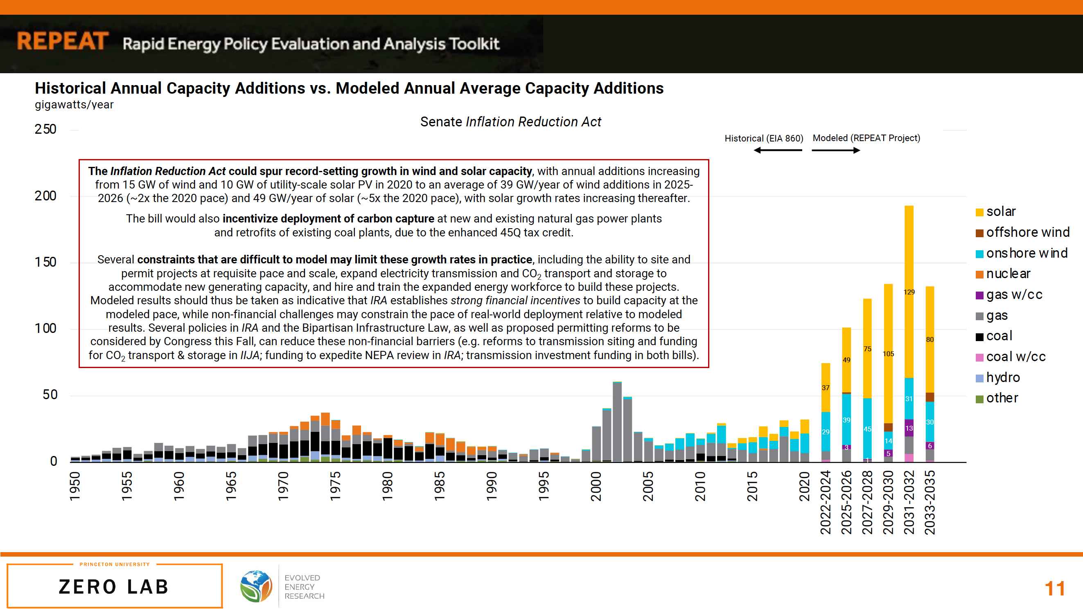

Slide 7
REPEAT Model: Likely Surge in Clean Energy

Slide 8
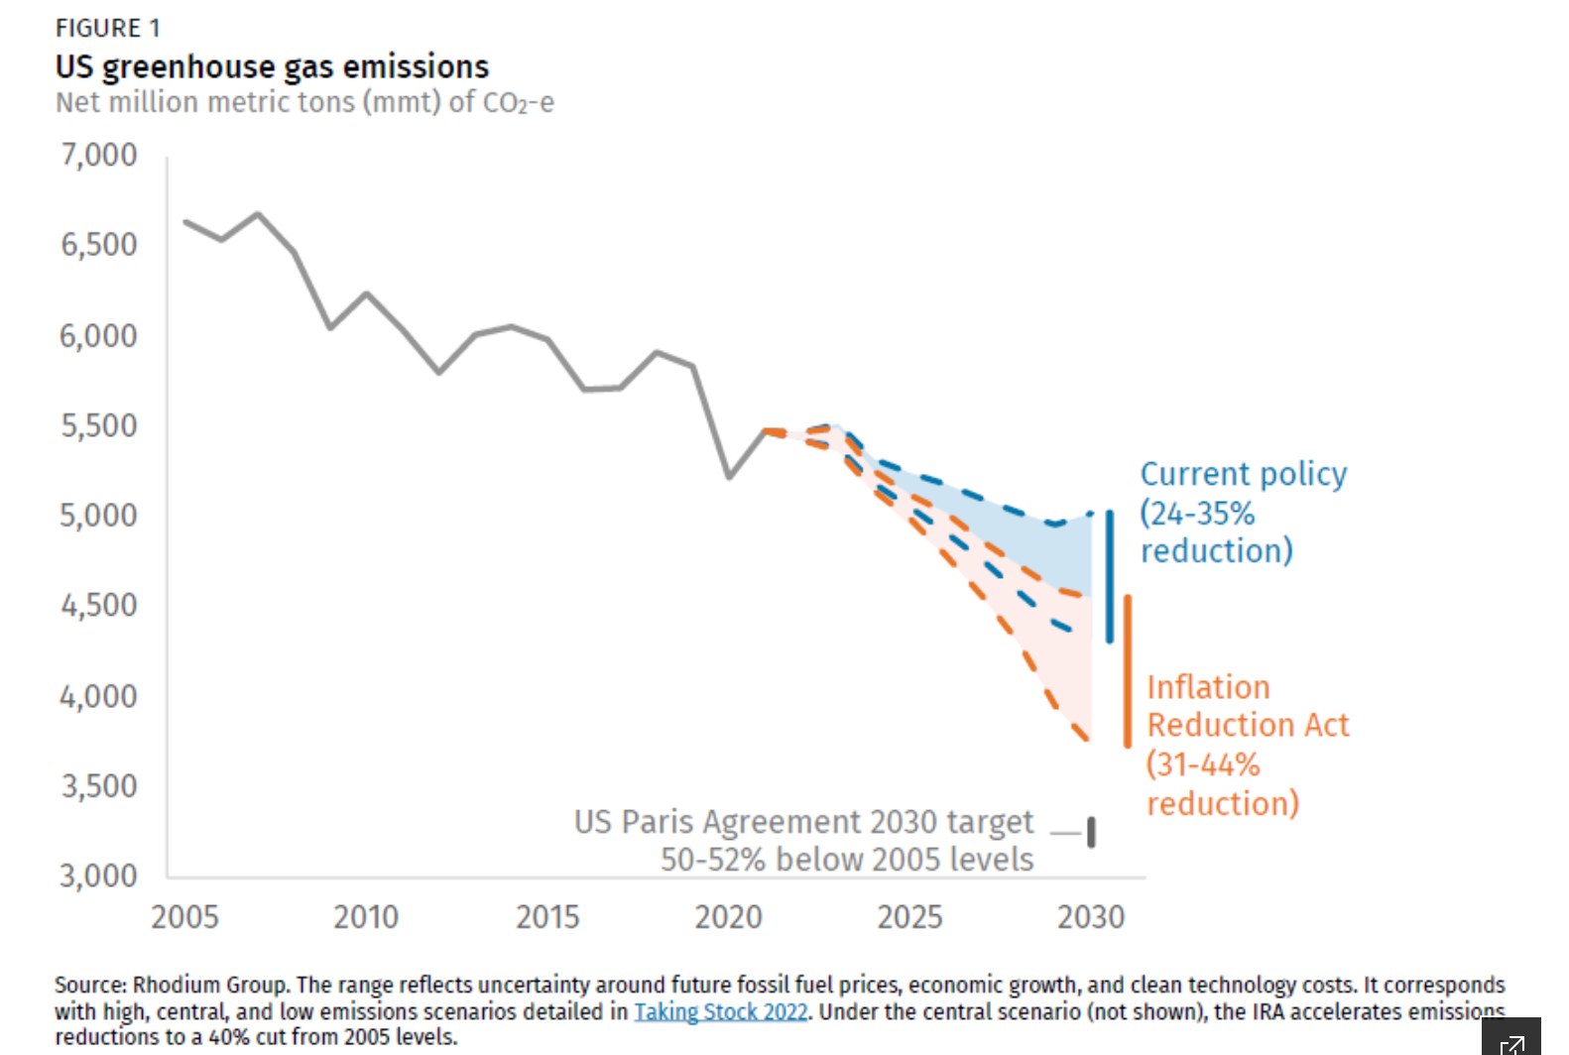
Rhodium Group

Slide 9
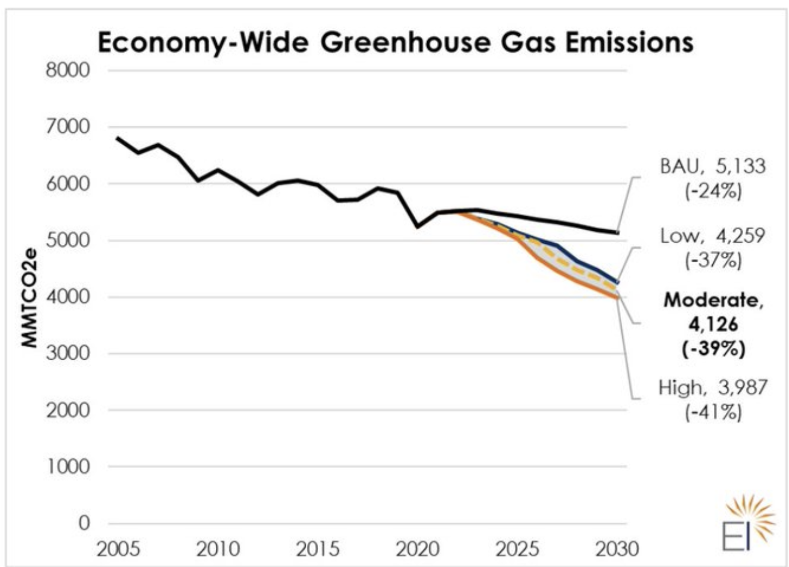
Energy Innovation

Slide 10
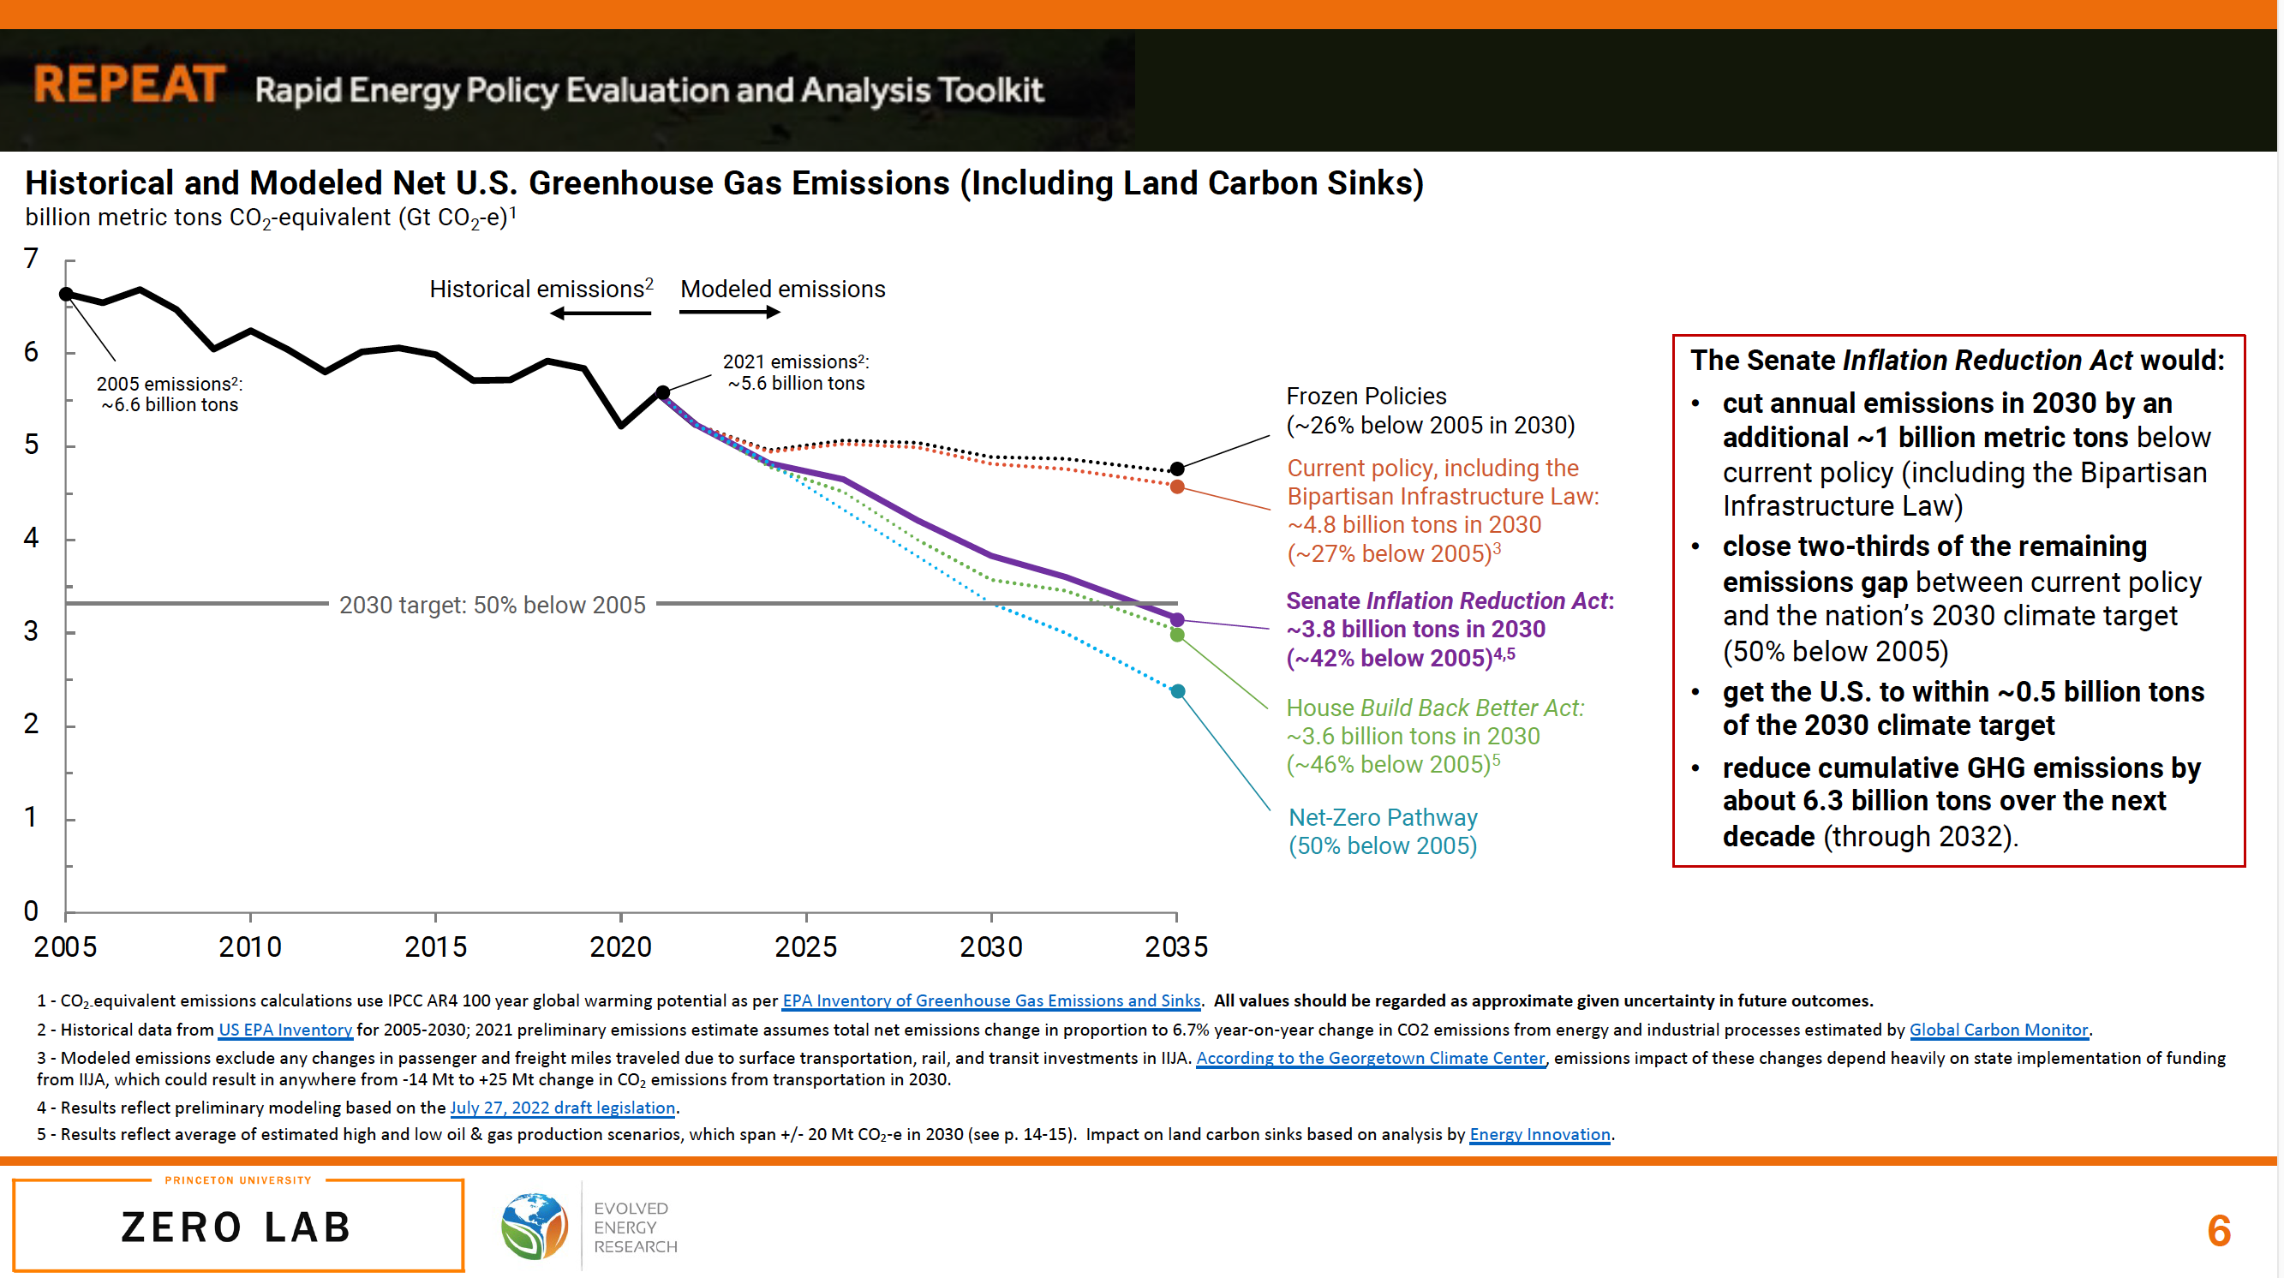
Princeton REPEAT, Zero Lab

Slide 11
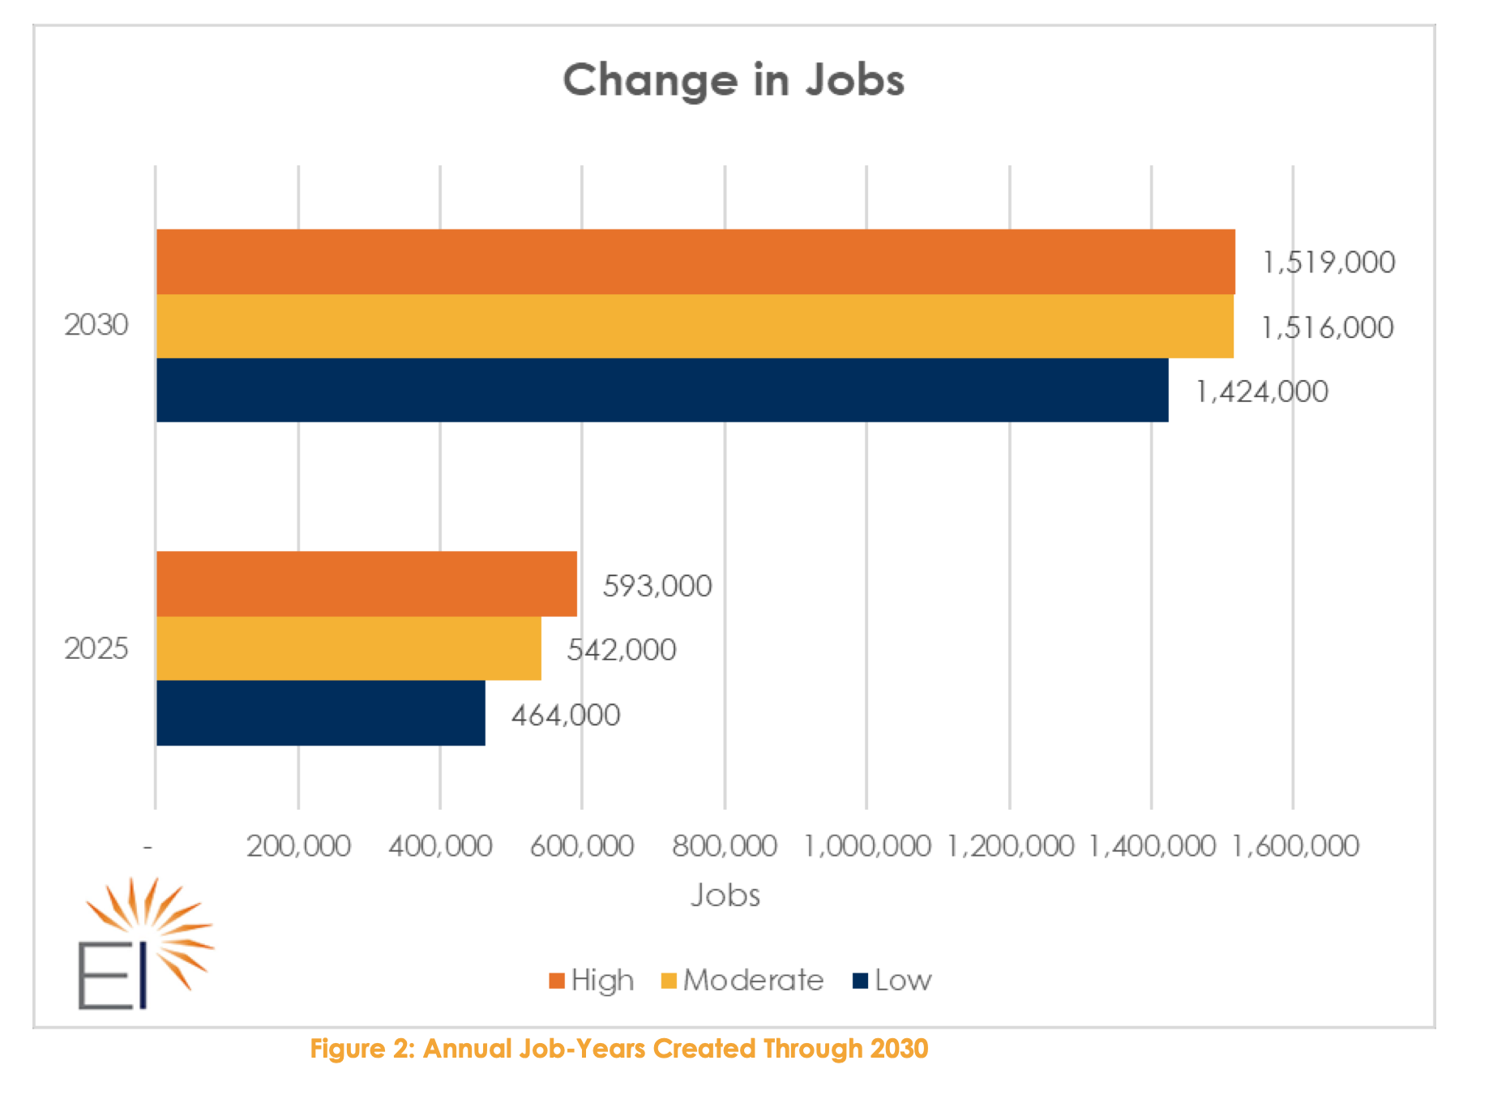
Jobs

Slide 12
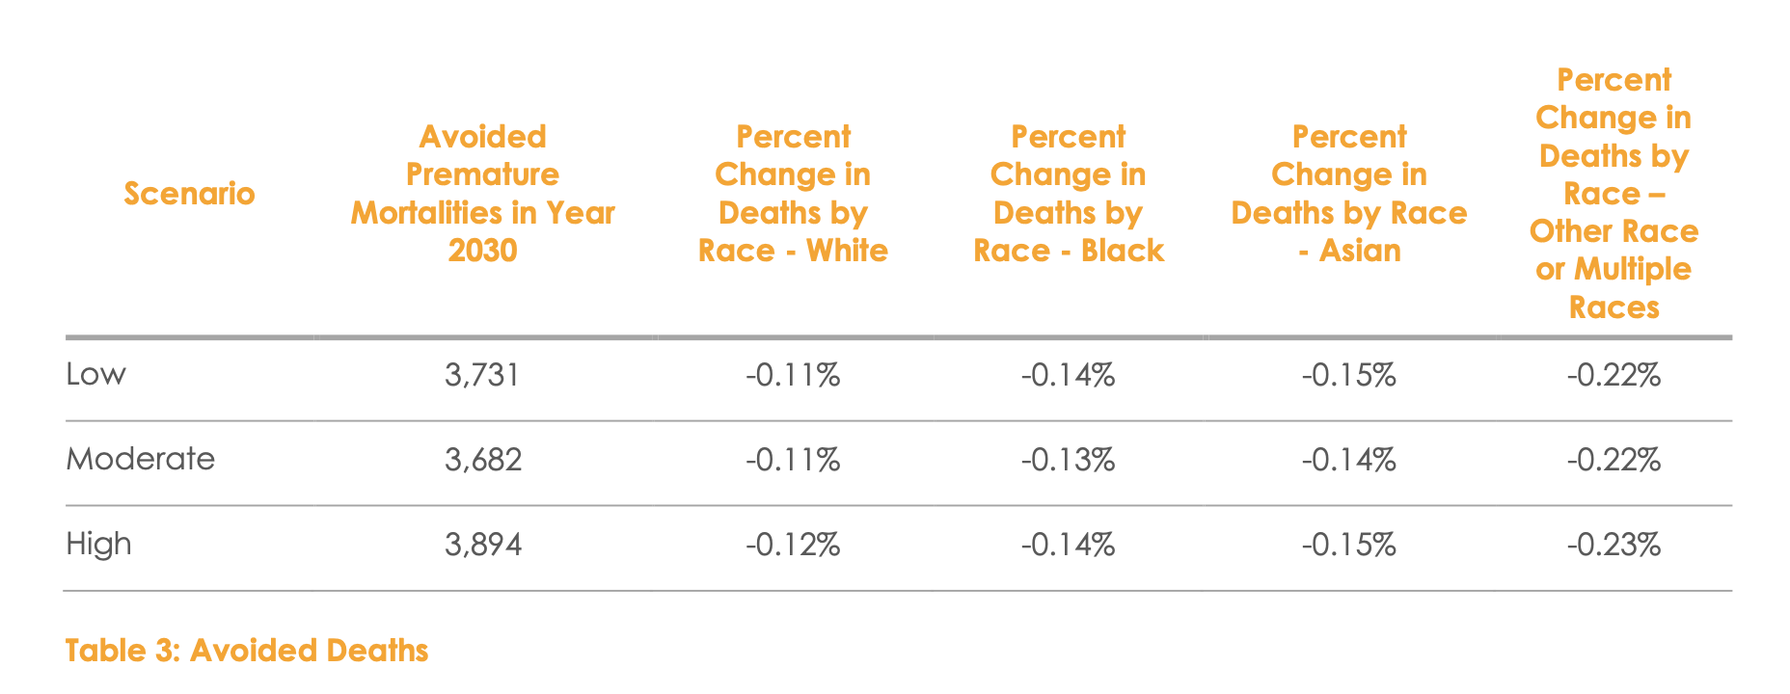
Avoided Deaths and Environmental Justice

Slide 13
Gratitude

Slide 14
Concerns

Slide 15
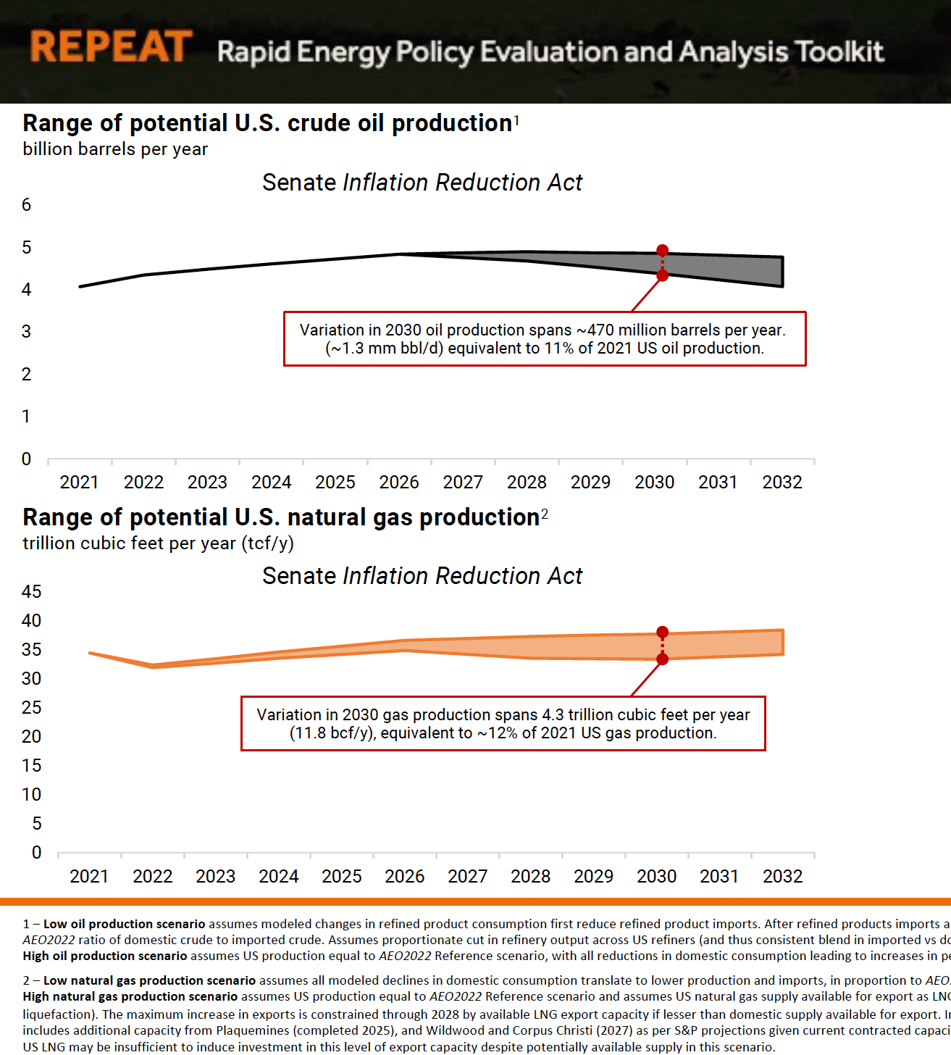
US Oil and Gas Production Likely to Increase

Slide 16
Areas of Interest

Slide 17
Momentum

Slide 18

The Feedback Loop Behaves Like a Snowball on a Hill

Slide 19
Falling renewables prices boosts production
Renewables Cost
Renewables Production

Slide 20
Production builds experience, acceptance, and R&D
Renewables Cost
Renewables Production
Cumulative experience
Production experience
Field experience
Public acceptance
Research and development

Slide 21
This creates a powerful reinforcing feedback loop modeled in the simulator
Renewables Cost
R
Renewables Production
Economies of Scale
Cumulative experience
Production experience
Field experience
Public acceptance
Research and development

Slide 22
The learning rate sets the strength of the loop
Renewables Cost
R
Renewables Production
Learning
Rate
Economies of Scale
Cumulative experience
Default: Every doubling of cumulative installed capacity reduces price by 20% - See “Progress Ratio” in the simulator

Slide 23
Subsidies externally reduce price and increase growth in the loop
Renewables Cost
Subsidies
R
Renewables Production
Learning
Rate
Economies of Scale
Cumulative experience

Slide 24
Momentum Builds Through Witnessing Success
US Action
Results

Slide 25
Momentum Builds Through Witnessing Success
US Action
Results
Confidence in effectiveness of actions

Slide 26
Momentum Builds Through Witnessing Success
US Action
Results
Confidence in effectiveness of actions

Slide 27
Momentum Builds Through Witnessing Success
US Action
R
Results
Momentum through confidence
Confidence in effectiveness of actions

Slide 28
Momentum Builds Through International Dynamics
US Action
Other country climate action
R
Global implications
R
Results
Momentum through confidence
US confidence in effectiveness of actions

Slide 29
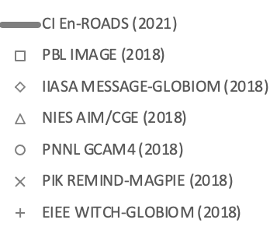
We Compare Our Scenarios Against Other Models
SSP2 Baseline
En-ROADS
Default Baseline
SSP2 6.0
SSP2 4.5
SSP2 3.4
SSP2 2.6
SSP2 1.9
Notes:
Updated with 062321 data

Slide 30
Momentum Builds Through International Dynamics
US Action
R
Results
Momentum through confidence
US confidence in effectiveness of actions

Slide 31
Momentum Builds Through International Dynamics
International belief that world’s largest historical emitter isn’t getting away with inaction
US Action
R
Results
Momentum through confidence
US confidence in effectiveness of actions

Slide 32
Momentum Builds Through International Dynamics
International belief that world’s largest historical emitter isn’t getting away with inaction
US Action
Other country climate action
R
Results
Momentum through confidence
US confidence in effectiveness of actions

Slide 33
Momentum Builds Through International Dynamics
International belief that world’s largest historical emitter isn’t getting away with inaction
US Action
Other country climate action
R
Results
Momentum through confidence
US belief that other countries are acting too
US confidence in effectiveness of actions

Slide 34
Momentum Builds Through International Dynamics
International belief that world’s largest historical emitter isn’t getting away with inaction
US Action
Other country climate action
R
Results
Momentum through confidence
US belief that other countries are acting too
US confidence in effectiveness of actions

Slide 35
Momentum Builds Through International Dynamics
International belief that world’s largest historical emitter isn’t getting away with inaction
US Action
Other country climate action
R
Global implications
R
Results
Momentum through confidence
US belief that other countries are acting too
US confidence in effectiveness of actions

Slide 36
Subsidies and the Learning Rate Affect The Feedback Loop Differently
Subsidies – How Hard We Push
Learning Rate – Slope of the Hill

Slide 37
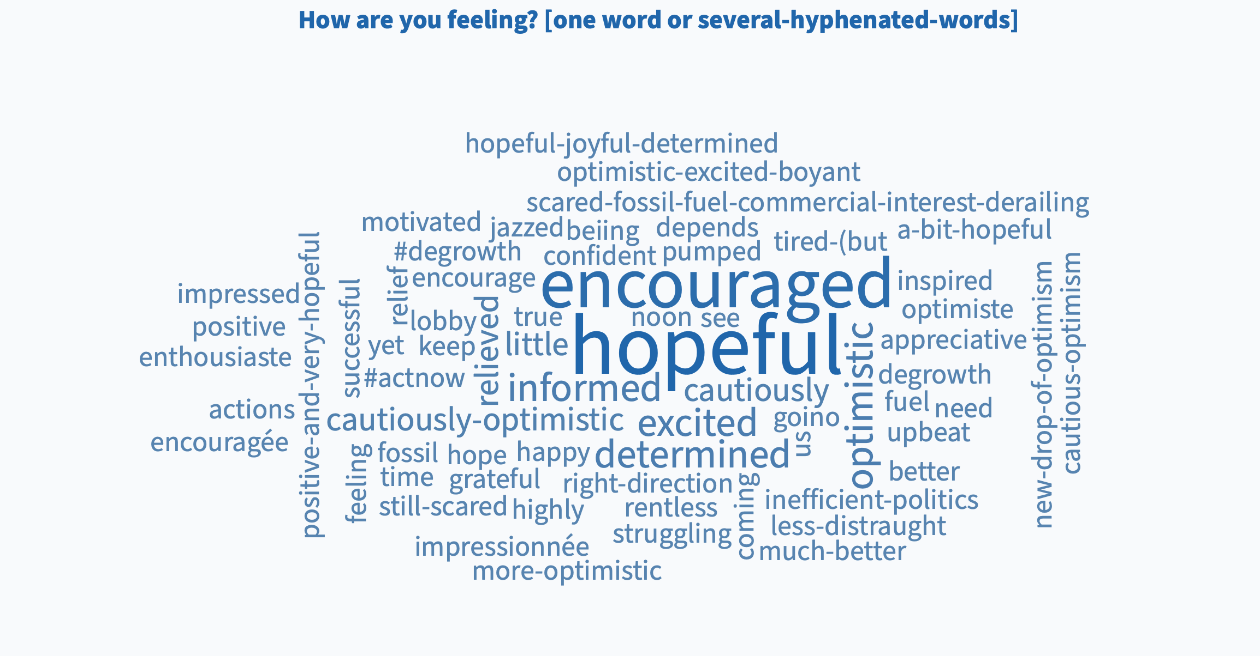
Poll results

Slide 38
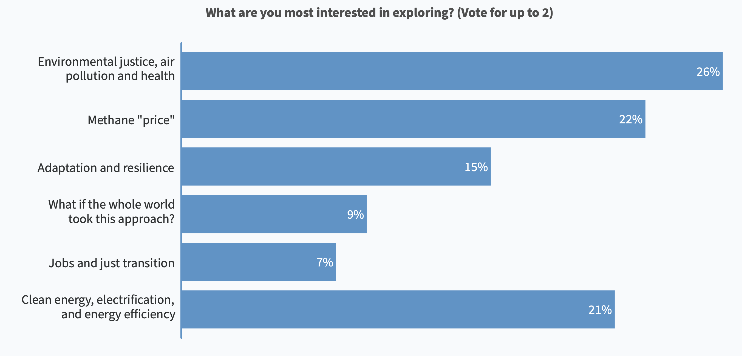
Poll results

Slide 39
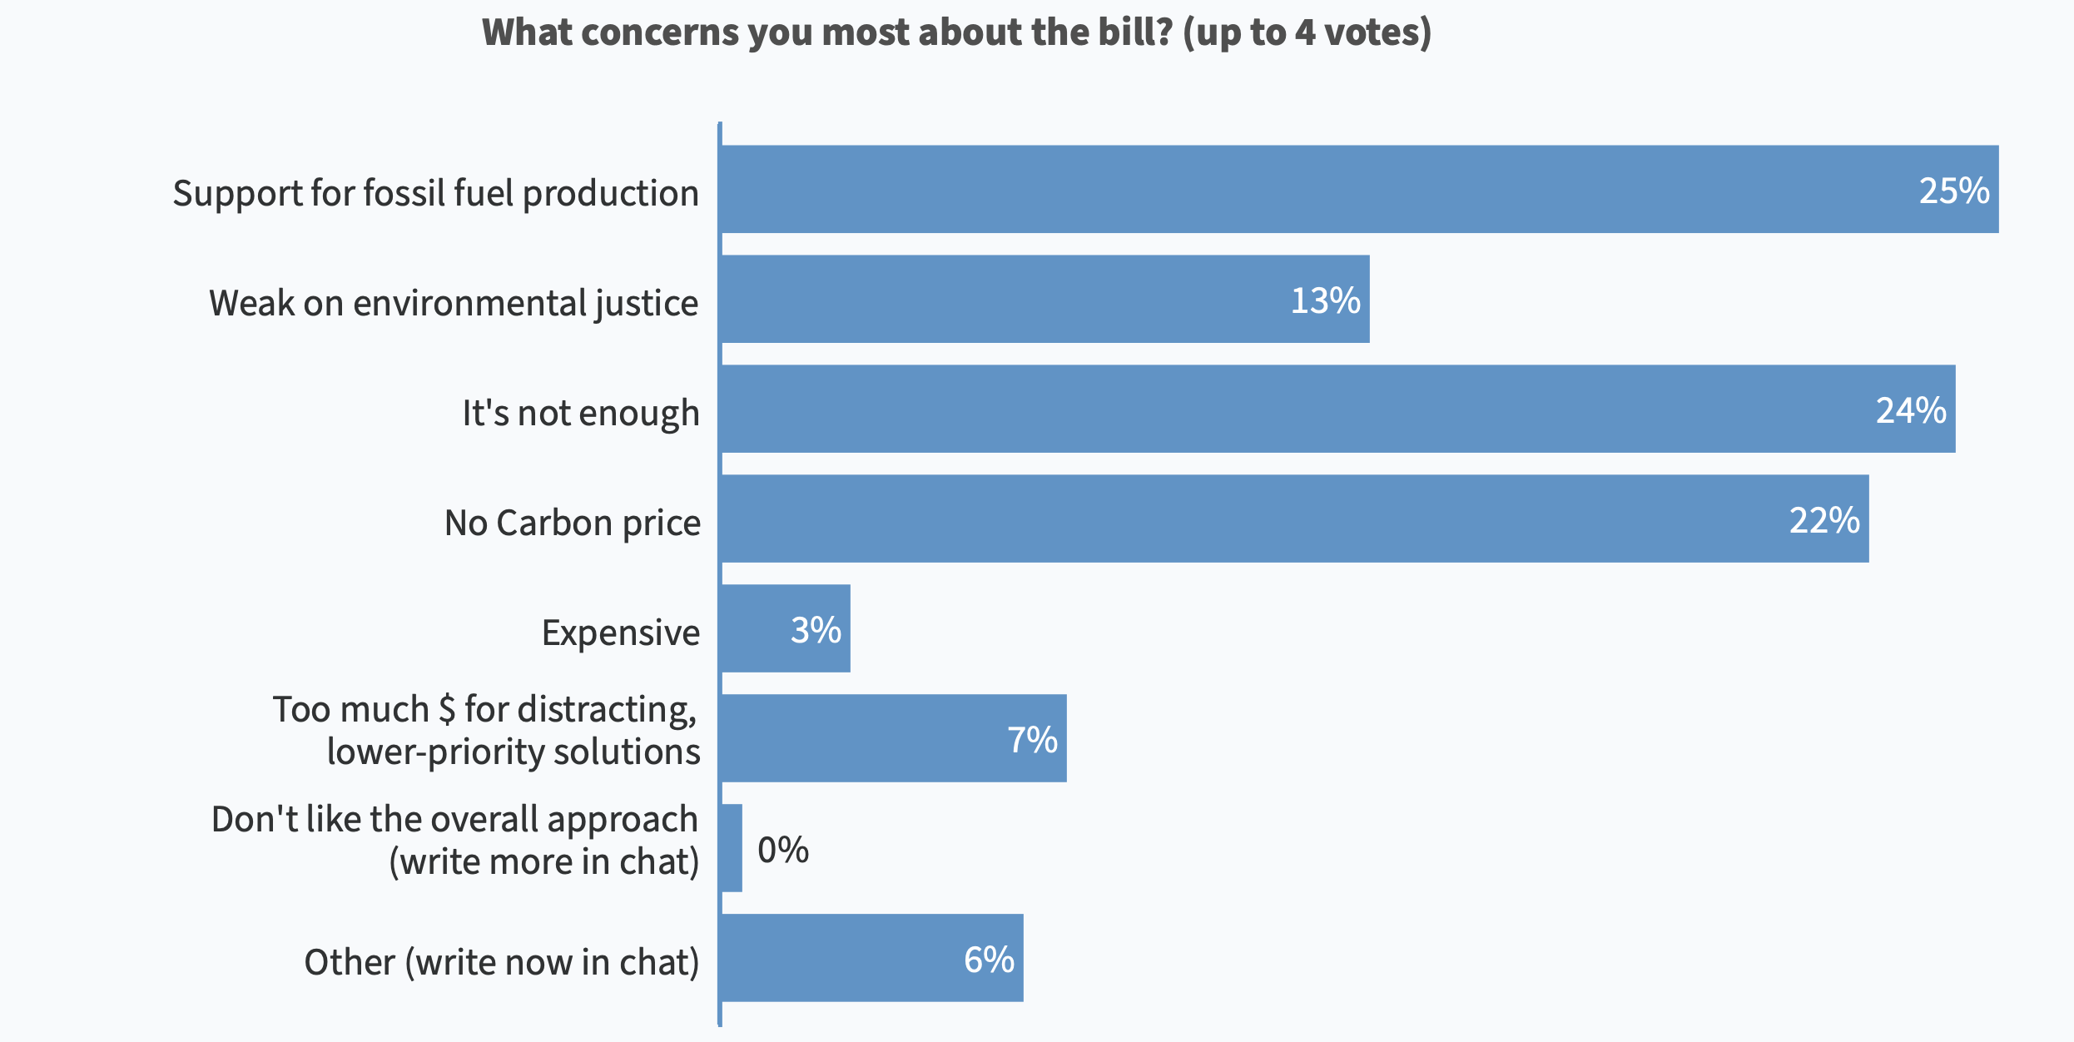
Poll results

