Slide 1

En-ROADS Testing and Confidence Building
Andrew P. Jones
9 July 2020

Slide 2

The En-ROADS Climate Ambassador Program
The En-ROADS Climate Ambassador Program is a unique leadership opportunity to become a climate leader in your field.

Slide 3
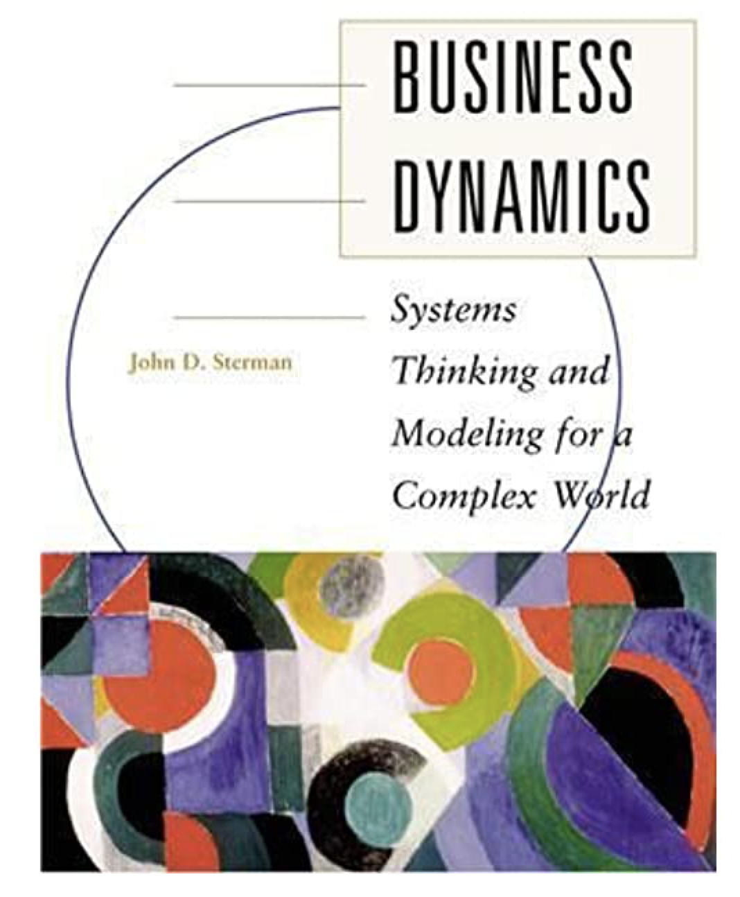
Our Guide to Testing – Chapter 21

Slide 4
Purpose of En-ROADS
Improve decision-maker and citizen understanding of energy, land, and climate dynamics as a means to effective action

Slide 5
Our Primary Confidence-Building Tests
Peer Review
Robustness to Extreme Conditions
Comparison of Behavior to Measured Historical Data
Comparison of Behavior to Other Models’ Future Projections
Comparison Against Experts’ Mental Models
Relevance to Policy-makers

Slide 6

Peer Review

Slide 7
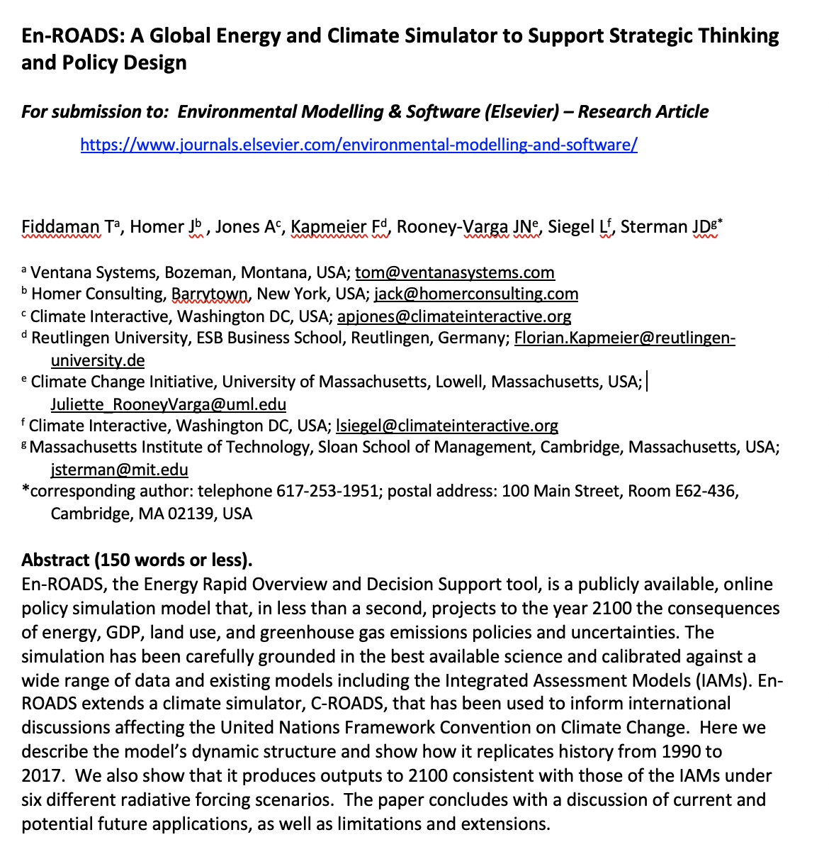
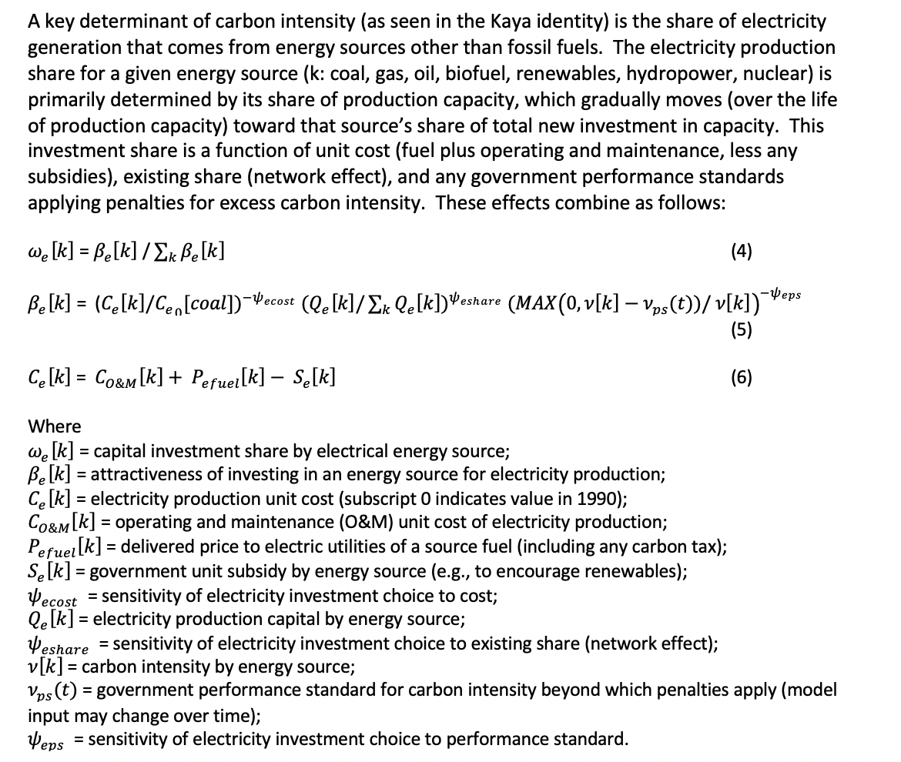

Slide 8
Robustness to Extreme Conditions

Slide 9
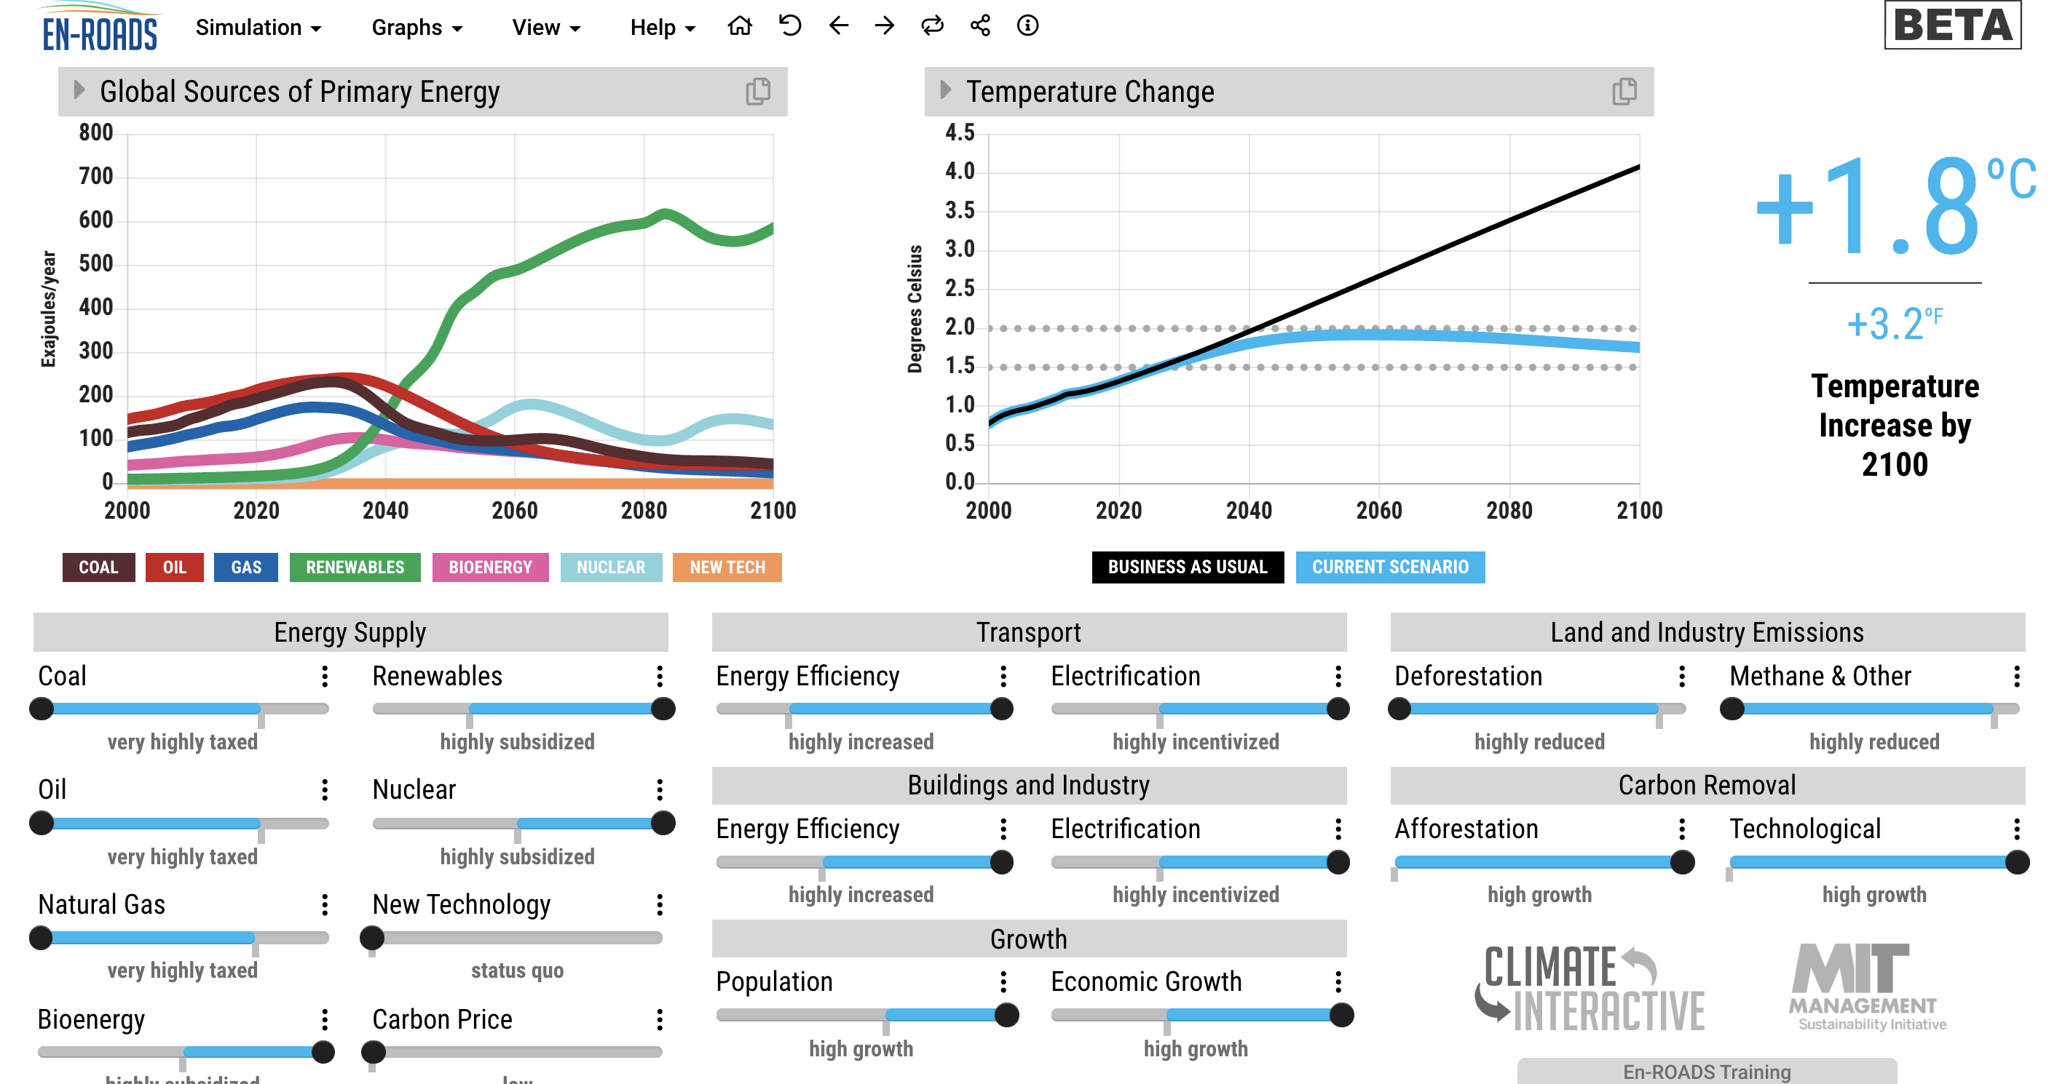
Notes:
This dramatically increases the cost of coal (and other FF) to end users
Note that scales are nonzero here to maximize visible variance – not how we normally present to users

Slide 10
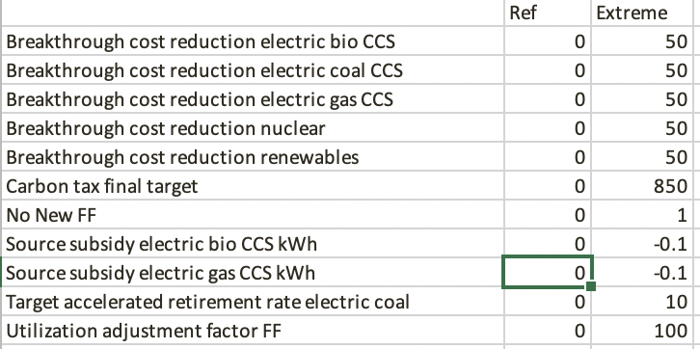
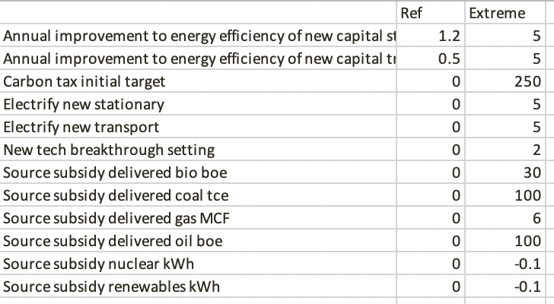
To Test Robustness, We Vary 23 Parameters to Their Extremes
Notes:
2 to the 11 is 2048. and 2 to the 12 is 4096

Slide 11
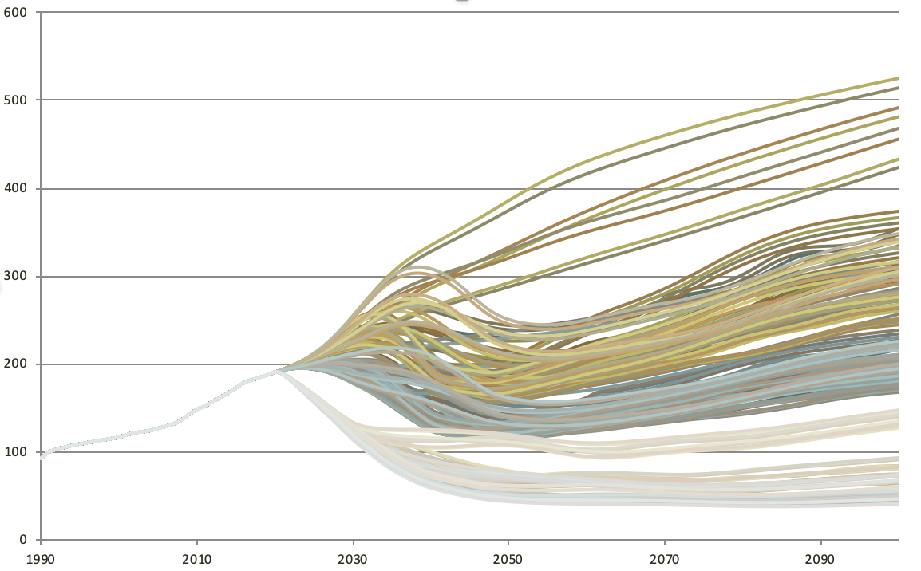
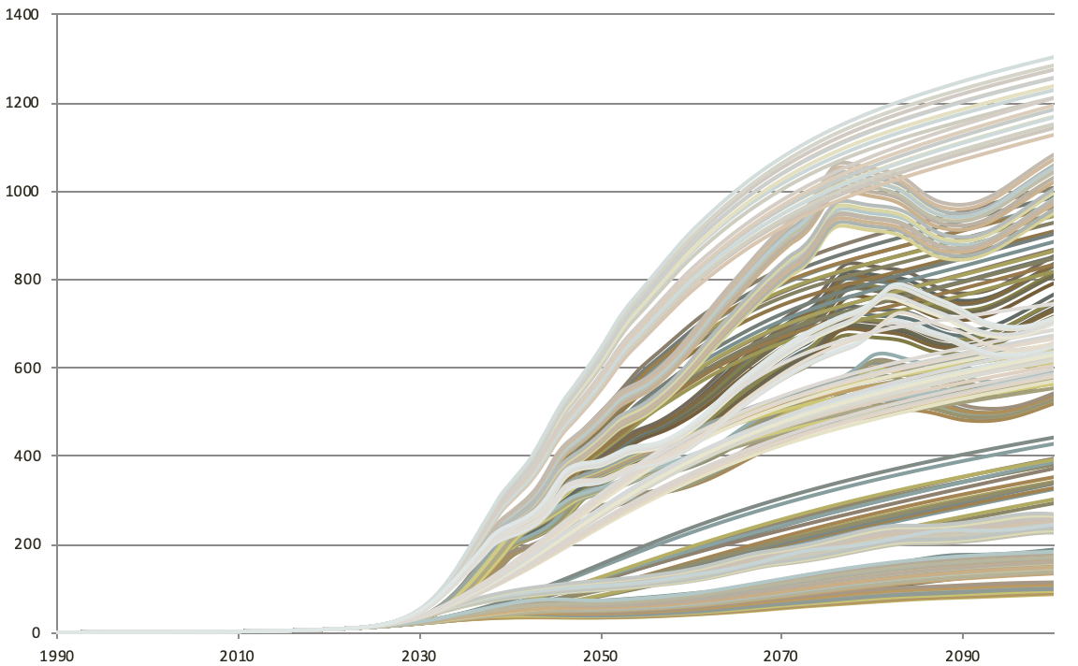
We Check Output for Anomalies
Primary Energy Demand of Renewables
Primary Energy Demand of Coal

Slide 12
Comparison of Behavior to Measured Historical Data

Slide 13
Coal Powered Electricity, 1990-2020

Slide 14
Oil Powered Electricity, 1990-2020

Slide 15
Natural Gas Powered Electricity, 1990-2020

Slide 16
Nuclear Powered Electricity, 1990-2020

Slide 17
Renewables Powered Electricity, 1990-2020

Slide 18
Total Electricity, 1990-2020

Slide 19
Comparison of Behavior to Other Models’ Future Projections

Slide 20
The Integrated Assessment Models Against Which We Compare En-ROADS Model Comparisons for SSPs
AIM/CGE
“Asia-Pacific Integrated Model/Computable General Equilibrium”
Developed by the National Institute for Environmental Studies in Japan
Shinichiro Fujimori
WITCH-GLOBIOM
“World Induced Technical Change Hybrid-Global Biosphere Management Model ”
Developed by the European Institute on Economics and the Environment in Italy, and the IIASA in Austria
Massimo Tavoni, Johannes Emmerling
IMAGE
“Integrated Model to Assess the Global Environment.”
Developed by the PBL Netherlands Environmental Assessment Agency in the Netherlands
Detlef van Vuuren, David Gernaat, Elke Stehfest
GCAM4
“Global Change Assessment Model”
Developed by the Joint Global Change Research Institute at PNNL in Maryland, USA
Kate Calvin and Jae Edmonds
MESSAGE-GLOBIOM
“Model for Energy Supply Strategy Alternatives and their General Environmental Impact-Global Biosphere Management Model ”
Developed by IIASA in Austria
Keywan Riahi, Oliver Fricko, Petr Havlik
REMIND-MAGPIE
“Regional Model of Investments and Development-Model of Agricultural Production and its Impact on the Environment.”
Developed by the Potsdam Institut für Klimafolgenforschung in Germany
Elmar Kriegler, Alexander Popp, Nico Bauer

Slide 21
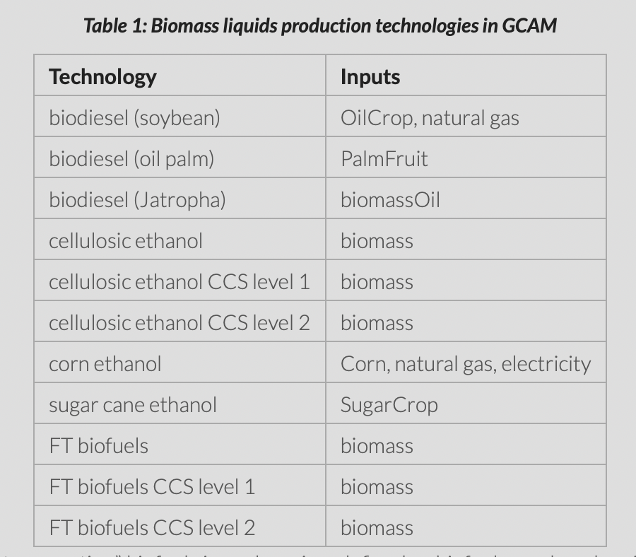
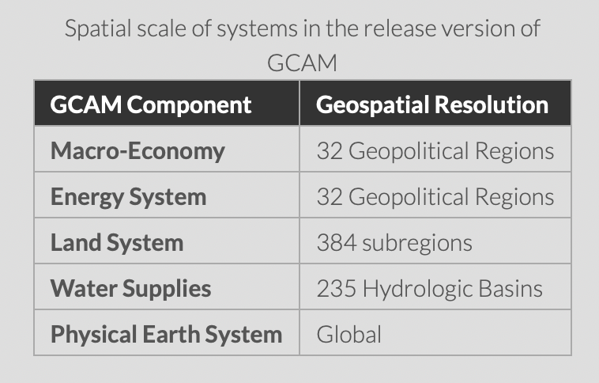
Example: Disaggregation in GCAM
http://jgcri.github.io/gcam-doc/energy.html#electricity

Slide 22
En-ROADS is Designed to Complement Disaggregated Models such as IAMs
Complex disaggregated models - GCMs, most large-scale IAMs
Scope and Detail
Simple models - En-ROADS, C-ROADS, FAIR, JCM, DICE
Speed, Simplicity of Use, Transparency
Notes:
En-ROADS in the Context of Other Tools to Help Navigate Climate Complexity
Other more complex and disaggregated models are important for giving decision-makers information on possible futures with higher degrees of spatial resolution and more details on climate impacts and economic considerations than simple models such as En-ROADS. Simple models thus complement these more disaggregated models, allowing users to gain general insights that can be refined with more complex models as needed. In turn, the insights of more complex models can be incorporated into simple models (as has been done for En-ROADS) in order to improve the performance of the simpler models and enhancing their ability to bring analysis and scenario testing into policy debate, negotiation, and decision-making in real time.

Slide 23
Calibrating Temperature, 1990-2100
Very close to the IAMs
Slightly below RCP 8.5
Well above RCP 6.0

Slide 24
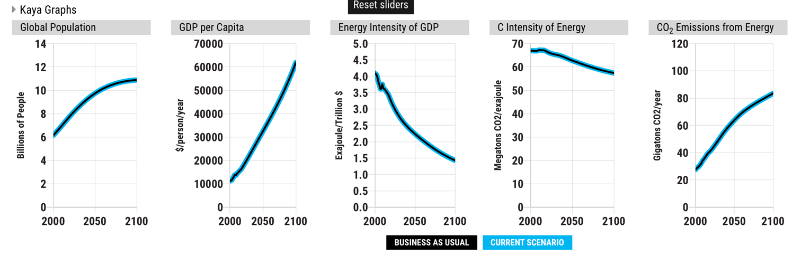
Starting with the Kaya Drivers of CO₂ Emissions
Relevant to graphs, below, from En-ROADS

Slide 25
Gross World Product (Global GDP), 1990-2100
Tight match
But this isn’t much of a test of anything

Slide 26
Energy per unit of global GDP, 1990-2100
Related to energy efficiency of global economy
How much energy it takes to deliver a dollar of GDP
Captured in “Kaya” view in En-ROADS

Slide 27
CO₂ emissions per unit of energy, 1990-2100
How much gets emitted per unit of energy
Driven by the fuel mix
Captured in “Kaya” view in En-ROADS

Slide 28
Carbon dioxide emissions from energy, 1990-2100
At the high end of the range

Slide 29
Land Use, Land Use Change and Forestry emissions, 1990-2100
We differ from IAMs for SSP2 Baseline
Given abundant standing biomass and high possibility of future deforestation, we keep emissions constant

Slide 30
Methane emissions, 1990-2100

Slide 31
N₂O Emissions, 1990-2100

Slide 32
F-gas Emissions, 1990-2100

Slide 33
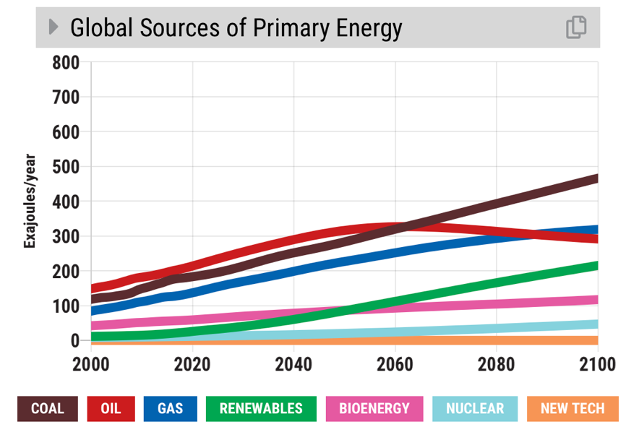
Now, exploring the sources of energy
Relevant to the graph, below, from En-ROADS

Slide 34
We compare coal “BAU” against history and future SSP2 projections from IAMs, 1990-2100
Tracks history.
Slightly higher than IEA and Shell Mountain.
In the middle of the IAMs for SSP2.

Slide 35
We compare oil “BAU” against history and future SSP2 projections from IAMs, 1990-2100
Upper end of the range.

Slide 36
We compare gas “BAU” against history and future SSP2 projections from IAMs, 1990-2100
Close match
High end in last three decades

Slide 37
We compare renewables “BAU” against history and future SSP2 projections from IAMs, 1990-2100
En-ROADS is higher than most.

Slide 38
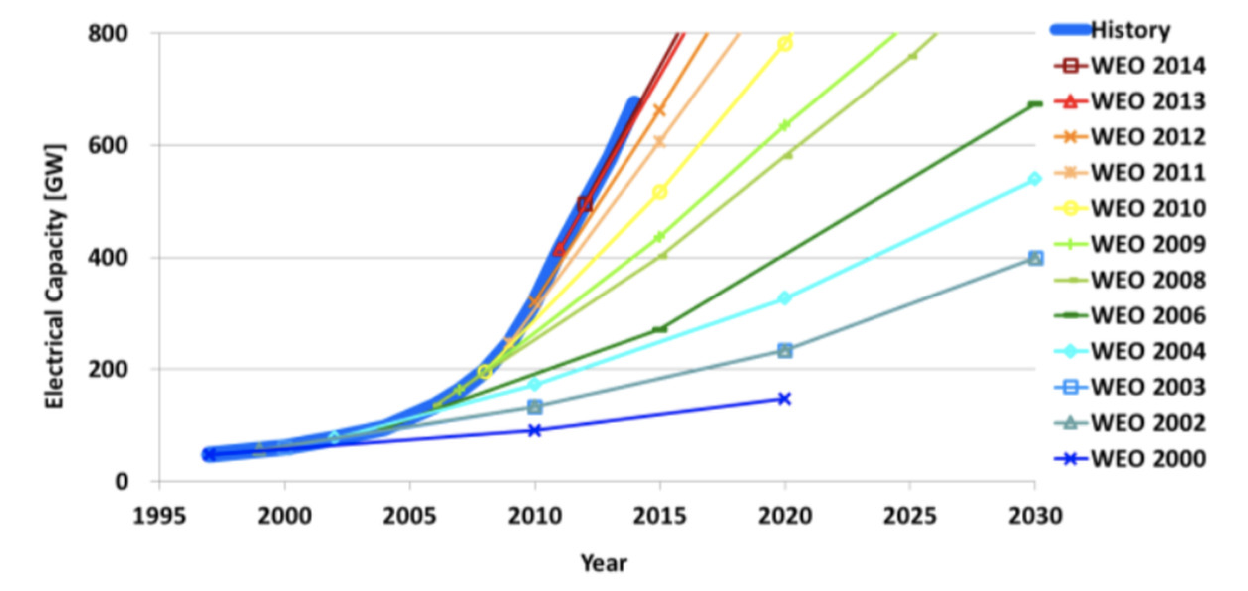
The IEA Has Long Underestimated Renewables Growth: Graph of Additions to Electrical Capacity from Wind and Solar
https://www.vox.com/2015/10/12/9510879/iea-underestimate-renewables

Slide 39
We compare bioenergy “BAU” against history and future SSP2 projections from IAMs, 1990-2100

Slide 40
We compare nuclear ”BAU” against history and future SSP2 projections from IAMs, 1990-2100

Slide 41
Confidence-Building: We compare En-ROADS (in blue) against IEA, Shell, BP, and six IAM Baselines (for SSP2) from 1990-2100
Further details on en-roads.org

Slide 42
Comparison of Behavior to Other Models’ Future Projections – Reduction Scenarios

Slide 43
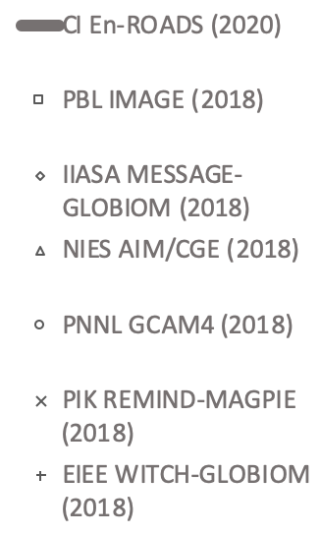
Temperature for Various Radiative Forcing (RF) Levels

Slide 44
Net GHG Emissions for RF Levels for SSP2

Slide 45
We compare bioenergy in En-ROADS against the IAMs’ 2.6 scenario
Testing C price and GDP assumptions from IAM SSP2 scenarios

Slide 46
We compare natural gas in En-ROADS against the IAMs’ 2.6 scenario
Testing C price and GDP assumptions from IAM SSP2 scenarios

Slide 47
We compare oil in En-ROADS against the IAMs’ 2.6 scenario
Note – one reason the En-ROADS scenario is high is because the other models build more bioenergy as a substitute

Slide 48
We compare renewables plus hydro in En-ROADS against the IAMs’ 2.6 scenario
Testing C price and GDP assumptions from IAM SSP2 scenarios

Slide 49
We compare nuclear in En-ROADS against the IAMs’ 2.6 scenario
Testing C price and GDP assumptions from IAM SSP2 scenarios

Slide 50
We compare coal in En-ROADS against the IAMs’ 2.6 scenario
Testing C price and GDP assumptions from IAM SSP2 scenarios

Slide 51
Coal Use for Three RF Levels for SSP2

Slide 52
How We Learn Via Model Comparison

Slide 53
We compare coal in En-ROADS against the IAMs’ 2.6 scenario
2019 version
Testing C price and GDP assumptions from IAM SSP2 scenarios

Slide 54
We compare coal in En-ROADS against the IAMs’ 2.6 scenario
2020 version
Testing C price and GDP assumptions from IAM SSP2 scenarios

Slide 55
Comparison of Behavior to Other Models’ Future Projections – Adding More SSPs

Slide 56
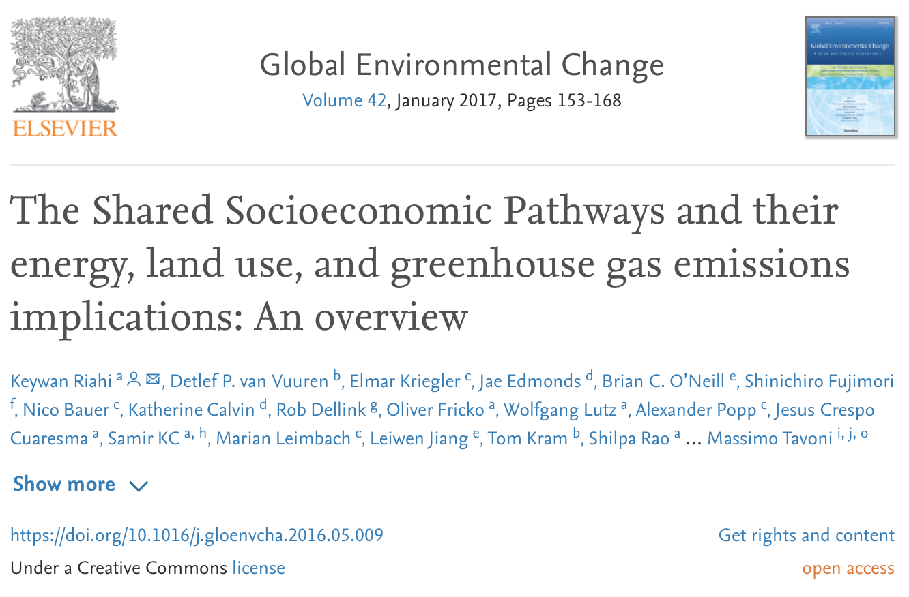

Slide 57
Shared Socioeconomic Pathways (SSPs)
“Fossil-fueled development”
“Regional rivalry – a rocky road”
“Middle of the road”
“Sustainability”
“Inequality – A road divided”
(Chart via WITCH model documentation - European Institute on Economics and the Environment. Adapted.)

Slide 58
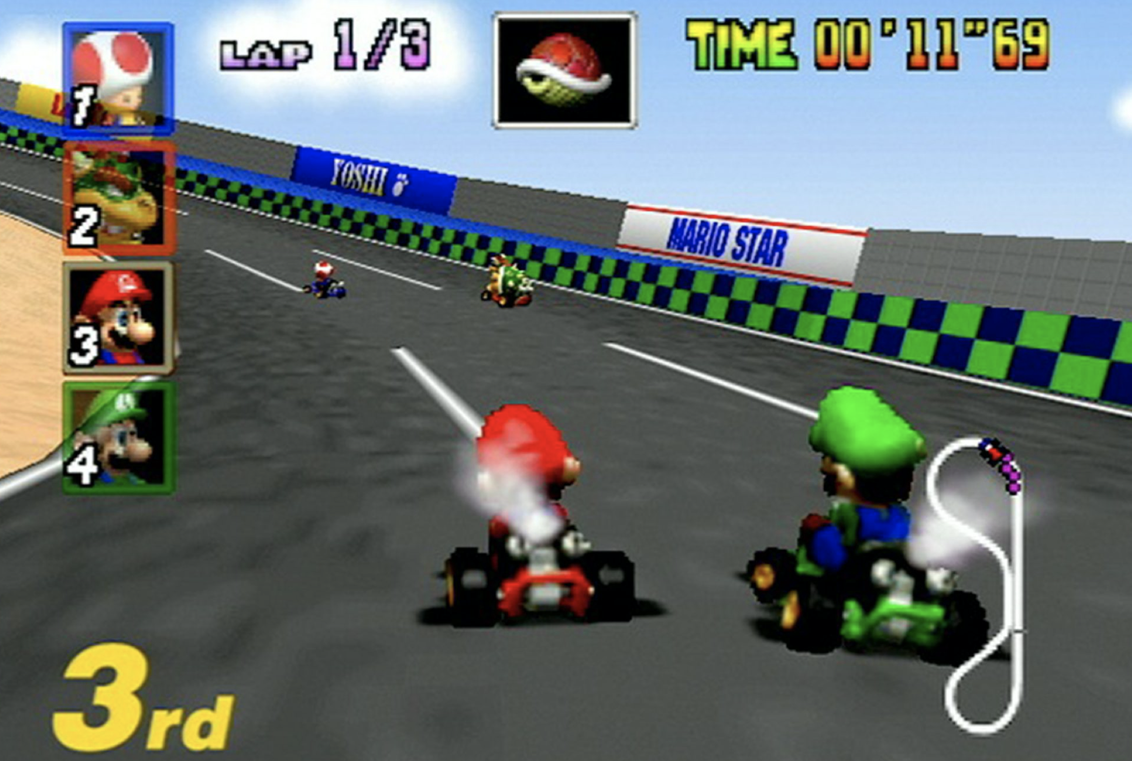

Slide 59
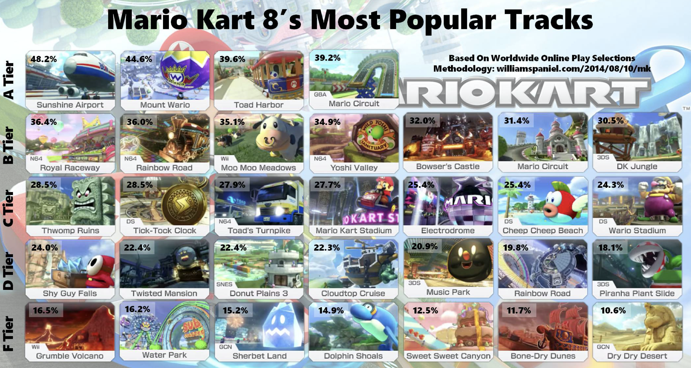

Slide 60
GDP per Capita
SSP1 “…more inclusive development…inequality is reduced both across and within countries.”
SSP2 “Development and income growth proceeds unevenly, with some countries making relatively good progress while others fall short of expectations. Income inequality persists or improves only slowly.”
SSP3 “Economic development is slow…and inequalities persist or worsen over time.”
SSP4 “…increasing inequalities and stratification both across and within countries. Over time, a gap widens between an internationally-connected society…and a fragmented collection of lower-income, poorly educated societies that work in a labor intensive, low-tech economy.”
SSP5 “Global markets are increasingly integrated…rapid growth of the global economy.”
5
1
2
 | 2018 Rate
SSP1 | 2.9
SSP2 | 2.5
SSP3 | 1.7
SSP4 | 2.3
SSP5 | 3.5
4
3

Slide 61
Coal
SSP1 "a more sustainable path…that respects perceived environmental boundaries…”
SSP2 “Environmental systems experience degradation…and challenges to reducing vulnerability to societal and environmental changes remain.”
SSP3 “A low international priority for addressing environmental concerns leads to strong environmental degradation in some regions.”
SSP4 “…investments in both carbon-intensive fuels like coal and unconventional oil, but also low-carbon energy sources.”
SSP5 “…the push for economic and social development is coupled with the exploitation of abundant fossil fuel resources.”
5
3
Exogenous Attractiveness Factor *
2
 | Coal
SSP1 | 0.5
SSP2 | 1
SSP3 | 3
SSP4 | 0.5
SSP5 | 2
4
1
*Ramping linearly between 2020 to 2100 from no effect, i.e., factor = 1, to full effect.

Slide 62
We compared En-ROADS against results from 6 IAMs for 5 SSPs for 6 RF levels for 30 variables (Note – some IAMs don’t share all 6 RF levels)

Slide 63
Net GHG Emissions for Baseline Scenarios SSP 1-5

Slide 64
Coal for Baseline Scenarios SSP 1-5

Slide 65
Comparison Against Experts’ Mental Models
And
Relevance to Policy-makers

Slide 66
Purpose of En-ROADS
Improve decision-maker and citizen understanding of energy, land use, and climate dynamics as a means to effective action

Slide 67
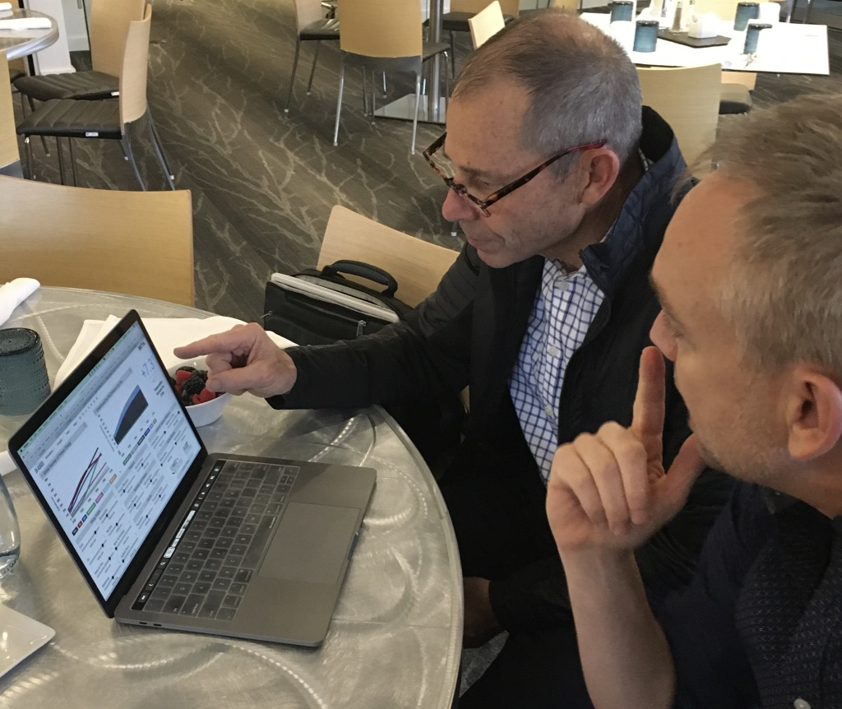
“What I like about En-ROADS is how it can support a really thoughtful conversation – I can see the ways that policy actions could be worth the pain.”
Rep. John Curtis
U.S. House of Representatives
Republican, Utah: 3rd District

Slide 68
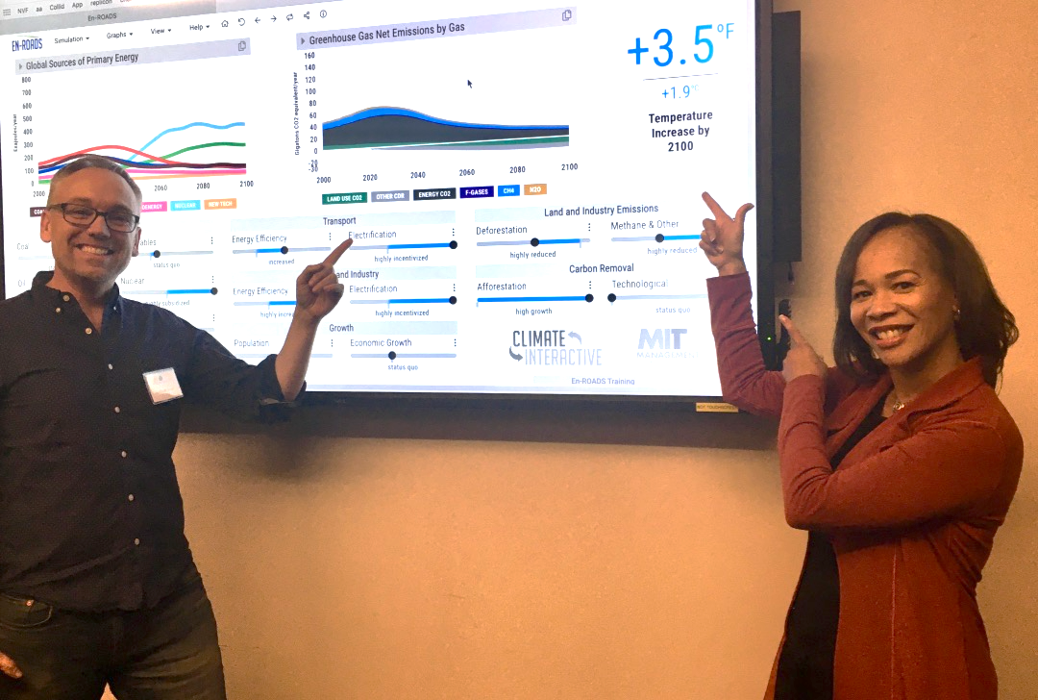
Rep. Lisa Blunt Rochester
U.S. House of Representatives
Delaware:
At-large District

Slide 69
“En-ROADS is a hands-on, science-based way to demonstrate both the urgency and possibilities for ambitious climate action.”
Gernot Wagner
Economist and Author
New York University

Slide 70
“This tool will guide policy makers as we make critical decisions to reduce carbon pollution and save our planet from the devastating impact of climate change.”
Rep. Ann McLane Kuster
U.S. House of Representatives
New Hampshire: 2nd District

Slide 71
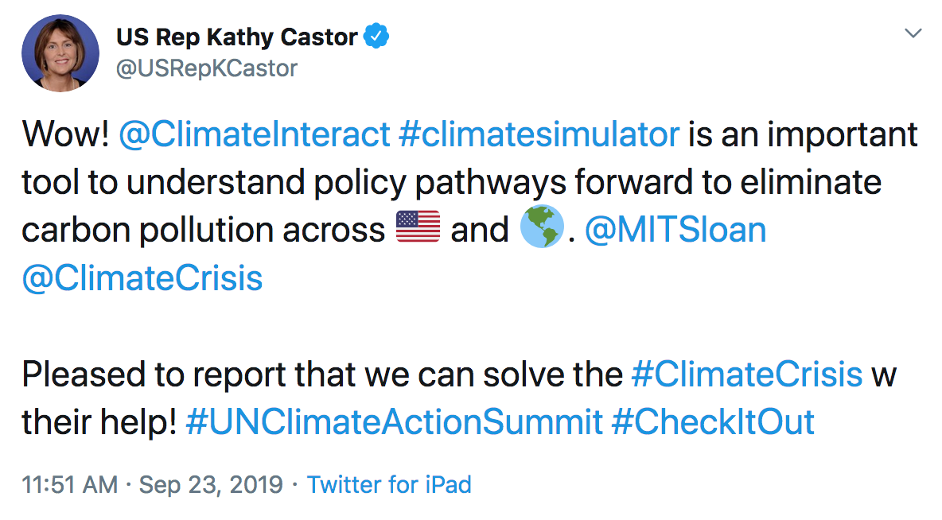
Rep. Kathy Castor
U.S. House of Representatives
Florida: 14th District

Slide 72
“This is an incredible tool that every Congress member, every State legislator and every County and local official should use to formulate the most effective, data driven decisions around our planet’s climate crisis.”
Rep. Julia Brownley
U.S. House of Representatives
California: 26th District

Slide 73
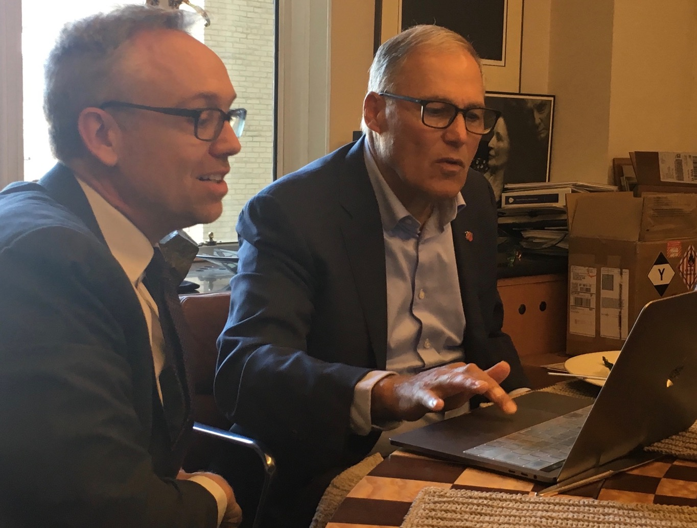
“This MIT/CI simulator is a terrific, fantastic tool — absolutely wonderful. What I like: it is honest, shows the interesting interplay between policies, and is a bugle call about how aggressive we need to be.”
Jay Inslee
Washington State Governor
Former presidential candidate

Slide 74
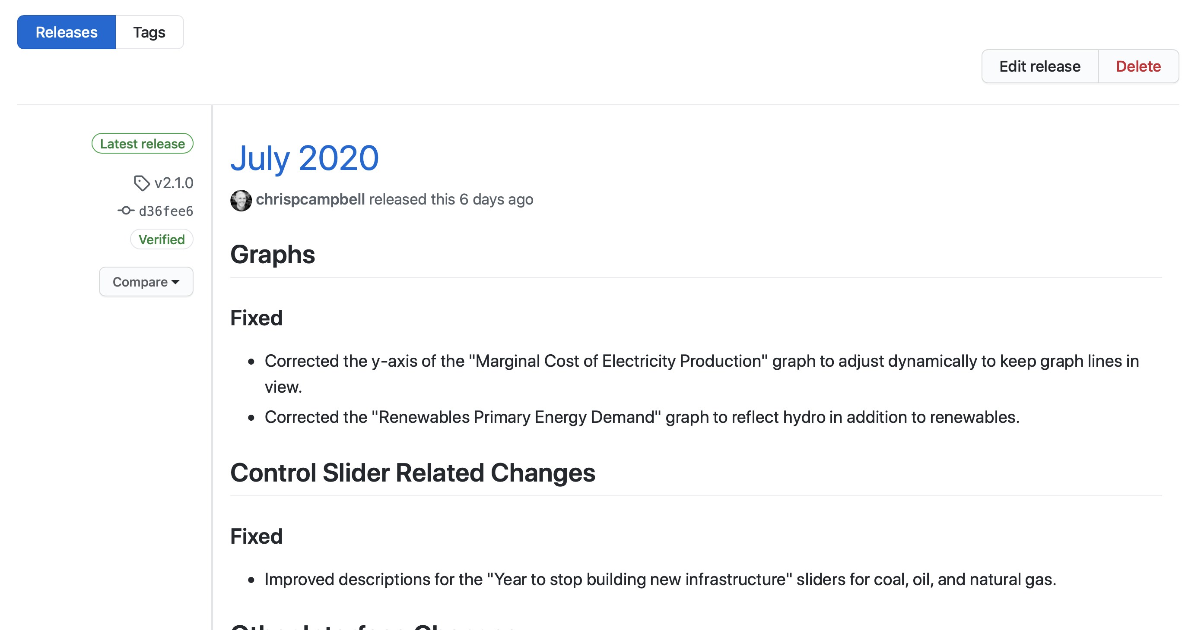
Other Approaches for Confidence Building
Updating with the latest in climate, energy, and land science
  Change log - https://docs.climateinteractive.org/projects/en-roads/en/latest/guide/changelog.html

Slide 75
What are the biggest limitations of En-ROADS?
Global aggregation (as opposed to regional disaggregation) limits treatment of heterogeneity
Detail limits tactical planning of energy system (not a bottom-up model)
Economy is not fully endogenous; not modeling welfare
  Growth of GDP per capita specified by the user; assumes regional convergence of GDP per capita at 1%/year over time
  Sources and uses of funds for subsidies and taxes are not accounted for (e.g., revenue recycling from a carbon price)
  Some technology policies are costless
  Implicit, transient non-conservation of money
Equity, non-climate environment, health and other effects excluded
Notes:
These arise from tradeoffs:
Detail
Data hunger
Execution time
Interactivity
Transparency
Sensitivity analysis

Slide 76
The En-ROADS Climate Ambassador Program
The En-ROADS Climate Ambassador Program is a unique leadership opportunity to become a climate leader in your field.

Slide 77

How to Become an En-ROADS Climate Ambassador
✓ Attend the webinars (or watch recordings)
✓ Read the suggested materials
✓ Watch two others lead the workshop and/or game (in person or video)
✓ Lead two sessions with anyone and register them
✓ Receive feedback from five participants
✓ Complete a (learning-oriented, not evaluative) practice test
✓ Pledge to register 100% of games and workshops
✓ Submit your application to become an En-ROADS Climate Ambassador & receive your certificate!

Slide 78
Who will you run your first session with?
(answer in “Questions”)

Slide 79


with
Andrew P. Jones
apjones@climateinteractive.org
@AndrewPJones
@ClimateInteract
Notes:
Logo blurry

Slide 80
Notes:
Logo blurry

